Slide 1
communication
UNIT 7 – THINGS THAT MATTER

Slide 2
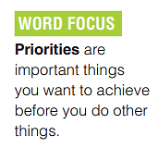
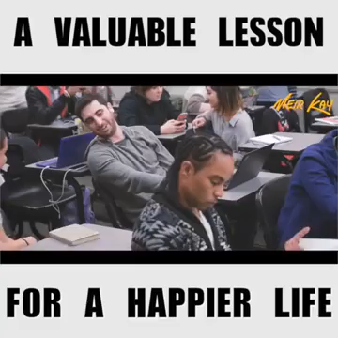
Warm-up: Setting priorities in life
set priority:
đặt ưu tiên

Slide 3
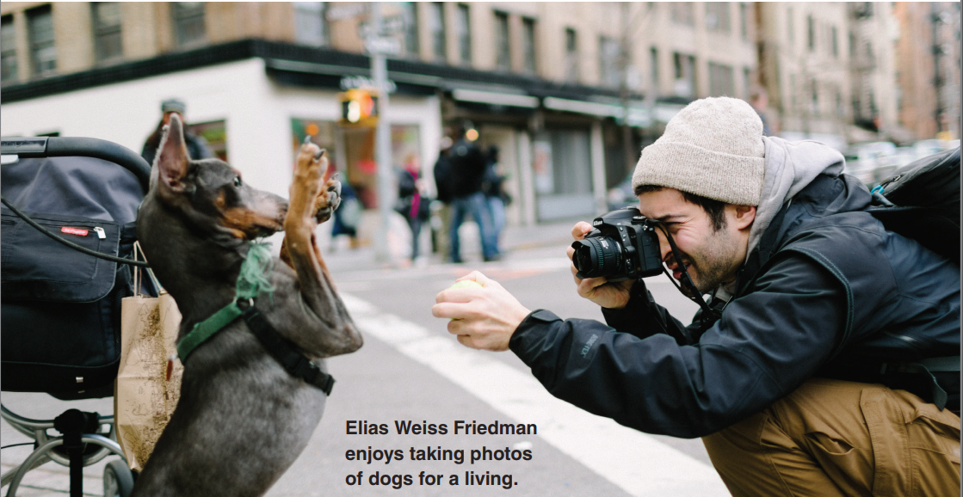
Do you think this man is satisfied with his life?
What do you think is important in his life?
his job
dogs
photography
his camera
for a living (): kiếm sống

Slide 4
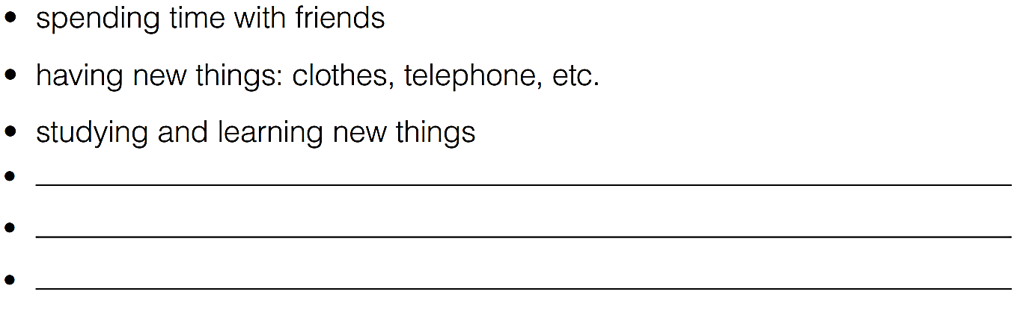
MY WORLD
What is important in your life right now?
travelling
doing exercises/ keeping fit

Slide 5
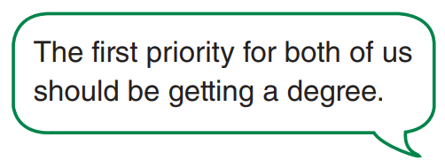
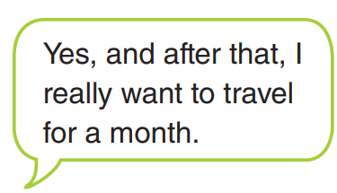
What are your priorities?
YOU | YOUR PARTNER
finish math’s deadlines
plan for the entrance exam next year
make a video for history class

Slide 6


