Slide 1
writing
UNIT 7 – THINGS THAT MATTER

Slide 2
Warm-up: guess what?
TEAM A | TEAM B
Students work in 2 teams (A & B)
Guess what materials used to make the products/things
Material things = things that we can see, touch or feel
Which team has more correct answer will win.

Slide 3
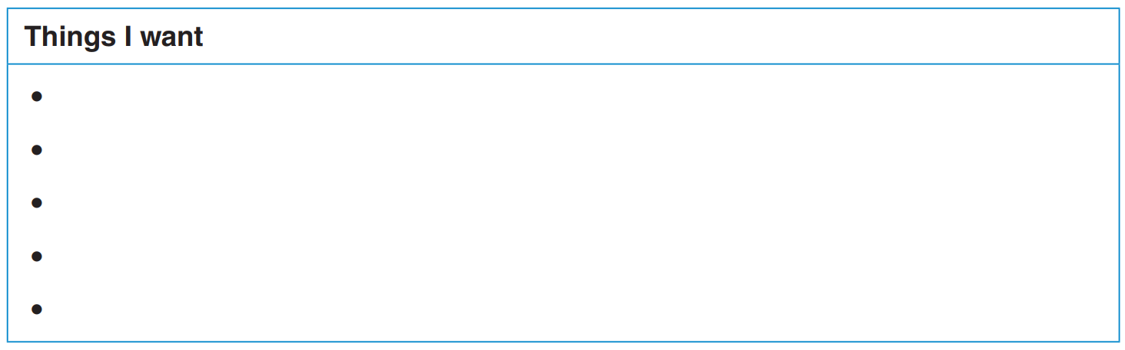
things you want to have in your future life?
Taking IELTS certificate
Applying a scholarship in Europe
Having part-time job
Raising a pet

Slide 4
WRITING SKILLS: Using Sequence Words
First
Second
Finally
Before/after
Next
Last
Once
Then
Eventually

Slide 5
Using Sequence Words: examples
When I think about my future, I have some priorities. First, I want to get a good education and focus on improving my English skills. With good English, I will be able to further my study abroad, perhaps in an English-speaking country. A good command of English can also help me adapt to the new culture quickly. That will open a lot of doors for me. Then, I will apply for a part-time job to support my study and learn some new skills. When I graduate from college, I want to come back to Việt Nam to find a job. I plan to work for someone else for a few years to get some work experience and then start my own business. Next, I need to buy a house so that I can settle down. After that, I might get married and start a family. Eventually, I'll retire and let my children run the business.

Slide 6
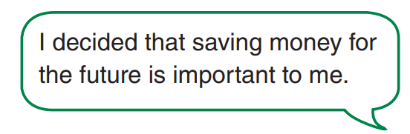
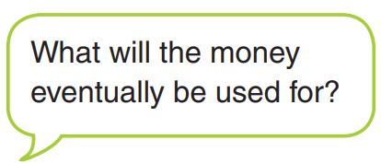
I decided that…
Saving money
Doing volunteering jobs
Taking IELTS exam
Having a part-time job after graduation
Raising a pet

Slide 7
Writing: Setting priorities
In the future, I envision a life filled with exciting opportunities and personal growth. First, I plan to take the IELTS certificate to enhance my language skills and open doors to international opportunities. Once I have obtained the certificate, I will then focus on applying for a scholarship in Europe. This will allow me to pursue higher education in a diverse and culturally rich environment. Once enrolling myself in a European university, I also plan to have a part-time job to gain practical experience and develop essential skills. This will not only provide financial support but also help me build a strong professional network. Next, I am eager to raise a pet as a companion and source of joy in my life. I believe that having a furry friend will bring a sense of responsibility and happiness to my daily routine. Overall, I am excited about the future and the possibilities it holds for personal and academic growth.

Slide 8


