Slide 1
opener - vocabulary
UNIT 8– CONSERVATION

Slide 2
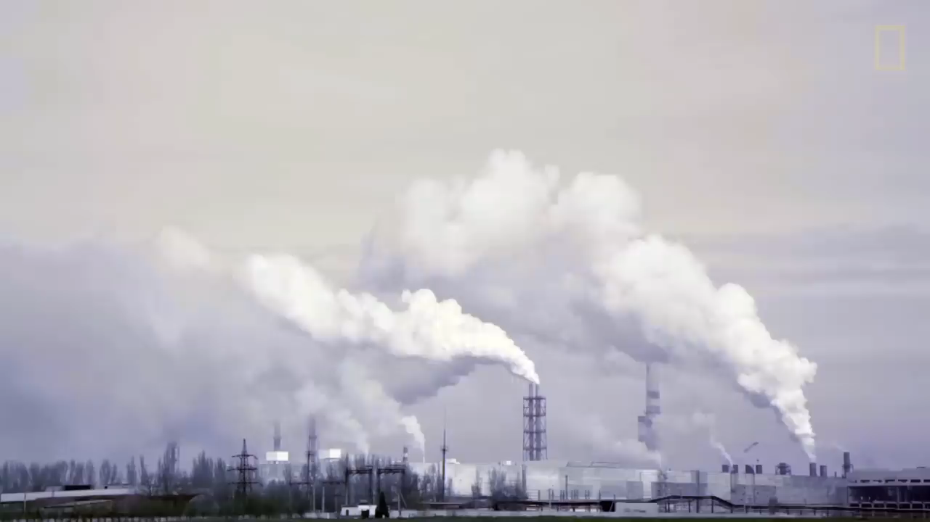
Warm-up: Let’s watch a video

Slide 3
Causes and effects according to the video
Causes:
The green-house effect
Effects:
Increasing Earth’s temperature
Changing weather
Agriculture challenges
Affecting health

Slide 4
Conservation & environmental issues
Conservation (n): prevention of wasteful use of a resource.
Environmental issue (n): climate change, pollution, environmental degradation, and resource depletion.

Slide 5
What do you know?
Environmental problems?
Impacts?
Suggested solutions?

Slide 6
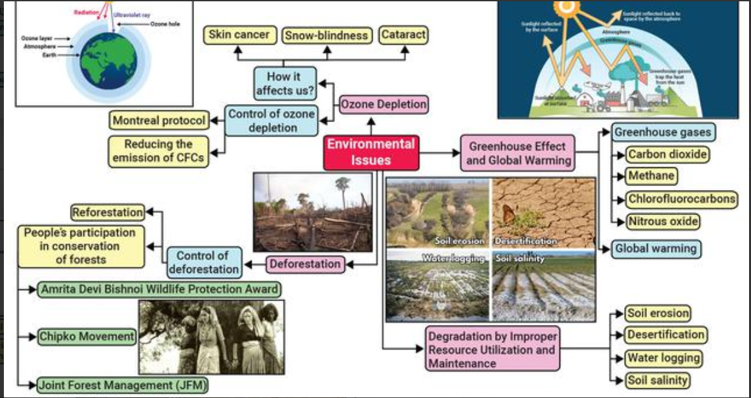
Environmental issues

Slide 7
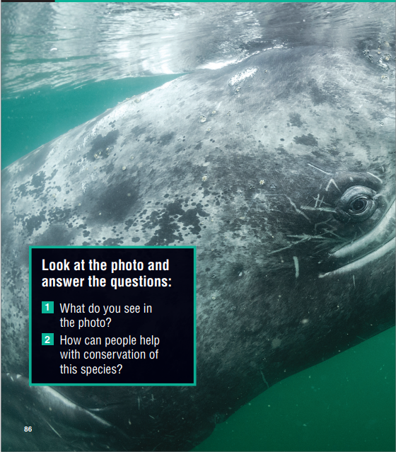
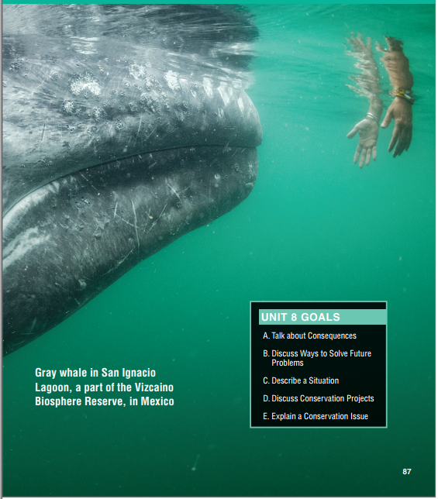
About the photo
This photo was taken by Thomas P. Peschak, a conservationist and National Geographic photographer.
Peschak focuses particularly on marine conservation issues. Here, a gray whale approaches a boat in San Ignacio Lagoon, Baja California, Mexico.
These whales make a 6,000-mile (9,656-km) journey from the cold waters near Alaska to the warmer waters of Baja California, where they breed and have their babies, called calves.
The gray whale is one of the few endangered species success stories.
Thanks to international conservation efforts, their population has grown significantly, and they are no longer on the endangered species list.

Slide 9
Talk about consequences
What will happen if you don’t come to our next class?
miss the class
cannot acquire new knowledge
may miss the test
break the class rule => may be punished?

Slide 10
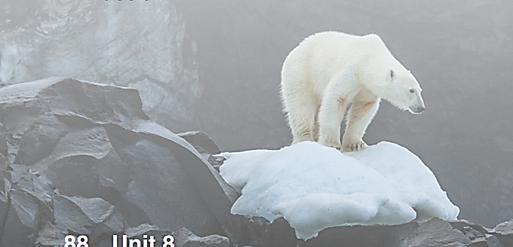
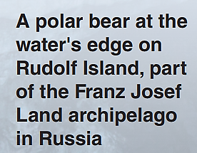
What do you know about this animal?

Slide 11
Climate Change
Polar bears live on the Arctic sea ice. It is their natural habitat. From these ice platforms, they can catch seals to eat. The ice is very important for polar bears, but sadly it is disappearing because of climate change. The world is getting warmer and the Arctic ice is melting. If the ice disappears, polar bears will have a hard time finding food. If we don't try to stop climate change, polar bears and other wild animals are going to become extinct. We need to protect these endangered species. They are all an important part of the natural world.

Slide 12
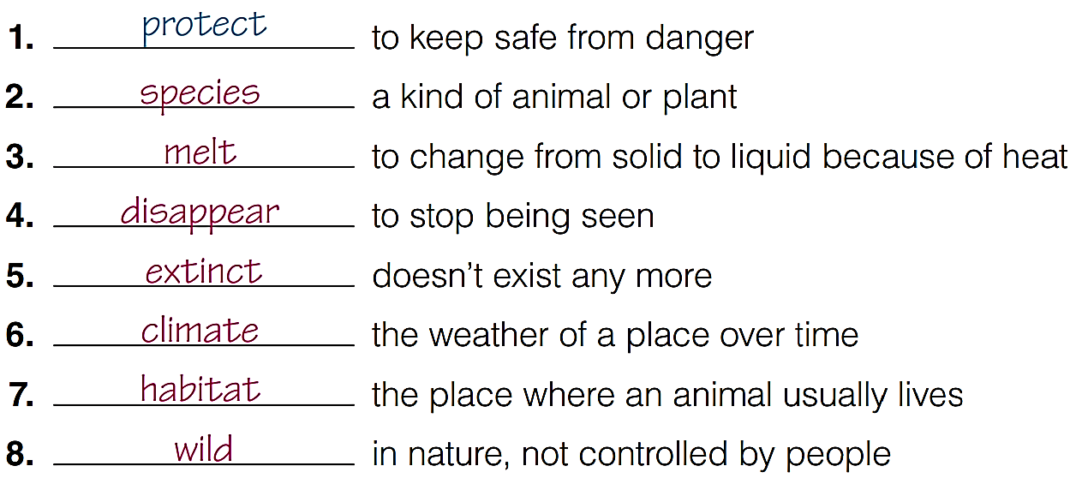
Match the words in the text with their meaning

Slide 13
Listen and repeat
Habitat (n) Môi trường sống
Disappear (v): biến mất
Climate (n) khí hậu
Species (n) giống loài
Melt (v) tan chảy
Wild (adj) hoang dã
Extinct (v) tuyệt chủng
Protect (v) bảo vệ

Slide 14
Complete sentences
wild
When people out down forests, many ______ animals lose their ___________.
The Arctic has a cold _________ in the winter, the temperature can be 50°C.
Some people are trying to _________ nature by changing some of their habits.
The number of gorillas in the world now is very small. They are an endangered _________.
habitat
climate
protect
species

Slide 15
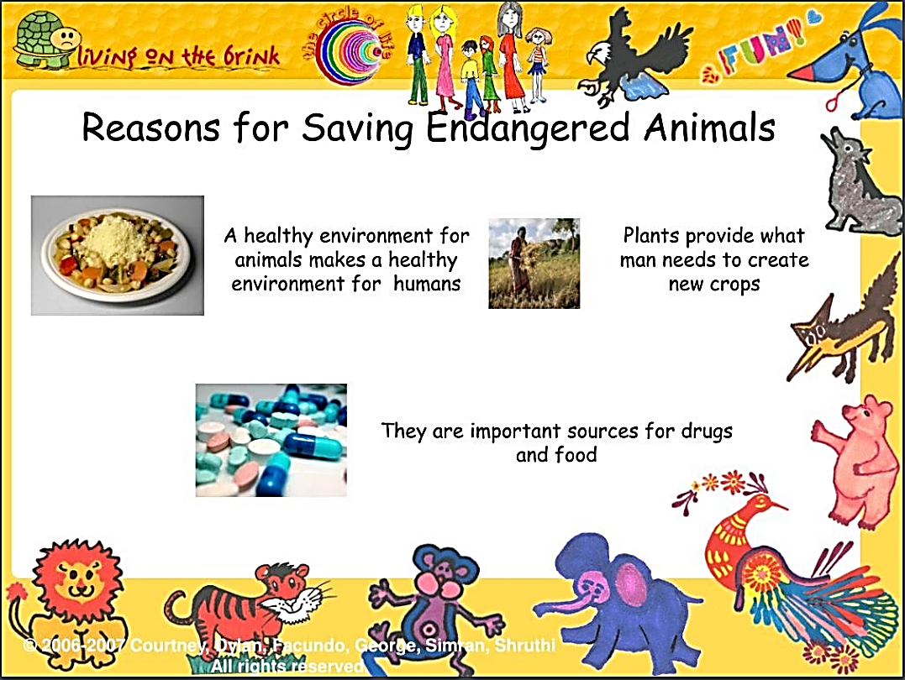

Slide 16
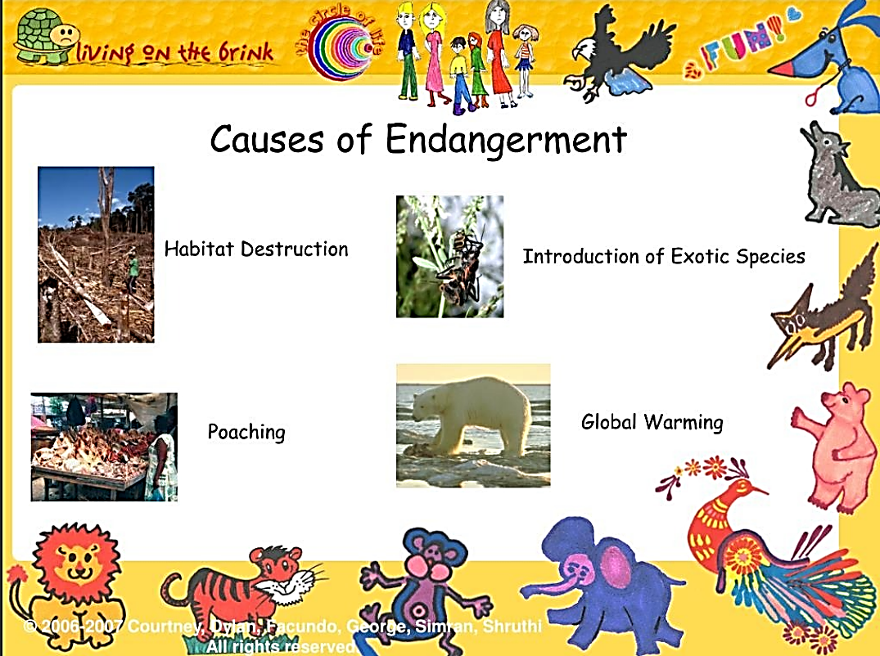

Slide 17
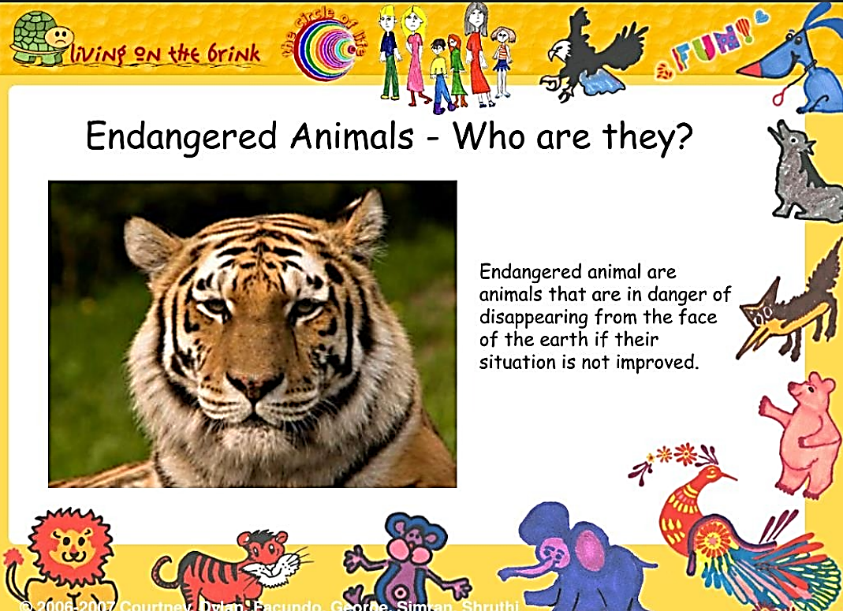

Slide 18
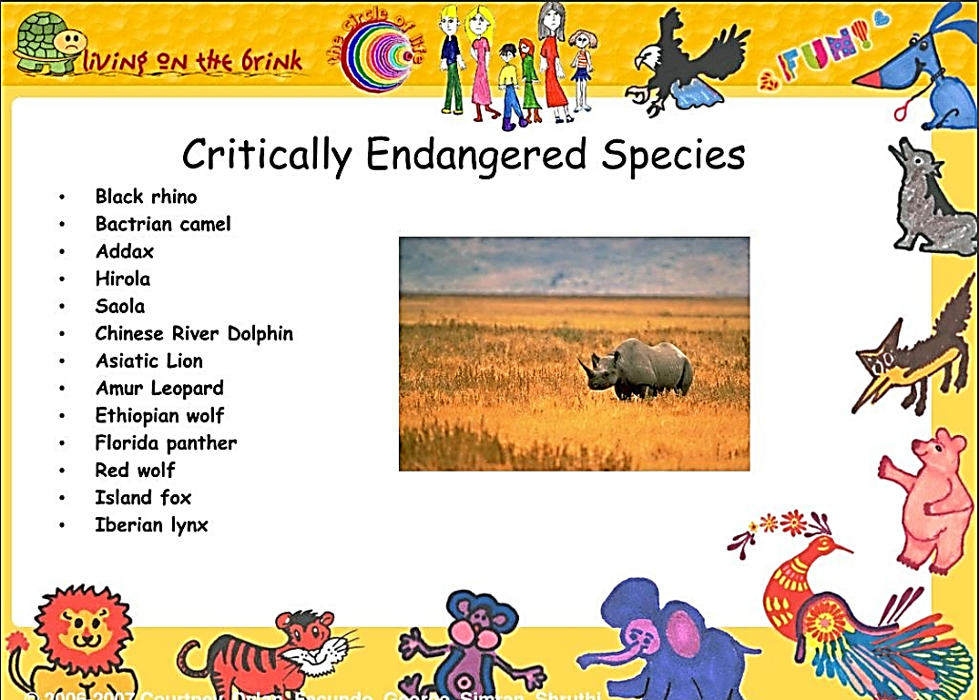

Slide 19

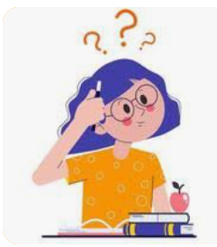

MY WORLD
Do you know any endangered species?

Slide 20


