Slide 1
grammar
UNIT 8– CONSERVATION

Slide 2
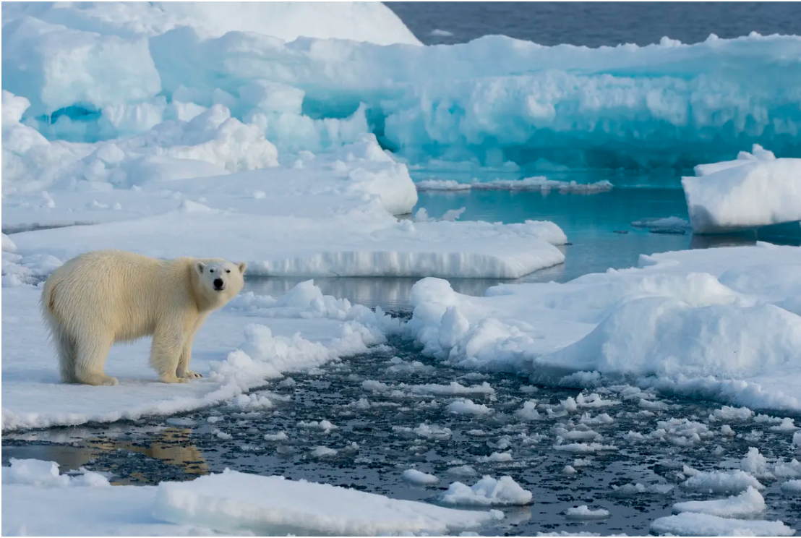
Real Conditionals in the Future
the real conditions that can happen.
If the Arctic ice melts......
... sea levels will rise.
... the climate will change.
... the habitat for various Arctic species will disappear.

Slide 3
Real Conditionals in the Future
Formular:
If we don’t control pollution, more sea animals will become extinct.
More sea animals will become extinct if we don’t control pollution.
Plastic straws are going to hurt more sea turtles if we keep throwing them away.
If we keep throwing plastics straws away, they are going to hurt more sea turtles.
If + S + do, S + will / be going to + do

Slide 4
Questions with If-clause
Yes/ No Questions:
Wh-Questions:
Will + S + do if + S + do?
Will our planet survive if temperatures continue to increase?
No, it won’t/ Yes, it will.
Wh-word + will + S + do if + S + do?
What is going to happen if temperatures continue to increase?

Slide 5
Climate Change
Polar bears live on the Arctic sea ice. It is their natural habitat. From these ice platforms, they can catch seals to eat. The ice is very important for polar bears, but sadly it is disappearing because of climate change. The world is getting warmer and the Arctic ice is melting. If the ice disappears, polar bears will have a hard time finding food. If we don't try to stop climate change, polar bears and other wild animals are going to become extinct. We need to protect these endangered species. They are all an important part of the natural world.

Slide 6
Complete sentences with correct verb forms
Polar bears _____________________ (lose) their habitat if the ice _______ (melt).
If we _________ (take) action now, we __________________ (help) protect nature.
If the temperature _________ (get) higher, more wild animals ____________________________ (be) endangered.
Polar bears ____________________ try to find food in towns if they ____________________ (have to) live on land.
If humans __________________ (not control) climate change, more species ________________________ (become) extinct.
will lose/ are going to lose
melts
take
will help/ are going to help
gets
will be/ are going to be
will try/ are going to try
have to
don’t control
will become/ are going to become

Slide 7
What will happen if…?
If the climate continues to change, …
If polar bears’ habitat disappears, ….
If polar bears can’t catch enough seals, …
If people protect polar bears,
If polar bears become extinct,
If polar bears try to find to food in town,

Slide 8
What will happen if…?
1. If the climate continues to change, there will be more extreme weather events all over the world.
2. If polar bears’ habitat disappears, they will be forced to find alternative environments to survive in or face extinction.
3. If polar bears can’t catch enough seals, their population will decrease.
4. If people protect polar bears, their population can stabilize and potentially recover, ensuring their long-term survival.
5. If polar bears become extinct, it would disrupt Arctic ecosystems and have far-reaching consequences for other species and the environment.
6. If polar bears try to find to food in town, they will come into conflict with humans and face various risks, such as traffic accidents or encounters with dangerous substances.

Slide 9
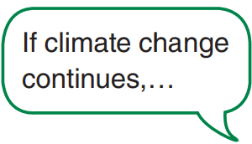
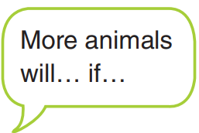
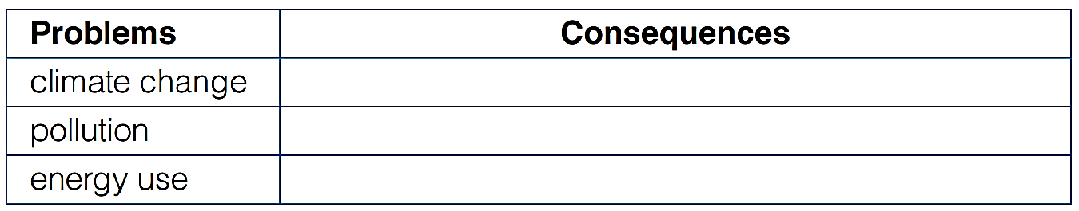
Goal check
How will these problems affect nature?

Slide 10
Word bank
alternative / green energy (n) nguồn năng lượng thay thế
extreme weather (n) hiện tượng thời tiết cực đoan
Drought (n) hạn hán
Hurricane (n) bão nhiệt đới
Storm (n) cơn bão
Tornado (n) lốc xoáy/vòi rồng
Illness (n) bệnh tật
Increase (n, v) gia tăng
Reduce (v) giảm
run out (of) (v) cạn kiệt
Smog (n) = smoke + fog : sương mù dày đặc
waste (v, n): thải/ chất thải

Slide 11


