Slide 1
Listening
UNIT 8– CONSERVATION

Slide 2
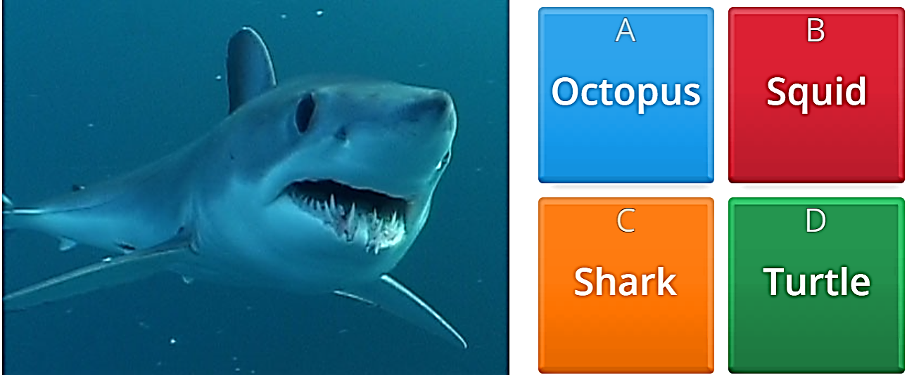

Warm-up: what I am?

Slide 3
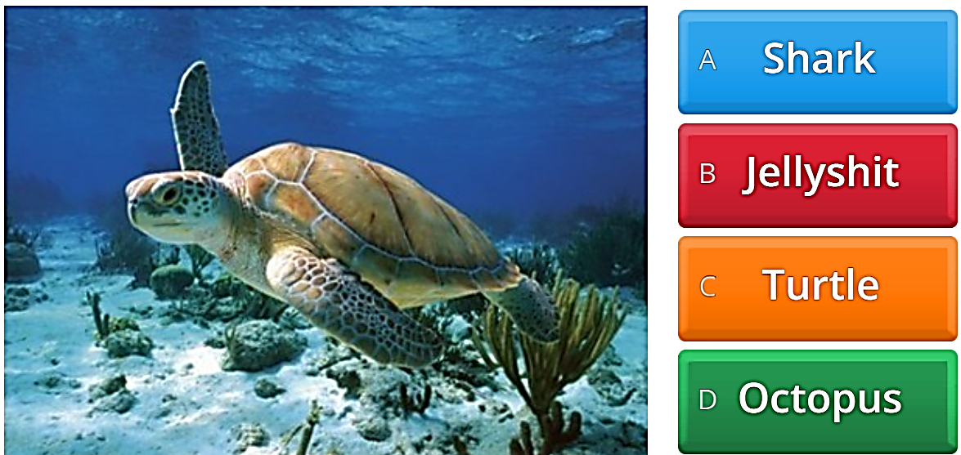

Warm-up: what I am?
Jellyfish

Slide 4
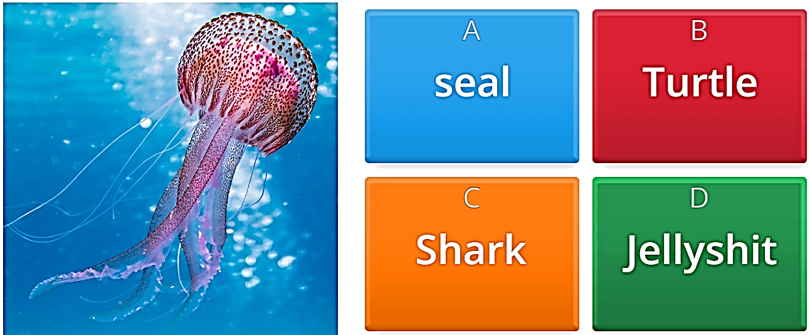

Warm-up: what I am?
Jellyfish

Slide 5
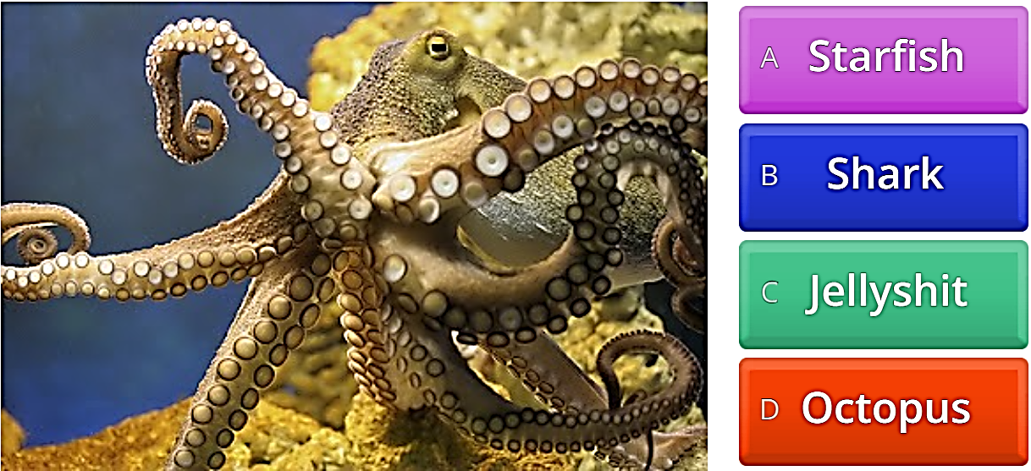

Warm-up: what I am?
Jellyfish

Slide 6
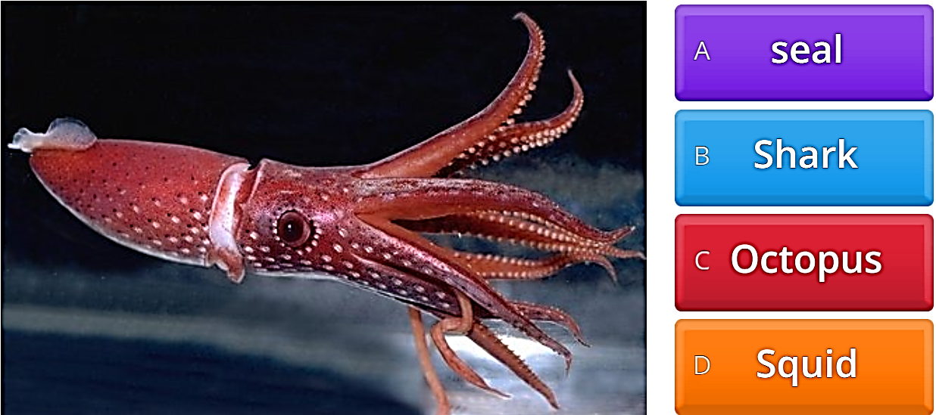

Warm-up: what I am?

Slide 7
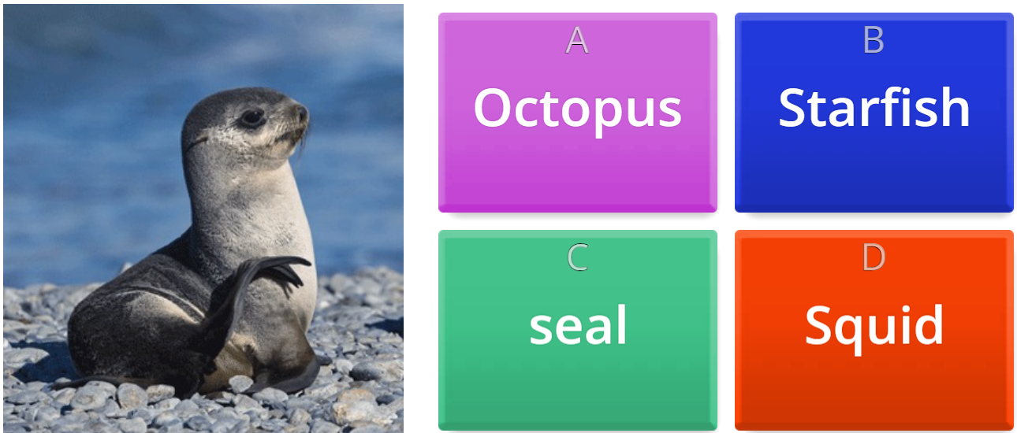

Warm-up: what I am?

Slide 8
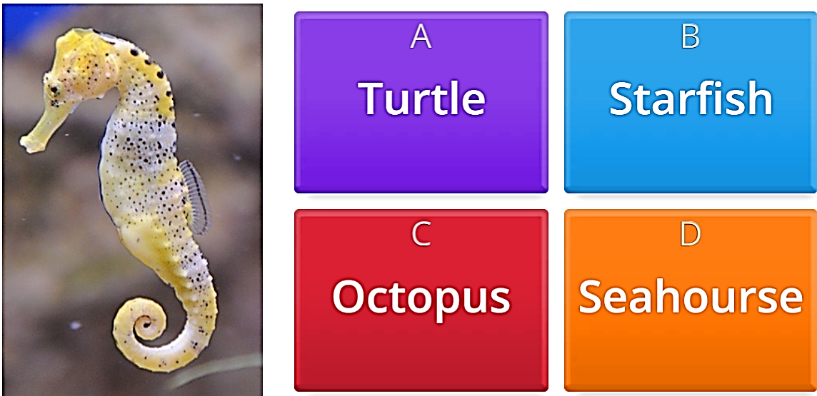

Warm-up: what I am?
Seahorse

Slide 9
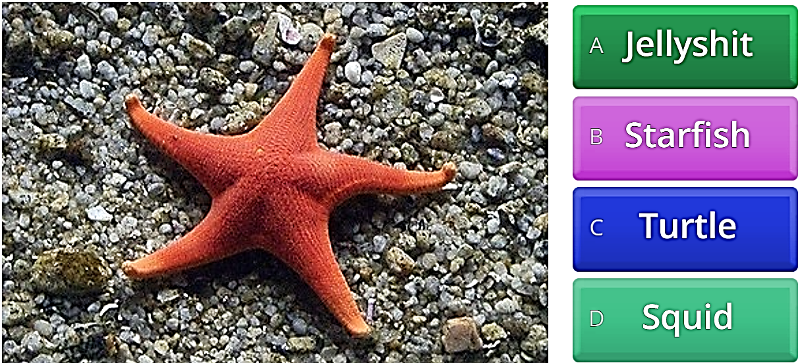

Warm-up: what I am?
Jellyfish

Slide 10
Some problems humans may face
Climate changes/ global warming
Running out of fresh and clean water
Food scarcity/ hunger
Extinction/ endangered species
Running out of natural resources
Etc.

Slide 11
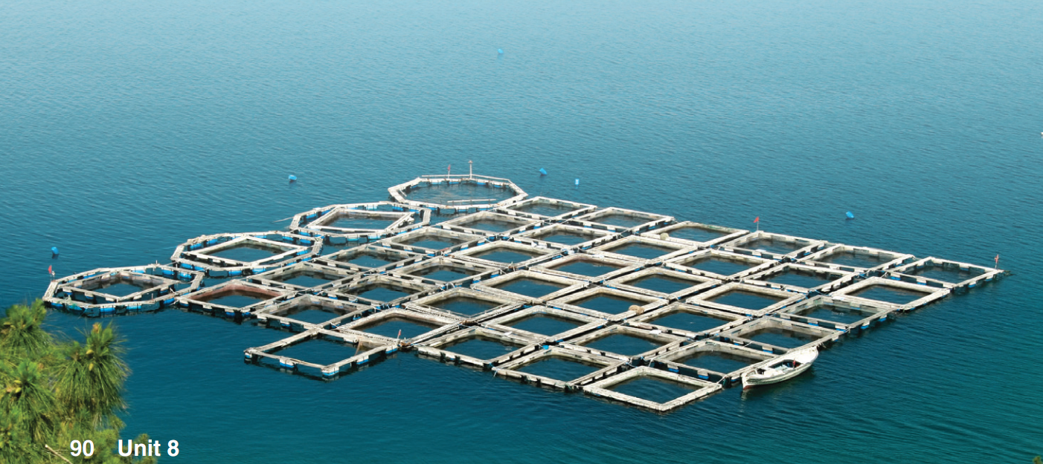

What can you see in the photo?
Do you think fish farms can help reduce overfishing?

Slide 12
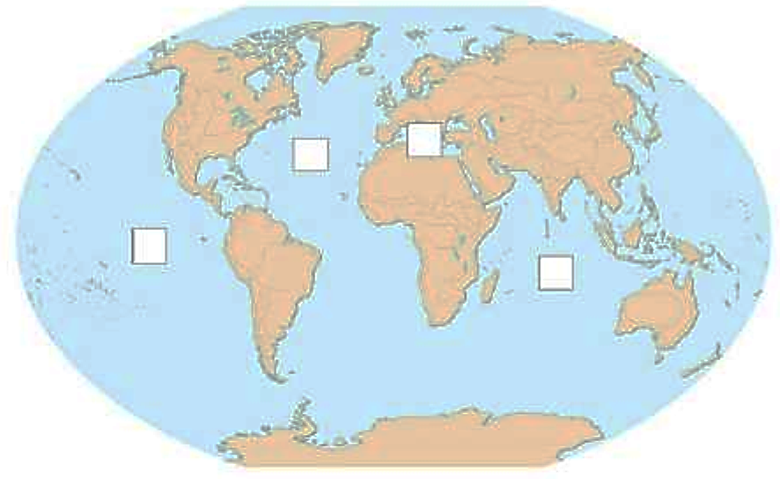
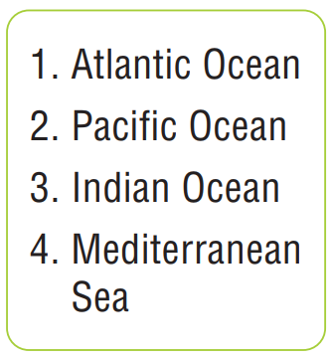
A – match the oceans and the places
4
1
2
3

Slide 13

b – circle the three places in the recording
4
1
2
3

Slide 14
Audio script (track 37)
The bluefin tuna is one of the most amazing fish in the world. A bluefin tuna can grow to be 12 feet long, and it can weigh more than 1,500 pounds. It's a beautiful fish, too, silver-colored with marks of yellow and blue. It can swim more than 25 miles an hour, and it can live for up to 30 years.
Unfortunately, the bluefin tuna is also delicious because it has a lot of fat in its body. In Japan, people use it to make sushi, and in Europe, people love to cook big pieces for tuna steaks. Every year, fishing boats catch more and more of these fish, and now they are in danger of disappearing. If the boats catch too many big bluefins, there won't be any young fish in the future.
In the past, bluefin tuna lived in the Pacific Ocean and Indian Ocean. But in the 1990s, only 10 percent of the original population of bluefins was left. So, the biggest fishing boats moved to the Mediterranean Sea, and now they catch up to 60,000 tons of bluefin tuna there every year.
Some scientists say that we should stop catching bluefin tuna for several years so that the population of tuna can grow again. If this amazing fish disappears, the seas will lose a great treasure.

Slide 15
Listening strategy
Listen for key words
Write down the key words you hear (catch the sounds and make guesses)
Check your spelling

Slide 16
C – listen and fill in the blanks
Bluefin Tuna
up to _________ feet long
weighs more than _________________
Colors: _________, ________, ________
swims more than ______ miles an hour
lives up to _________ years
12
1,500 pounds
silver
yellow
blue
25
30

Slide 17
Listen & complete the sentences
in Europe
In _______, people use it to make sushi, and _________, people love to cook big pieces for tuna steaks.
If the boats _____________ big bluefins, there ___________ young fish in the future.
Only ___________of the original population of bluefins was left.
If the big boats ________ the fishing in the Mediterranean, many poor people ________ their work.
If this amazing fish __________, the seas _________ a great treasure.
Japan
catch too many
won't be any
ten percent
destroy
will lose
disappear
will lose

Slide 18
Audio script (track 38/39)
The bluefin tuna is one of the most amazing fish in the world. A bluefin tuna can grow to be 12 feet long, and it can weigh more than 1,500 pounds. It's a beautiful fish, too, silver-colored with marks of yellow and blue. It can swim more than 25 miles an hour, and it can live for up to 30 years.
Unfortunately, the bluefin tuna is also delicious because it has a lot of fat in its body. In Japan, people use it to make sushi, and in Europe, people love to cook big pieces for tuna steaks. Every year, fishing boats catch more and more of these fish, and now they are in danger of disappearing. If the boats catch too many big bluefins, there won't be any young fish in the future.
In the past, bluefin tuna lived in the Pacific Ocean and Indian Ocean. But in the 1990s, almost all of these fish were caught. Only 10 percent of the original population of bluefins was left. So, the biggest fishing boats moved to the Mediterranean Sea, and now they catch up to 60,000 tons of bluefin tuna there every year.
There are international rules for fishing, but these boats don't follow the rules. They catch too many fish, and they harm the environment. If the big boats destroy the fishing in the Mediterranean, many poor people will lose their work. Some scientists say that we should stop catching bluefin tuna for several years so that the population of tuna can grow again. If this amazing fish disappears, the seas will lose a great treasure.

Slide 19
MY WORLD Discuss these questions in pairs
Is fish cheap or expensive where you live? How often do you eat it?
Do you know where the fish you eat comes from?

Slide 20


