Slide 1
Pronunciation
UNIT 8– CONSERVATION

Slide 2
Warm-up: matching sentences
Students works in 2 teams. In half a minute, team A write half of a randomly sentence with If-clause. Team B write a randomly independent clause.
E.g.: Team A: If it rain very hard,
Team B: I will buy a house.
Teacher collects all pieces and pile them into parts. Each team send a member to the front of the class and in turn randomly pick up one of the pieces in each part, say it out loud to make a full sentence.

Slide 3
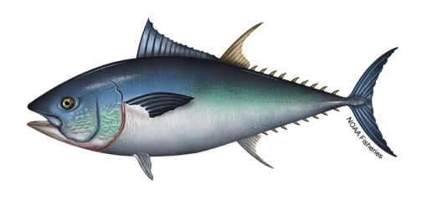
bluefin tuna
DO YOU KNOW?
12 feet long
How long are the bluefin tuna?
How much do they weigh?
What color are they?
More than 1,500 pounds
silver, yellow, blue

Slide 4
Sentence rhythm
Bluefin tuna | are silver, | yellow, | and blue.

Slide 5

F - Listen and repeat
A bluefin tuna | can swim very fast | and live a long time.
In Japan, | people use it | to make sushi.

Slide 6
G – draw lines then listen and repeat
If they catch all the big fish, the species won’t survive.
The bluefin tuna is also delicious.
There are international rules for fishing.
Bluefin tuna lived in the Pacific Ocean and the Indian Ocean.
It is important to try to understand how our actions affect nature.

Slide 7
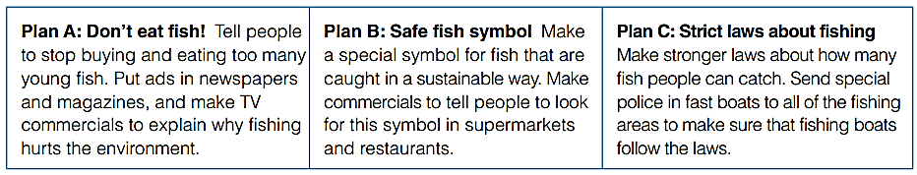
Goal check – discuss ways to solve future problems
Read each plan. What will happen if we follow each one? Write some notes
Discuss the plans with your group
As a group, decide which is the best plan.
Explain your decision to the class

Slide 8


