Slide 1
language expansion adverbs of manner – linking verbs
UNIT 8– CONSERVATION

Slide 2
WARM-UP: Guessing game
2 teams send a member each turn to pick up a card and then try to act to let other team’s members guess what it is.
Once you find out the answer, come and write it on the board and get a point for a correct guess.
In 5 minutes (30 sec.s for each acting), which team has more points will win.

Slide 3
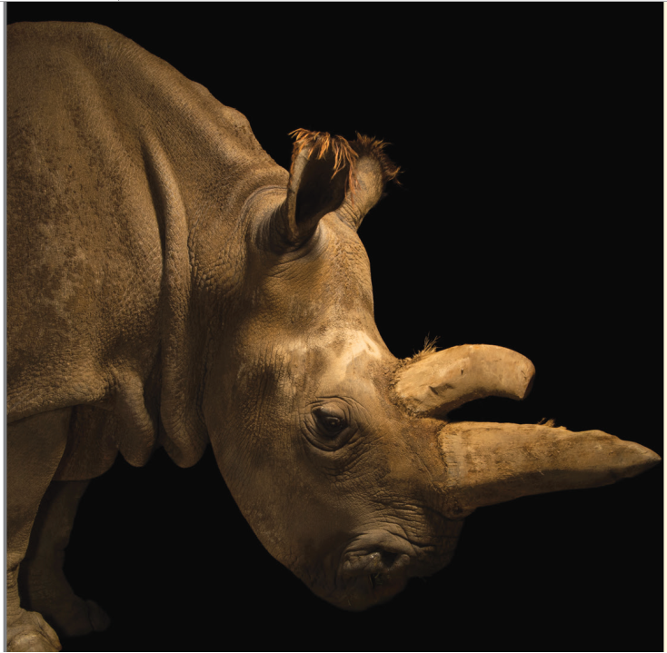
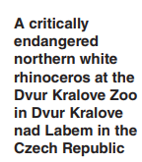
What do you know about rhinoceroses?
- How does a rhino move?
- Does it move quickly or slowly?
A rhino can run at 31 mph (50 km/h)

Slide 4
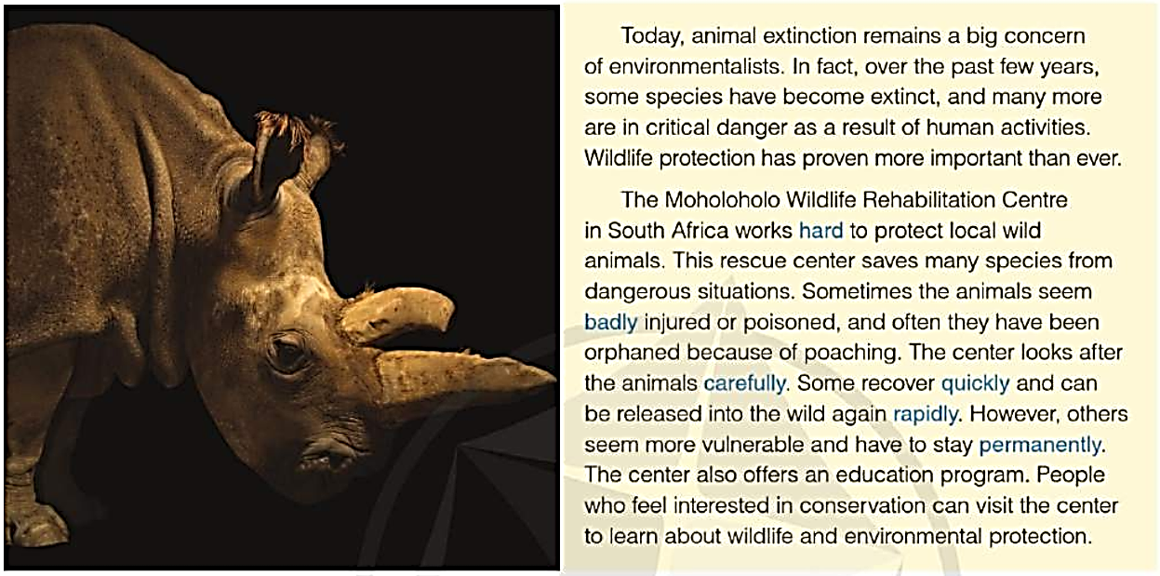
What does the rescue center do?
They takes care of injured, poisoned, orphaned animals; teaches people about wildlife and conservation

Slide 5
Listen and repeat
Extinct (v) tuyệt chủng => extinction (n)
To be in critical danger (n) đang bị đe dọa nguy hiểm nghiêm trọng
Hard (adv): vất vả, chăm chỉ
Poisoned (adj) bị trúng độc
Badly (adv) tệ hại/ nghiêm trọng
Poach (v) săn trộm (động vật)
Carefully (adv): một cách cẩn thận
Quickly (adv) một cách nhanh chóng = rapidly
Permanently (adv) lâu dài, vĩnh viễn
Vulnerable (adj) dễ bị tổn thương

Slide 6
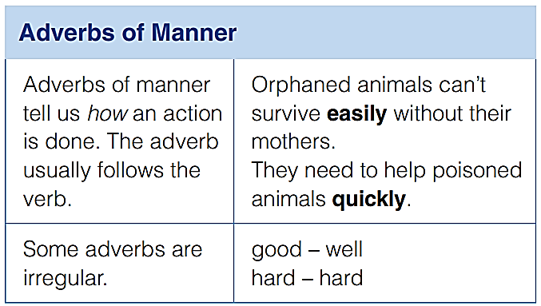
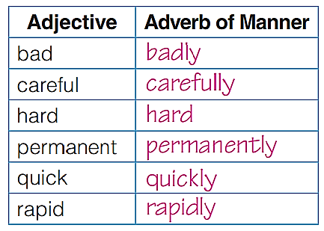
Irregular adverbs
Good => well
hard => hard
Adverb is a part of speech
Adj + ly => adverb

Slide 7
Complete the sentences with the adverb forms
carefully
The vet checks the animals _______ before they enter the center
The baby cheetah is eating ______ now and it plays _______ with the other cheetah.
The visitors watched the baby rhino __________ . They didn’t want to frighten him.
The staff at the center works _____ to help the animals.
The lion was walking _________ because its leg was ______ injured
well
happily
quietly
hard
slowly
badly

Slide 8
Linking verbs
Defining the subject or adding more details to it.
Is followed by an adjective or a noun
Some common linking verbs:
Become
Remain
Stay
Get
Turn
Grow
Look
Sound
Smell
Feel
Seem

Slide 9
Underline all the linking verbs

Slide 10
Circle the correct word to complete each sentence.
Trang felt eager/eagerly to join the conservation project.
Those scientists sounded worried/worriedly when they mentioned the environmental issues.
Will that little animal recover quick/ quickly from the injury?
Join us if you are interest/ interested in the program.
Poaching remains a threat/ threatened to wildlife

Slide 11
Correct sentences
wild
Some dogs can go wildly if they are kept indoors for too long.
In some cases, a full recovery from injury seems impossibly.
How can we help people become awareness of this issue?
Is environmental protection one of the main concerned of the government?
impossible
aware
concern

Slide 12
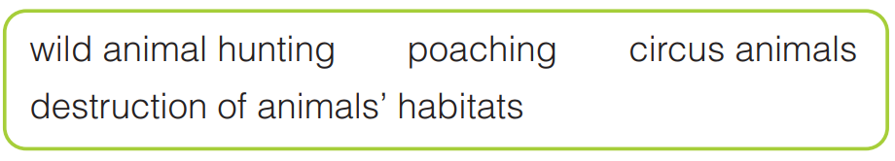
GOAL CHECK Describe a Situation
Describe one of the situations in the box to a partner.
Use adverbs of manner and linking verbs.
deforestation illegal issue laws loss of
protect release respect take care of
treat (v)/treatment (n)
Word bank

Slide 13


