Slide 1
Reading making a different
UNIT 8– CONSERVATION

Slide 2
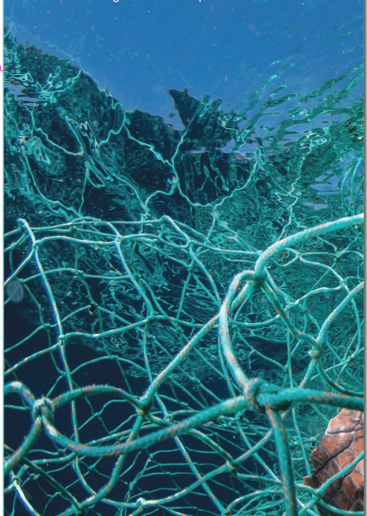
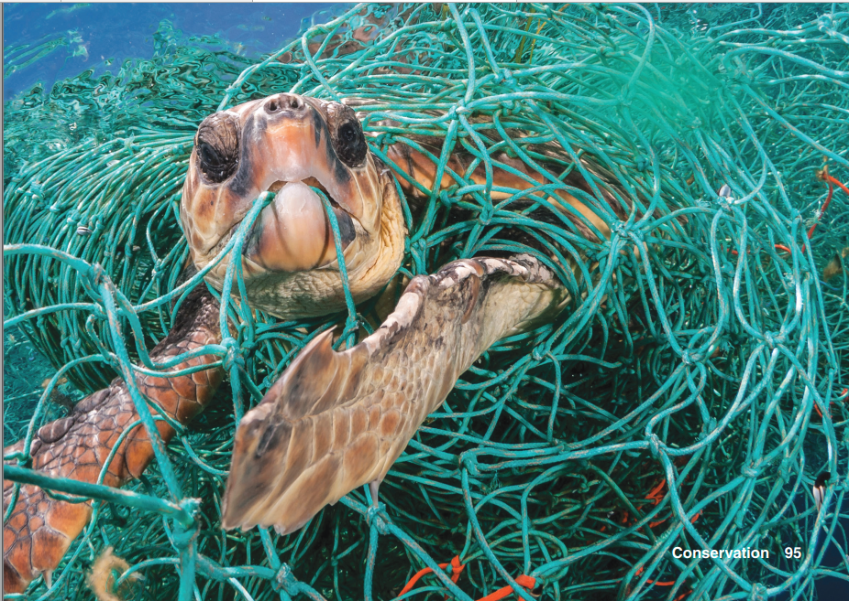
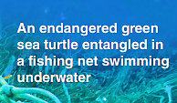

Slide 3
About the Photo
This photo shows a common problem in the oceans today.
Turtles and other sea animals are at great risk from the large amount of plastic, including fishing nets, that ends up in the world’s oceans.
The photo was taken by Jordi Chias, a freelance photographer who specializes in photographing underwater sea life.
His photos, including this one, have been published in various media and used by wildlife organizations to support their conservation campaigns.

Slide 4
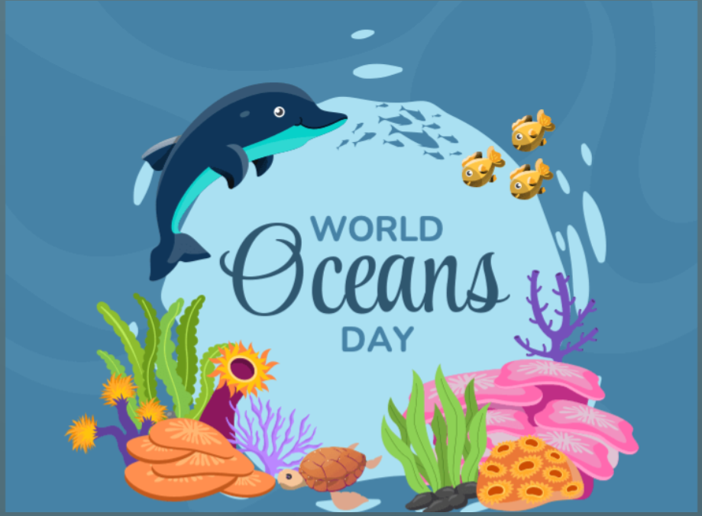
Ocean conservation
What problems are related to the oceans?
Over fishing
Distinctions of some marine species
Let’s make a mindmap
Do these problems affect you? If so, how?
June 8

Slide 5
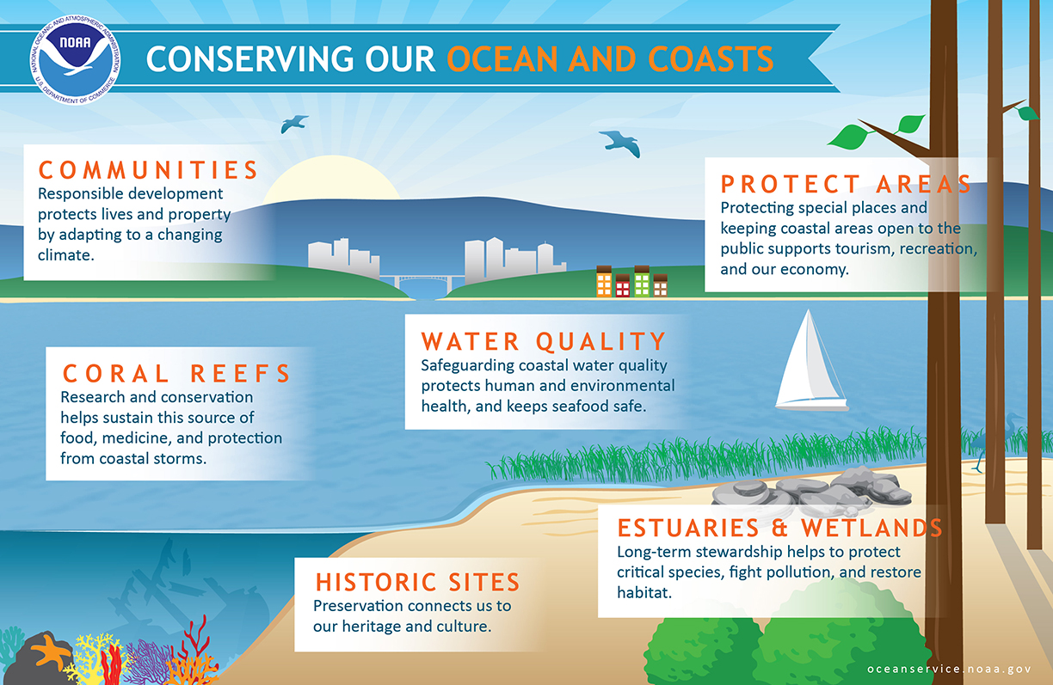

Slide 6
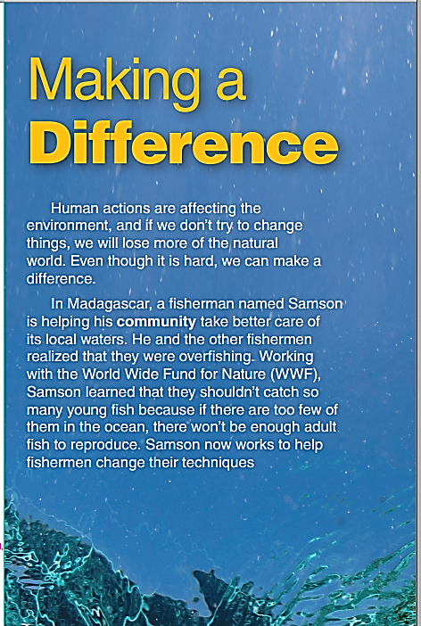
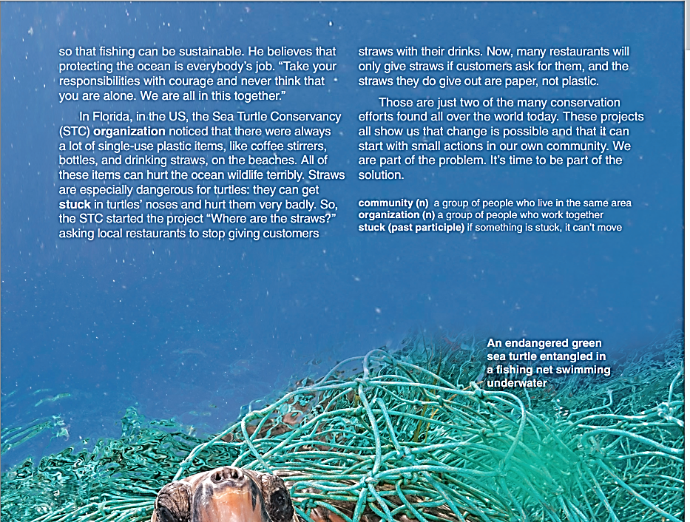

What can you see?
a turtle stuck a fishing net
What do you expect in the reading?

Slide 7
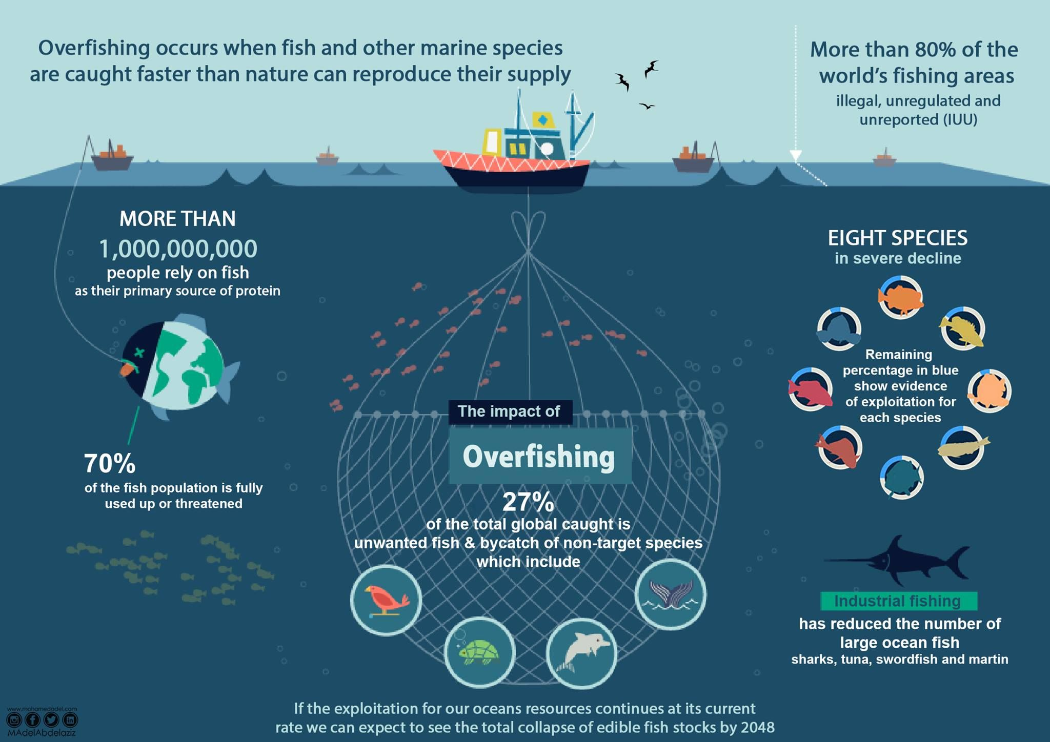
Overfishing?
= catching too many fish and causing their population to decrease

Slide 8
find the main idea
Change is possible.
Trash is the ocean’s main problem.
Straws can kill turtles.
We need to protect the ocean.

Slide 9
Listen and repeat
Overfishing (n) đánh bắt quá mức
Trash (n) rác
Straw (n) ống hút
Community (n) cộng đồng
Reproduce (v) sinh sản
Organization (n) tổ chức
Single-use (adj) dùng 1 lần
Stick (v) dính/ mắc vào => stuck (V_ed/ed2)

Slide 10
Read the article and answer questions
What was happening in Madagascar?
How have they solved the problem?
What do you think Samson means when he says, “We are all in this together”?
What has happened as a result of the Sea Turtle Conservancy’s project in Florida?
Fishermen were overfishing.
They change their fishing techniques.
Your ideas/ opinions.
Many restaurants will only give straws if customers ask for them, and the straws they do give out are paper, not plastic

Slide 11
GOAL CHECk
What can you do to make a difference for the environment? Write a list of specific actions and habits you could change
What can you do to make a difference for the environment? Write a list of specific actions and habits you could change.
Discuss a conservation project.
Write a list of local or national conservation projects that you know about.
Share your list in pairs. Discuss the different projects.
Join another pair. Choose one of the projects to research and find out more about it.
With your group, present the project you researched to the class.

Slide 12


