Slide 1
communication
UNIT 8– CONSERVATION

Slide 2

Let’s watch

Slide 3
Mind-mapping
What are some conservation issues?
What has happened?
What are some related effects?
What have been done to reduce the negative impact?

Slide 4
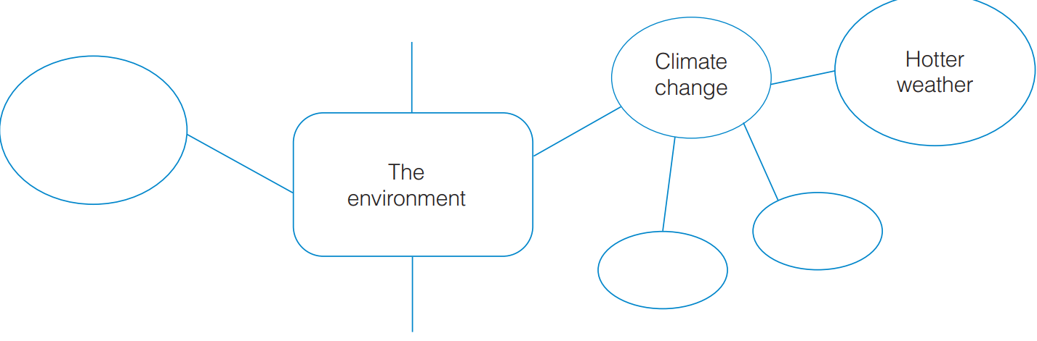
Mind-mapping
Air/water/
land pollution
flood
drought
Garbage/
wastes

Slide 5
Causes and sequences
Causes | Sequences
Pollution (air/soil/water, etc.)
More diseases/illnesses
Climate changes
Extreme weather events
Deforestation
Flood/ erosion
Environmental degradation
Low quality of living conditions
Bio-diversity loss
Endangered species
Ozone depletion
Global warming/ polar ice melting

Slide 6

How can we save the world?

Slide 7
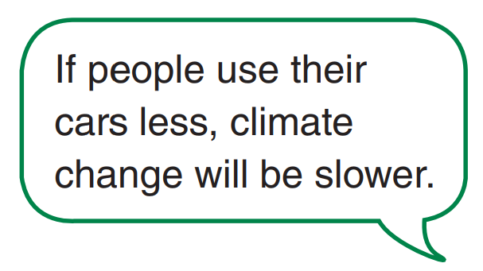
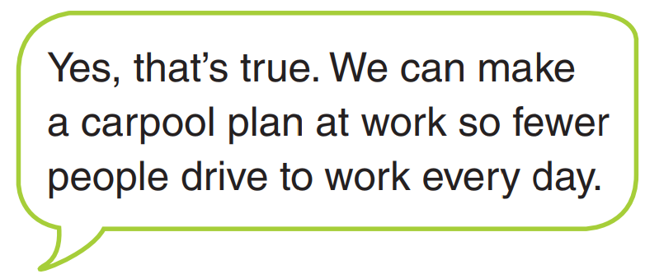
Pair work – identify causes and consequences

