Slide 1
writing
UNIT 8– CONSERVATION

Slide 2
Warm-up: Acting game
2 teams A and B
Each member of each team go to the board and pick up a piece of paper with half a sentence. In 30 seconds, without saying, act for other to guess the meaning of the sentence part.
Teacher shows the other half of the sentence on board
Other members have to guess what the other half goes.

Slide 3
Sentence completion
If we believe in conservation, we will _____
If_______ , many animals will be saved.
If people want to make positive changes, they will_________

Slide 4
Complete the paragraphs with conjunctions
By the 1990s, many species of animals were endangered in Namibia because of poaching. The situation was serious, (1) ____ conservationists needed to find a way to protect the animals. They found one, (2) ______ wasn't what you would expect they asked poachers for help. (3) ____________ this seemed crazy, I think it was a great idea. If we want to protect endangered species, we need to consider every solution.
so
but
Even though

Slide 5
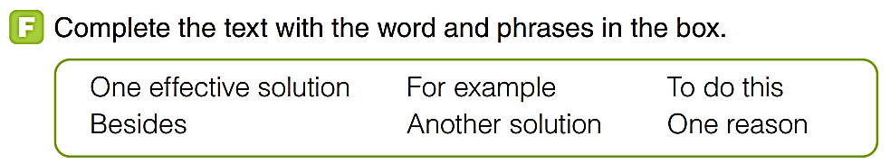
Many developing countries in South East Asia are witnessing an alarming increase in poaching. This causes great concern in those countries. There are several reasons why many people continue their illegal act of hunting wild animals. (1) _____________ is that people hunt for some parts of rare animals' body. (2)______________, they kill elephants for ivory or rhinos for horns. (3)________, some local people hunt wild animals for food. If poaching continues, it will threaten the survival of many species.
Poaching also affects the natural ecosystem. In particular, the ecosystem will be unbalanced if one species becomes extinct. To prevent these possible consequences. both governments and people should take action. (4) __________________ awareness of poaching problems. (5)___________, schools can educate students about the importance of wild animals and the dangers of poaching. (6) _______________ could be making the laws against poaching stricter. Building more wildlife rescue centers like the Moholoholo Wildlife Rehabilitation Centre in South Africa is also a good suggestion to solve the issue of poaching.
One reason
For example
Besides
One effective solution
To do this
Another solution

Slide 6
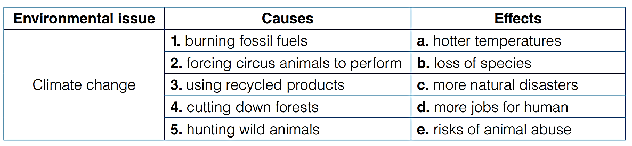
G - Discussion

Slide 7
Writing – explain a conservation issue
It’s the fact that rain forest is being cutting down for woods and land. Forest is home of animals and plants, destroying their habitats means driving them to the verge of extinction. Besides, the result of cutting down trees is the soil erosion, we won’t be able to use it anymore and sometimes erosions cause danger to people living there. To stop this destruction, first and for most, government must pass severe laws, which ban cutting plants and fine heavily those who break the laws. Besides, launch campaign across every part of a country for growing trees and saving endanger animals and plants. Last but not least, raise awareness of people on the importance of forest, especially to children and people in remote areas.

Slide 8
Peer- review Check-list
1. Appropriateness
2. Content
3. Organization
4. Format
5. Self-checking for grammar and spelling

Slide 9


