Slide 1
opener & vocabulary
UNIT 9
LIFE NOW AND IN THE PAST

Slide 2
Warm-up: Snake game
Teacher choose a letter of the Alphabet and prompt a word, e.g. turtle
students to say a word starting with the last letter in the word on board, e.g. environment, and so on
The game ends after 3 minutes or when students cannot find any word starting with the last letter of the previous one.

Slide 3
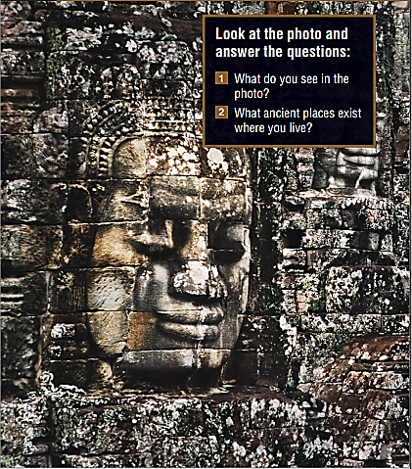
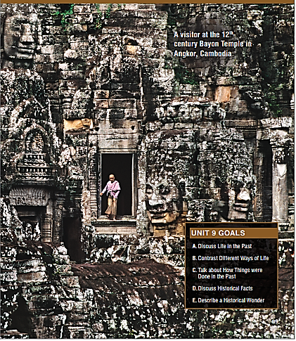
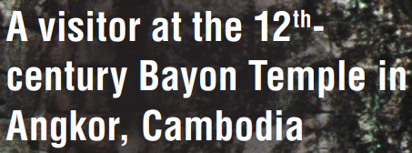
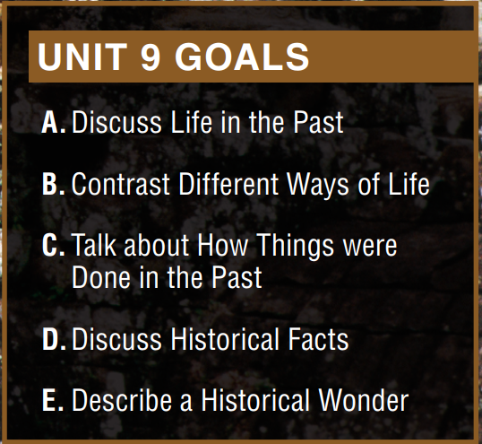

Slide 4
About the Photo
This photo was taken by Steve McCurry, a photographer and photojournalist.
His most iconic photo is one of a green-eyed Afghan girl that appeared on the cover of National Geographic magazine in 1985.
McCurry has worked a lot in areas of conflict, but he also focuses on ancient traditions and modern culture, as can be seen in this photo, in which he contrasts a modern-day visitor with an ancient temple in Cambodia.

Slide 5
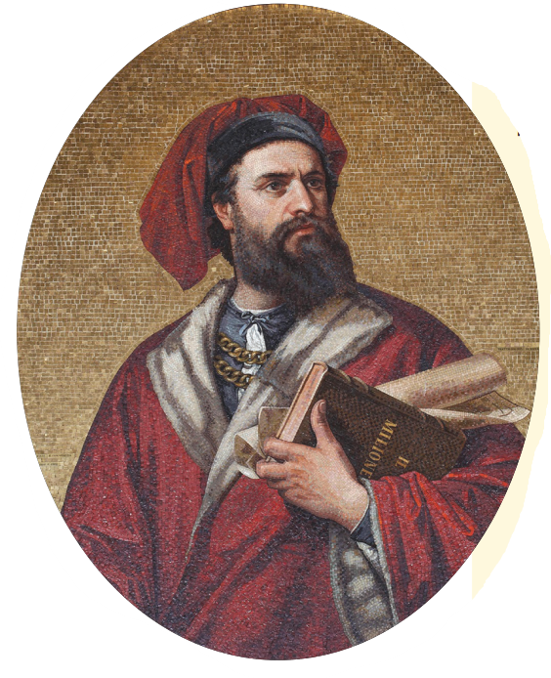
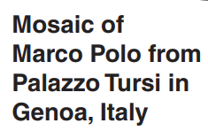
Answer the questions
What do you know about Marco Polo?
Where did he travel? How do you think he traveled?
He’s one of the greatest explorer with his extensive travels throughout Asia
He traveled extensively throughout Asia, including China, Mongolia, India, and Persia. He likely traveled by land and sea, using various modes of transportation such as horses, camels, and boats.

Slide 6
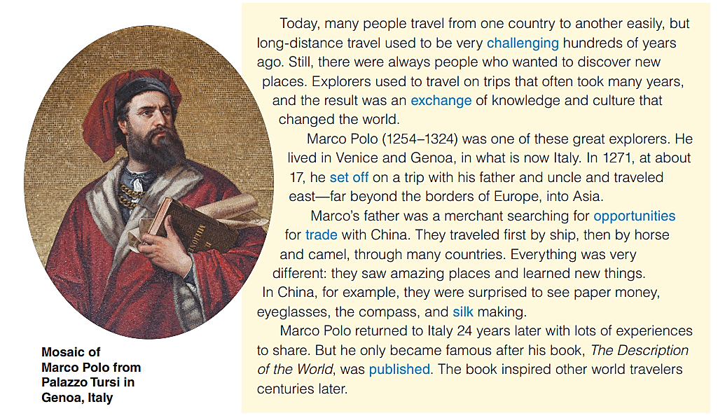

Slide 7
Read the text and answer the questions
Why did people travel in the past?
Where was Marco Polo from?
Where did Marco, his father, and his uncle travel to?
Because Marco’s father was a merchant searching for opportunities for trade with China.
He was from Venice, in Italy.
They travelled east – far beyond the borders of Europe, into Asia.

Slide 8
Find correct definition/synonym
set off
published
___________ started a journey
___________ giving and receiving
___________ difficult
___________ buying and selling
___________ printed and sold
___________ a very soft cloth
___________ chances
exchange
silk
challenging
opportunities
trade

Slide 9
Listen and repeat
challenging (adj) thách thức/ khó khan
far beyond (adv) vượt xa ra khỏi (ranh giới/giới hạn)
merchant (n) thương nhân
exchange (n) sự trao đổi => ~ (v) trao đổi
set off (phrasal verb) bắt đầu
opportunity (n) cơ hội
trade (n) thương mại/ giao thương/mua bán
silk (n) tơ lụa
publish (v) xuất bản

Slide 10
Complete each sentence with a blue word
opportunities
Traveling provides people with many ___________ to learn about different cultures and customs.
We use ____ to make beautiful dresses and shirts.
Marco Polo ______ for China in 1271.
Living in a foreign country can be very __________ at first.
Today, there is a lot of ____ between China and Europe.
silk
set off
challenging
trade

