Slide 1
grammar
UNIT 9
LIFE NOW AND IN THE PAST

Slide 2
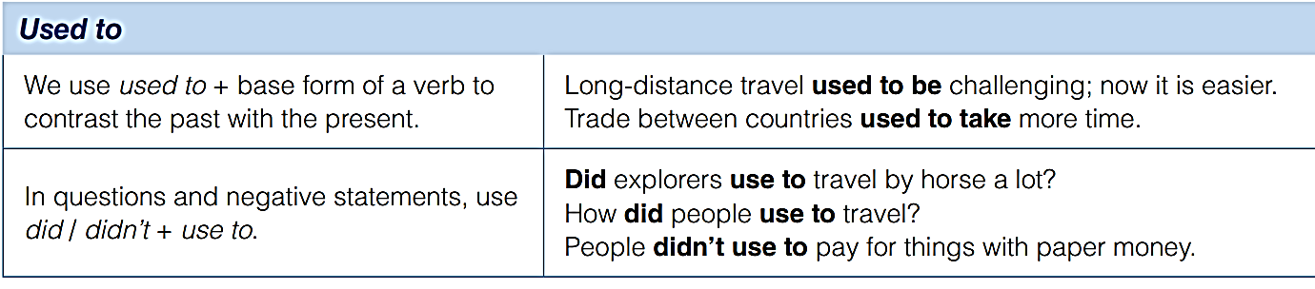
Used to + V-Infinitive => past habit
People used to travel from Europe to America by ship. Now they usually go by plane.

Slide 3
Write questions
How did people use to travel?
people/travel ______________________________________
trade/take longer __________________________________
clothes/people/wear ________________________________
merchants/trade ____________________________________
Did trade use to take longer in the past?
What kind of clothes did people use to wear?
What did merchants use to trade?

Slide 4

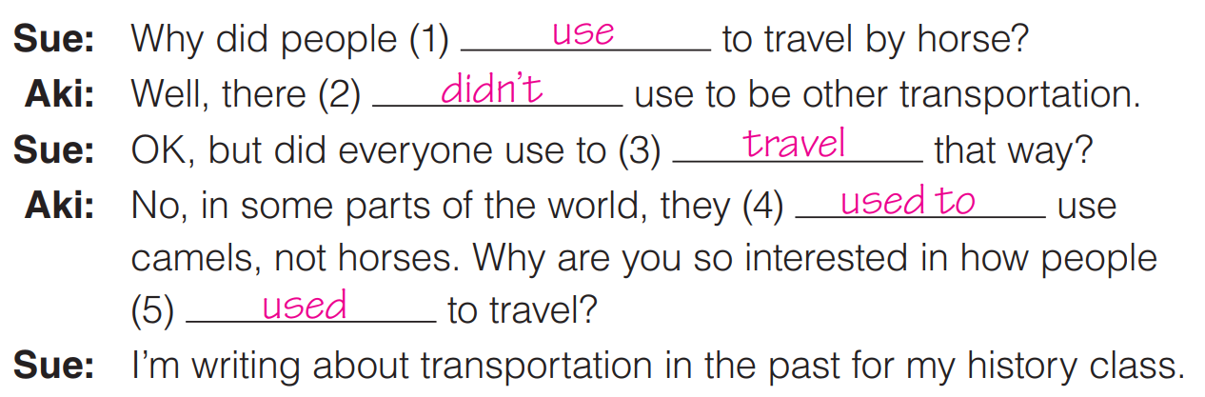
Complete the conversation.
Then, listen and check your answers

Slide 5
Things of more than 1000 years ago
Vietnam was a colony of France, so the country was under French colonial rule.
There were no smartphones, internet, or computers, and the means of communication were limited.
Transportation was very different as there were no cars, motorcycles, or airplanes. People mostly traveled by horse carts, bicycles, or walked.
Education was not widely available, and the literacy rate was lower than it is now.
The country was not unified, and there were different kingdoms and regions with different cultures and languages.

Slide 6
Things of more than 1000 years ago
The economy was based mostly on agriculture, and industrialization was limited.
Women's rights were not as advanced as they are now, and they were not allowed to participate in politics or hold high-level jobs.
Healthcare was not as advanced as it is now, and there were limited medical facilities and treatments available.
The architecture and urban development were different, and many cities and towns had different layouts and structures.
The population was much smaller, and the demographics were different with a higher percentage of the population living in rural areas.

Slide 7
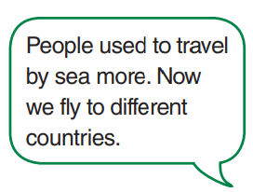
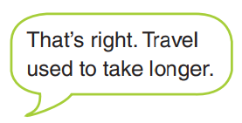
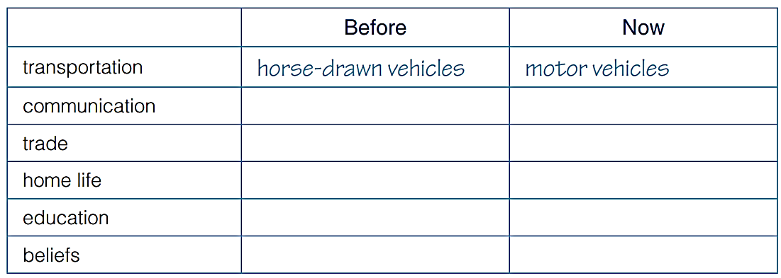
Discuss life in the past

Slide 8
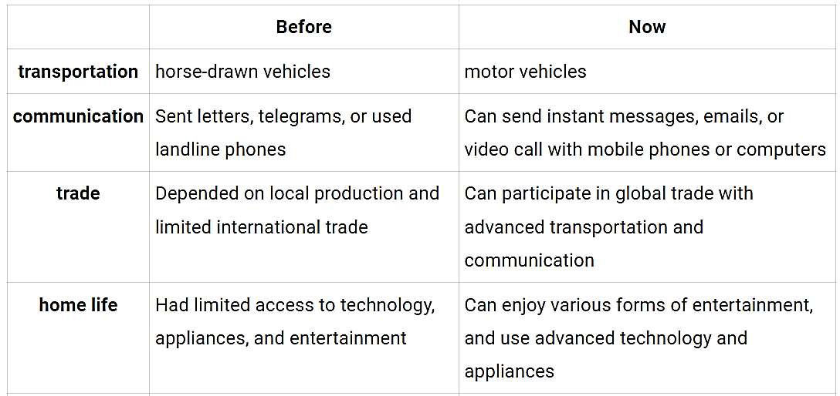
Suggested answers

Slide 9
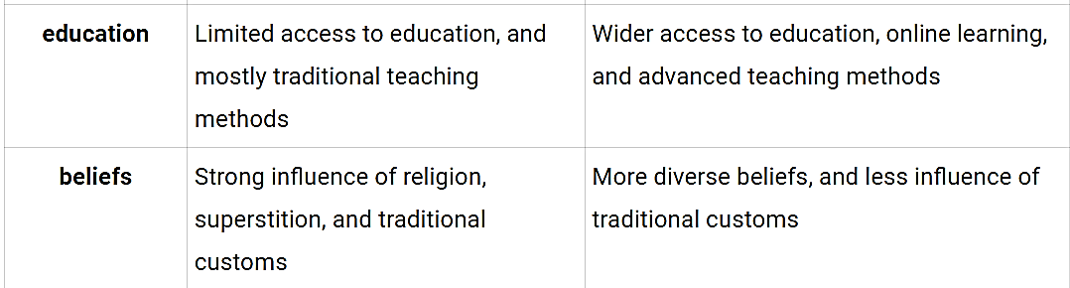
Suggested answers

Slide 10
describe what people used to do in the past
Transportation: People used to travel by foot or horse for short distances, and by horse carts or boats for longer distances. They also had to plan their trips carefully, as it took much longer to get from one place to another.
Communication: People used to communicate by sending letters, telegrams, or using landline phones. It was much more difficult to stay in touch with family and friends who lived far away, and communication was slow and expensive.
Trade: People used to depend on local production and limited international trade. They had to rely on what was available locally, and there were fewer options for goods and services.

Slide 11
describe what people used to do in the past
Home life: People used to have limited access to technology, appliances, and entertainment. They spent more time outdoors or doing chores at home. Families were also larger and more closely knit, and they spent more time together.
Education: Access to education was limited, and mostly traditional teaching methods were used. Students had to attend school in person, and there were fewer opportunities for higher education.
Beliefs: Religion, superstition, and traditional customs had a strong influence on people's beliefs and values. People were more conservative and traditional in their thinking, and there was less diversity in beliefs and ideas.

Slide 12


