Slide 1
listening
UNIT 9
LIFE NOW AND IN THE PAST

Slide 2
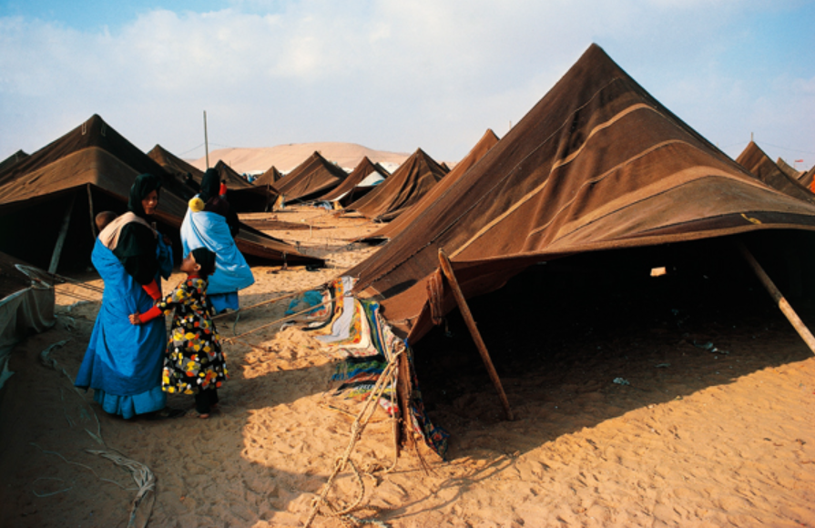
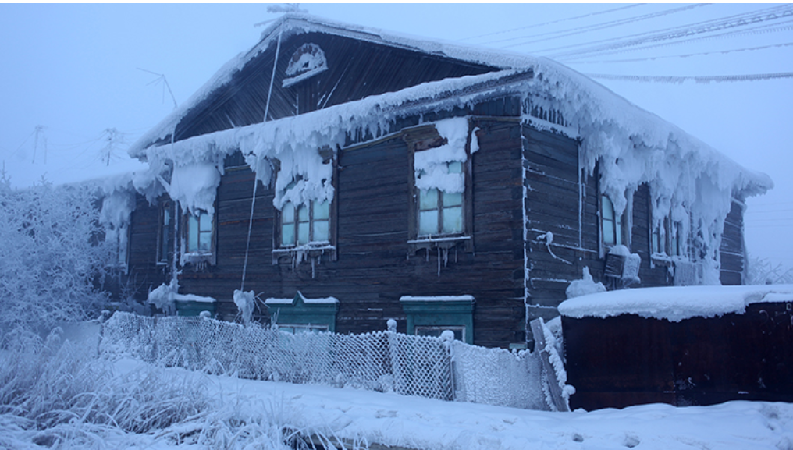
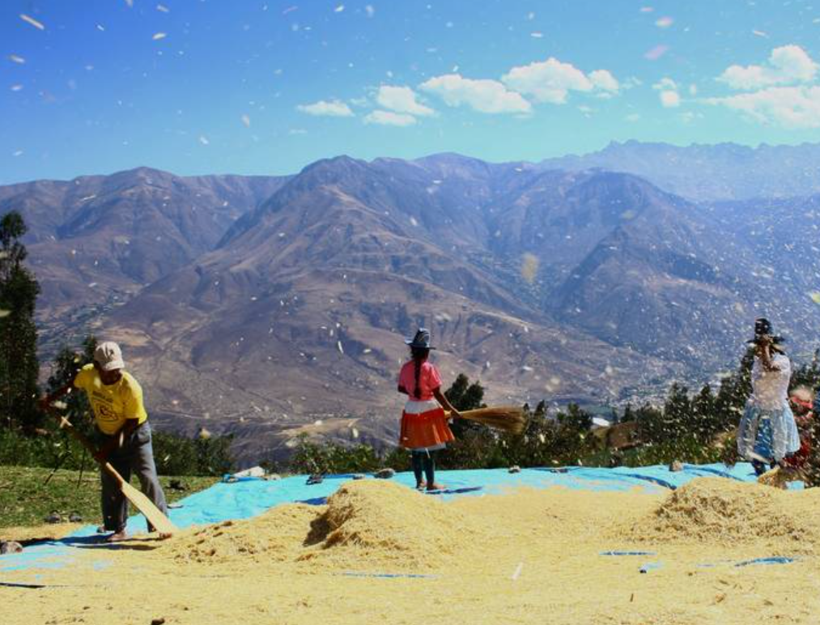
How are ways of life different in different parts of the world?

Slide 3
In cold places
This is an igloo.
An igloo is a house made from snow and ice.

Slide 4

House built on stilts

Slide 5
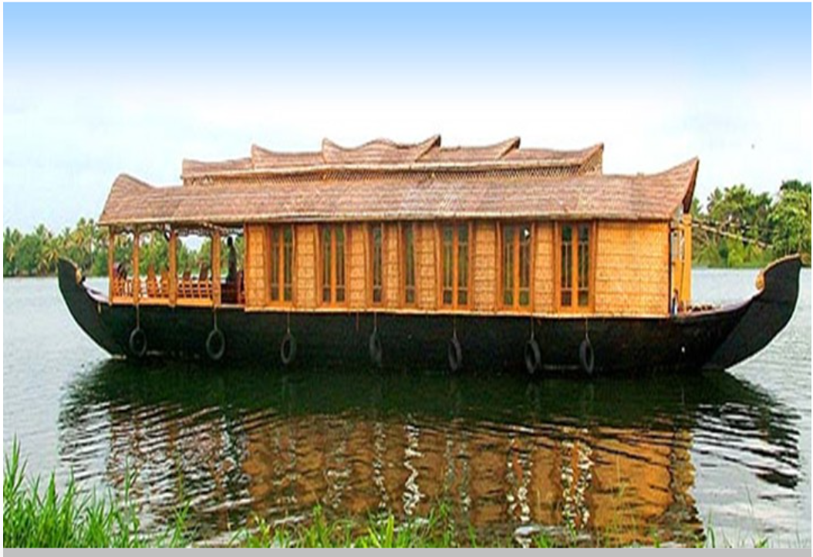
House boat

Slide 6
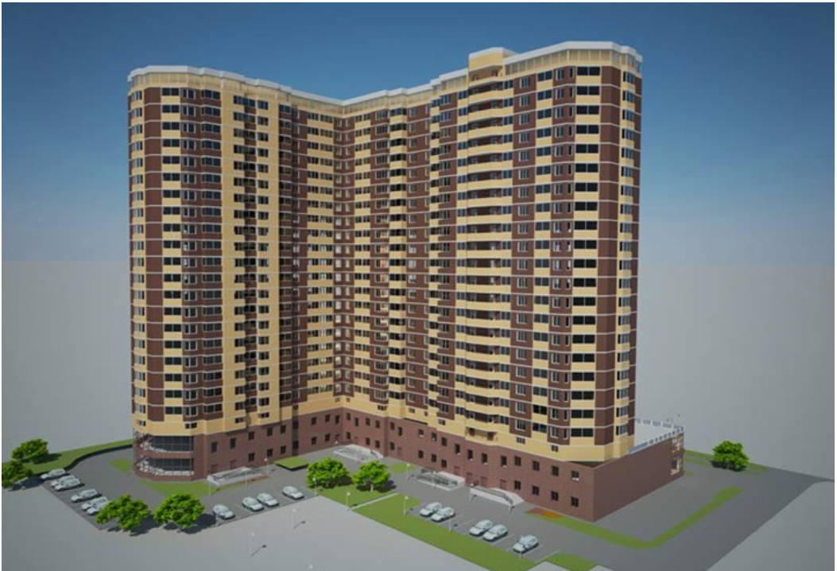
Multistoried building

Slide 7
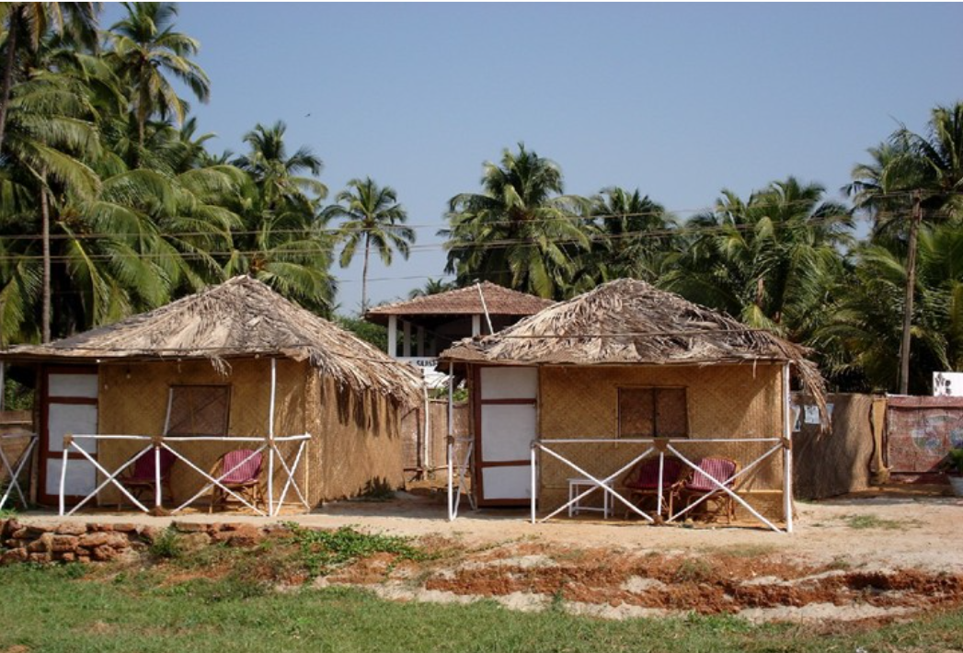
Hut

Slide 8
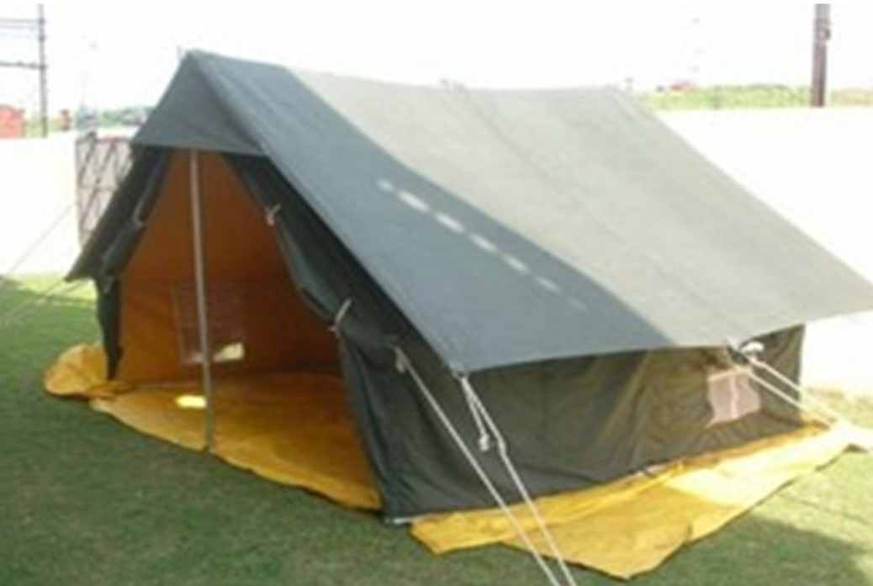
Tent (when go camping)

Slide 9

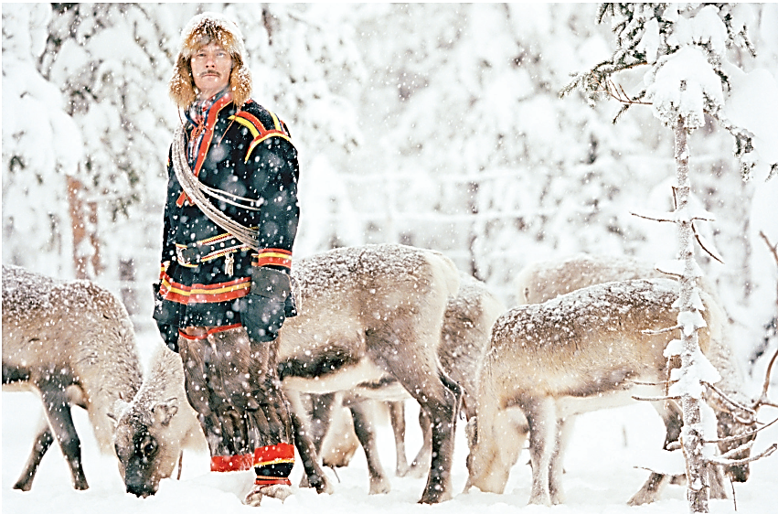
Would you like to live here?

Slide 10
Suggested answer
Student 1: Hey, have you seen those pictures of the forests in Lapland, Sweden in the winter? They look so beautiful!
Student 2: Yeah, I've seen them. But do you think you would actually want to live there?
Student 1: I think it would be amazing to live in the middle of a snowy forest, surrounded by all that natural beauty.
Student 2: But what about the cold? It gets really cold in Lapland in the winter, and it's dark most of the day.
Student 1: Yeah, but I think it would be worth it. Imagine waking up every morning to that view, and being able to go on long hikes through the forest.

Slide 11
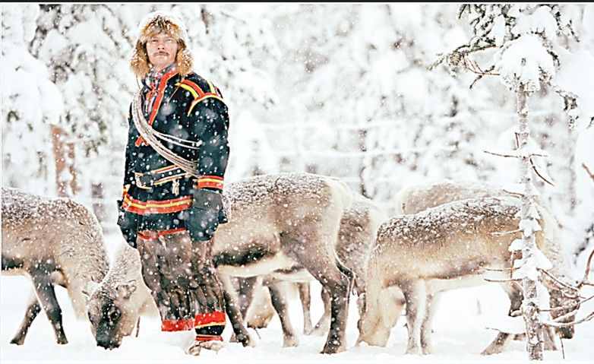
Did people use to live in this place 1,000 years ago?
1. _____ ate fish from the Arctic Ocean
2. _____ lived on small farms
3. _____ followed groups of animals, such as reindeer
4. _____ lived in houses made of wood
5. _____ had their own language and customs

Slide 12

Listen to a talk about the Sami people and choose the main idea.
The Sami people depend on animals, especially reindeer, to make a living.
Life is changing for the Sami people, but some of them still live in traditional ways.
Many young Sami people want to attend a university and choose a career.

Slide 13
Audio script (track 45)
Narrator: Imagine living at the top of northern Europe—in the cold, snowy land that extends from Norway across parts of Sweden, Finland, and Russia. It’s the land of the Sami people, and it stretches to the north, far beyond the Arctic Circle.
Traditionally, the Sami people depended on reindeer for much of their food, clothing, and protection from the cold. Instead of living in one place, the Sami people used to follow large groups, or herds, of reindeer as they searched for food. When the reindeer stopped, the Sami people put up tents to sleep in—tents made from reindeer skins.
These days, only a few Sami people herd reindeer in this way, and only a few still speak the Sami language. Now, they feed the animals on farms with fences so the reindeer can’t escape. And like people everywhere, many Sami people don’t want to live in traditional ways. They want to explore the world, attend a university, and choose a career for themselves.
For families that maintain a traditional lifestyle, however, life without reindeer is difficult to imagine. They’ve had to adapt to new technology and new laws for land use. Despite these changes, though, the work they do, the food they eat, and the customs they maintain are nearly the same as they have been for thousands of years.

Slide 14
Listen again and decide true or false
1. Traditionally, the Sami people stayed and lived in one place.
2. Reindeer were used by the Sami people for food and clothing.
3. Most Sami people still live in the traditional way.
4. Some Sami people now raise reindeer on farms.
5. New laws affect the way Sami people may use land.
T F
The Sami people followed their reindeer as they searched for food
T F
T F
Only a few Sami people live in the traditional way.
T F
T F
Despite the changes, life is nearly the same as it has been for thousands of years

Slide 15
Discuss your ideas in pairs
Do you think it’s important to maintain traditions from the past? Or do you think people should focus on the future?
Traditions are an important part of cultural heritage and can provide a sense of identity, belonging, and continuity with the past. Maintaining and preserving traditions can also help to safeguard the cultural diversity and richness of different communities around the world.
On the other hand, focusing solely on the past can sometimes hinder progress and innovation, and prevent societies from adapting to changing circumstances and evolving needs. Thus, striking a balance between preserving cultural traditions and embracing change and progress is essential.
Ultimately, whether or not it is important to maintain traditions from the past depends on the context and individual values. Some may argue that traditions should be preserved at all costs, while others may prioritize progress and innovation above all else.

Slide 16


