Slide 1
Pronunciation & communication
UNIT 9
LIFE NOW AND IN THE PAST

Slide 2
Reduction of used to
When we speak quickly, used to is sometimes pronounced /’just∂ /

Slide 3

F - Listen and repeat
1. The Sami people used to follow their herds of reindeer.
2. They used to sleep in tents.
3. They used to make the tents from reindeer skins.
4. Did the Sami use to raise sheep?
5. No, they didn't use to raise sheep, only reindeer.

Slide 4
G. Complete the sentences & Use the reduced form /'justә/.
play a lot of sports with my friends.
1. When I was younger, I used to __________________________.
2. As a child, I used to want money for ____________________.
3. In my country, people used to __________________________.
4. Before I was born, my grandparents used to __________________________________________________________.
5. As children, my parents used to ________________________.
toys and games.
celebrate certain cultural festivals in a more traditional way.
farm and grow their own food as they had a really big garden.
play a lot of board games and card games together.

Slide 5
Communication - MY WORLD
How has your culture changed? Write notes to answer the questions below.
1. Fifty years ago in your culture:
How old were men and women when they got married?
How many children did they use to have?
Where did people use to live?
What kind of jobs did people use to do?
2. How have these things changed?

Slide 6
Fifty years ago in my culture:
Men and women used to get married at a younger age, typically in their early twenties.
It was more common for families to have a larger number of children, usually four or five.
People tended to live in more rural areas, with many living in smaller villages or on farms.
Many people worked in agriculture, manufacturing, or trade jobs, with fewer opportunities in services or technology.

Slide 7
These things have changed over time
Today, the average age for marriage has increased, with many people choosing to marry in their late twenties or early thirties.
The number of children per family has decreased, with most families having one or two children.
More people live in urban areas and cities, with fewer living in rural areas.
There are more opportunities for employment in a variety of industries, including services, technology, and other fields.

Slide 8
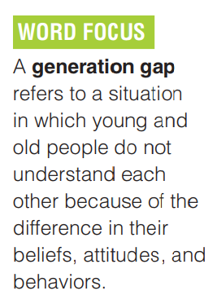
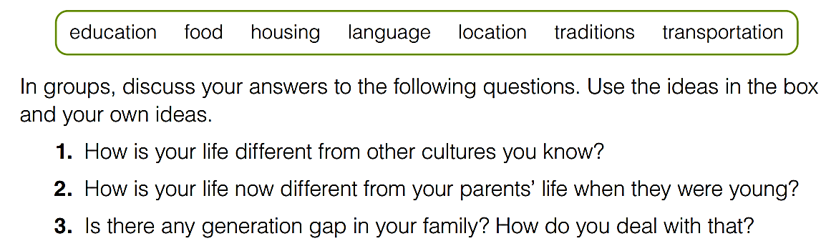
GOAL CHECK
Contrast Different Ways of Life

Slide 9


