Slide 1
Language expansion grammar
UNIT 9
LIFE NOW AND IN THE PAST

Slide 2
Separable phrasal verbs
E.g.:
Pick up your book.
Pick the book up.
Pick it up!

Slide 3
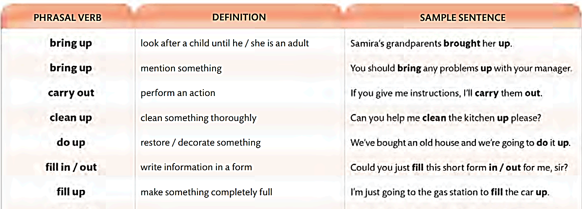
Common separable phrasal verbs

Slide 4
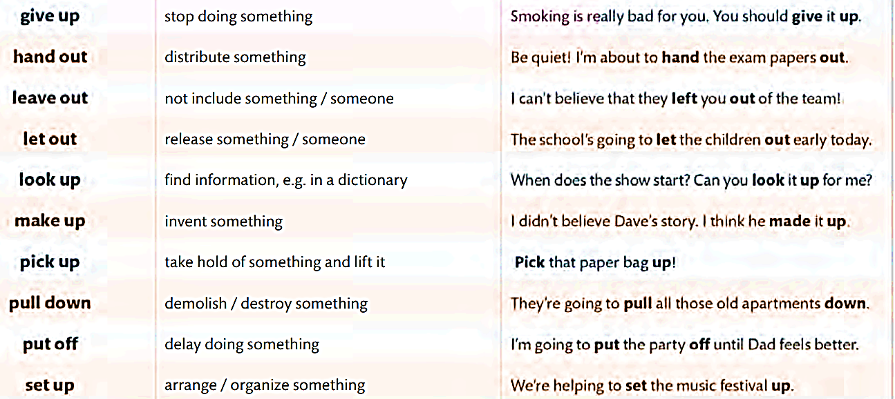
Common separable phrasal verbs

Slide 5
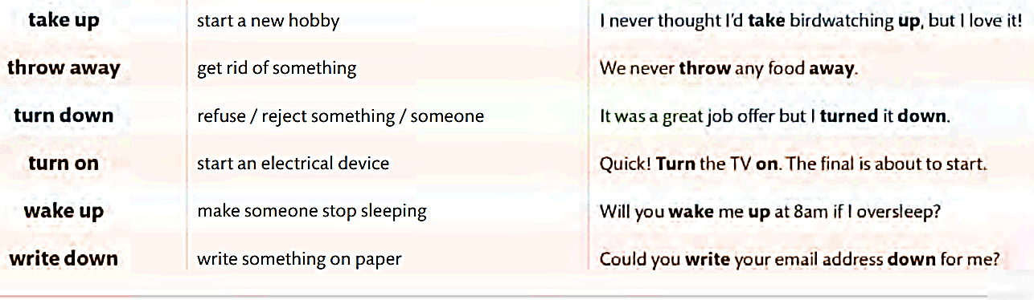
Common separable phrasal verbs

Slide 6
A – complete the paragraph
bring back bring up figure out help out put on turn on
Hi, my name is Susie, and I live in the Nunavut Territory in Canada. Life in Nunavut hasn't changed as much as it has in other places. It's true that nowadays we can (1) _________ (start) the furnace when it gets cold instead of building a fire, but we haven't given up our traditional culture. We still (2) __________ (raise) our children in the land our people have lived on for thousands of years. We teach them to (3) _________ (wear) our traditional clothing to stay warm in the winter. When they're old enough, we teach them to (4) ____________ (discover, solve) solutions to everyday problems. We teach them to (5) ____________ (return) anything they borrow. And most importantly, we teach them to always (6) __________ (aid) their family and their community. Those things will never change.
turn on
bring up
put on
figure out
bring back
help out

Slide 7
B. Answer the questions
Use pronouns and the separable phrasal verbs in A
1. What do you do with children?
2. What do you do with shoes?
3. How do you assist your friends?
4. How do you understand something?
5. What do you do with a borrowed book?
6. What do you do to the heater when it’s cold?
We bring them up.
We put them on.
We help them out.
We figure it out.
We bring it back.
We turn it on.

Slide 8
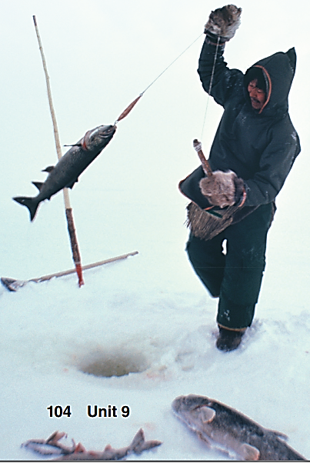
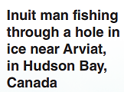
grammar
Parents taught their children to fish
through holes in the ice.
=> active/passive?
=> past or present?
Children were taught to fish through holes in the ice (by their parents).
By + O => used when the agent is important or unusual

Slide 9
Grammar – passive voice in the past
used for completed events or processes that took place before the present.
Form:
S + was/were + V_ed2. (+)
S + wasn’t/weren’t + V_ed2 (-)
(Wh_) Was/Were + S + V_ed2 (?)
E.g.: Paper money wasn’t invented in Europe; it was invented in China.
By + O => emphasize who/what did the activity
The Sami languages were recognized by the Swedish government in 2000.

Slide 10
C. Match the sentence parts.
1. Paper money _____ | a. from reindeer skins
2. Explorers _____ | b. in China
3. The Sami tents _____ | c. by the Sami people
4. Fires _____ | d. when it was cold
5. Reindeer _____ | e. by Marco Polo’s stories
b
e
a
d
c
1. Paper money was invented in China.
2. Explorers were inspired by Marco Polo’s stories.
3. The Sami tents were made by the Sami people.
4. Fires were built when it was cold.
5. Reindeer skins were used for paper money.

Slide 11
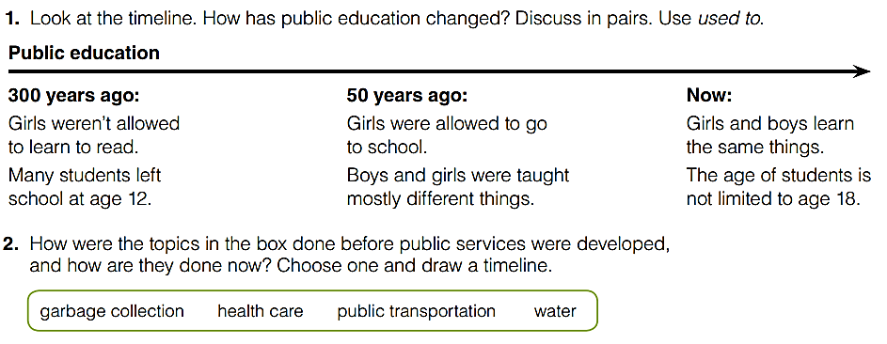
Goal check talk about how things were done in the past

Slide 12
1. How has public education changed?
In the past, girls weren't allowed to learn to read, and many students left school at the age of 12.
Nowadays, girls are allowed to go to school, and boys and girls learn the same things.
Also, the age of students is not limited to 18.
We used to have a very different educational system than what we have now, and it has changed a lot over the years.

Slide 13
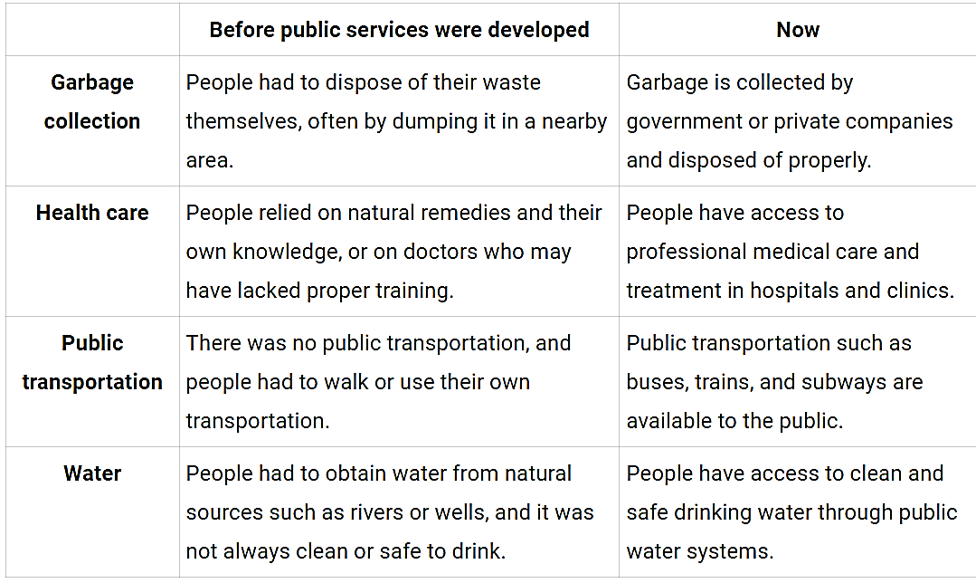
2. How were the topics in the box done before public services were developed, and how are they done now?

Slide 14


