Slide 1
reading
UNIT 9
LIFE NOW AND IN THE PAST

Slide 2
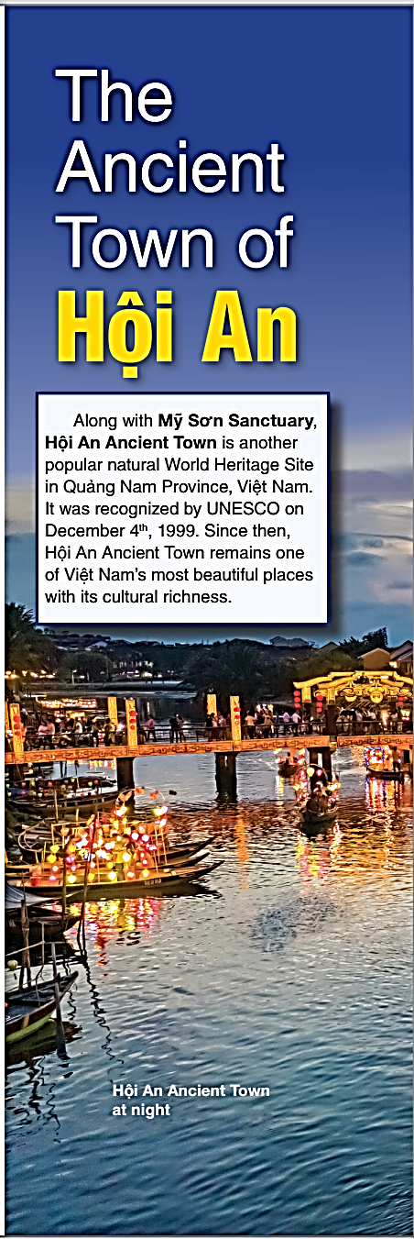
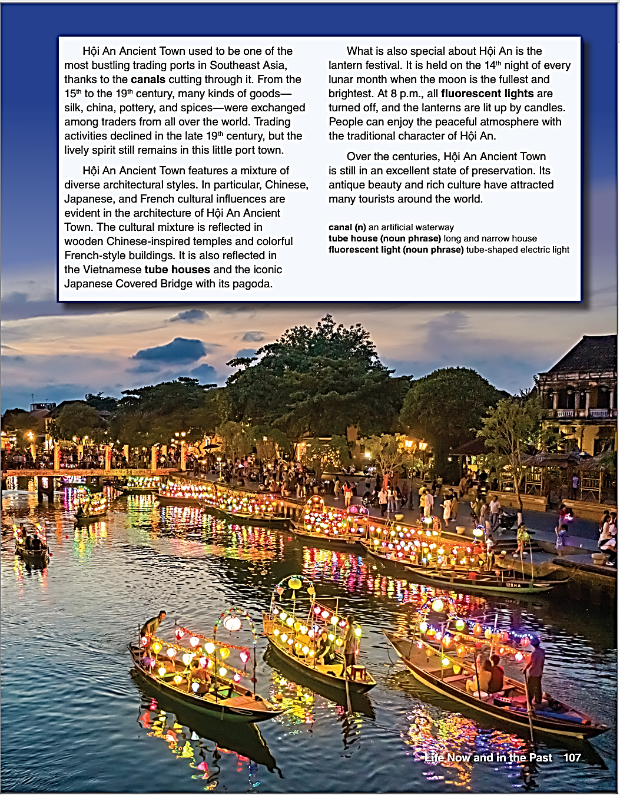

Slide 3
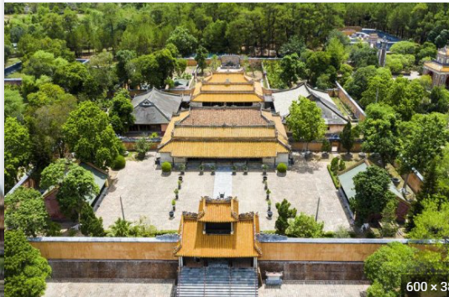
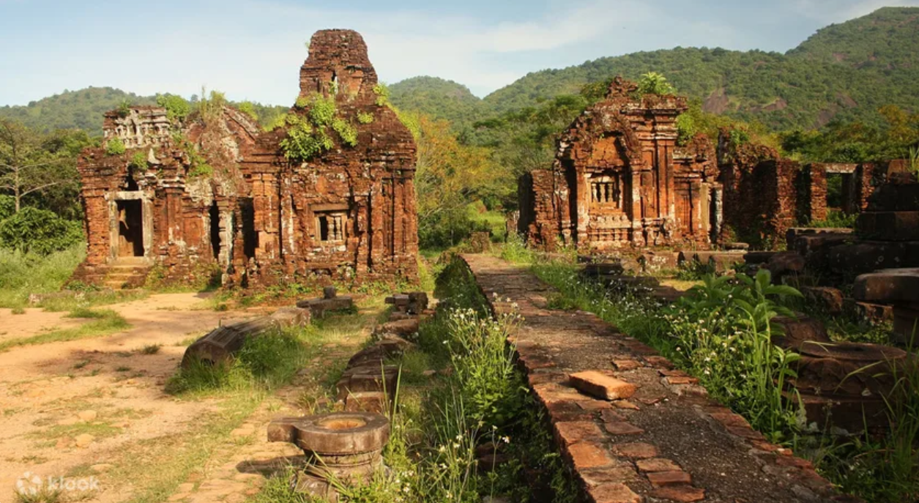



A. MY WORLD – work in pairs

Slide 4
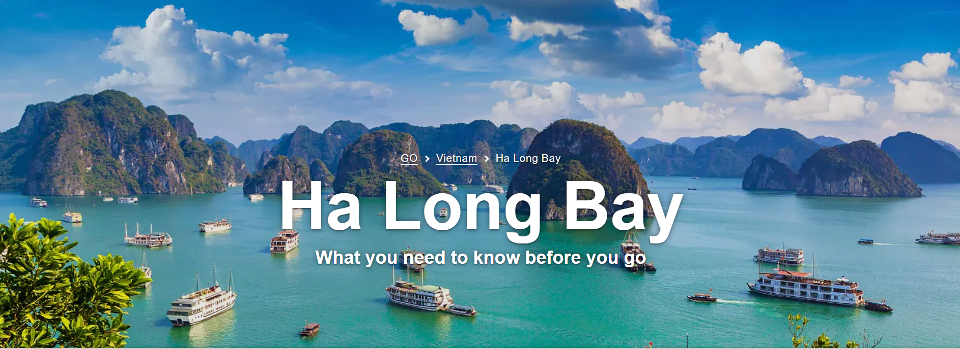
A. MY WORLD – work in pairs

Slide 5
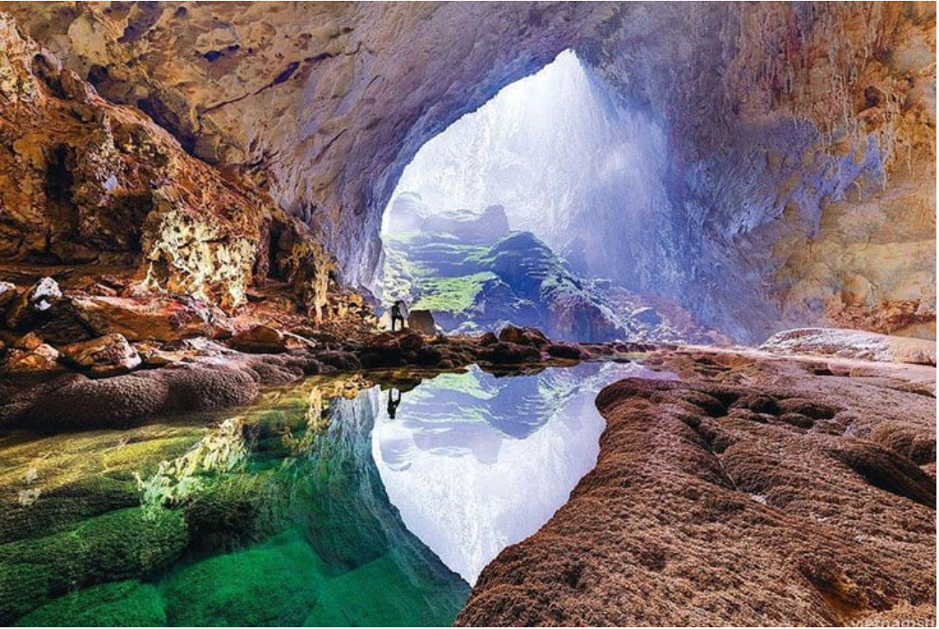
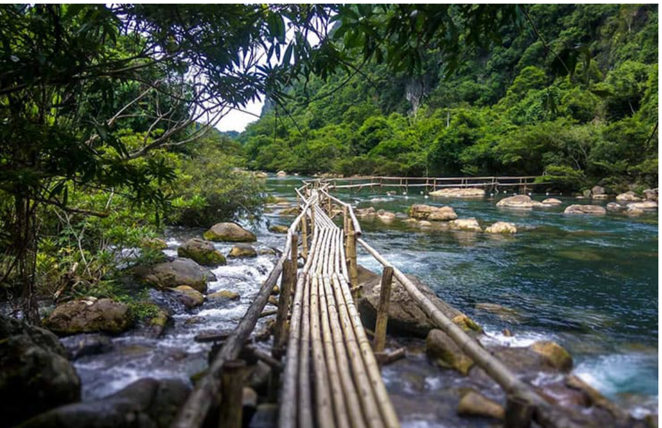
Phong nha – Ke Bang National park

Slide 6
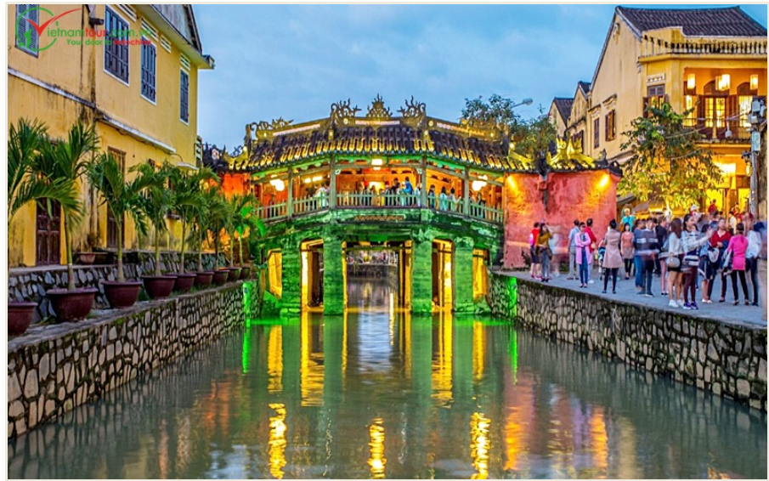
Hoi An Ancient Town

Slide 7


Slide 8
Listen and repeat
Sanctuary (n) thánh địa
Heritage (n) di sản
Architecture (n) kiến trúc
Lantern (n) đèn lồng
Well-preserved (adj) được bảo tồn tốt
Canal (n) kênh đào
China (n) đồ sứ
Pottery (n) đồ gốm
Cultural mixture (n) sự pha trộn về văn hóa
Tube house (n) nhà ống (hẹp chiều ngang)
Fluorescent light (n.phrase) đèn huỳnh quang
Atmosphere (n) bầu không khí

Slide 9
B. Read the article. Circle True or false
My Son Sanctuary and Hoi An Ancient Town are World Heritage Sites in Quang Nam Province.
Hoi An Ancient Town used to be a trading port.
The architecture of Hoi An is affected by only one culture.
Hoi An lantern festival is held every night.
Hoi An Ancient Town is well-preserved.
T F
T F
T F
multiple cultures
T F
on the 14th night of every lunar month
T F

Slide 10
C. Answer the questions
When did UNESCO recognize Hoi An Ancient Town as a world heritage site?
Which goods were exchanged in Hoi An trading port?
What are the diverse cultural influences on the architecture of Hoi An?
What happens during the night of Hoi An lantern festival?
What attracts many tourists to Hoi An Ancient Town?
…. on December 4th, 1999.
Silk, china, pottery, and spices were exchanged in Hoi An trading port.
The architecture of Hoi An reflects diverse cultural influences, including Chinese, Japanese, French, and Vietnamese.
During the night of Hoi An lantern festival, fluorescent lights are turned off, and the lanterns are lit up by candles, creating a peaceful atmosphere with the traditional character of Hoi An.
The antique beauty and rich culture of Hoi An Ancient Town attract many tourists around the world.

Slide 11
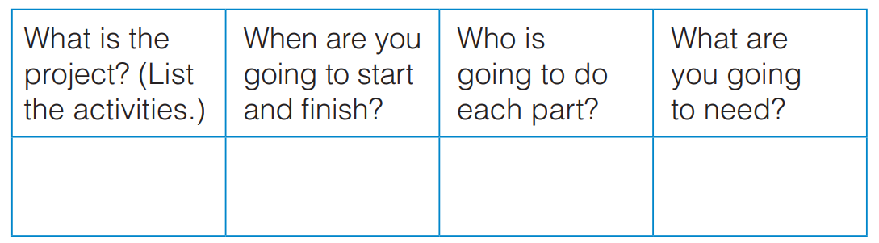
Goal check - plan one of these projects
A campaign to help preserve the antique beauty of Hoi An Ancient Town.
An event for landscape preservation in Viet Nam.

Slide 12


