Slide 1
communication
UNIT 9
LIFE NOW AND IN THE PAST

Slide 2
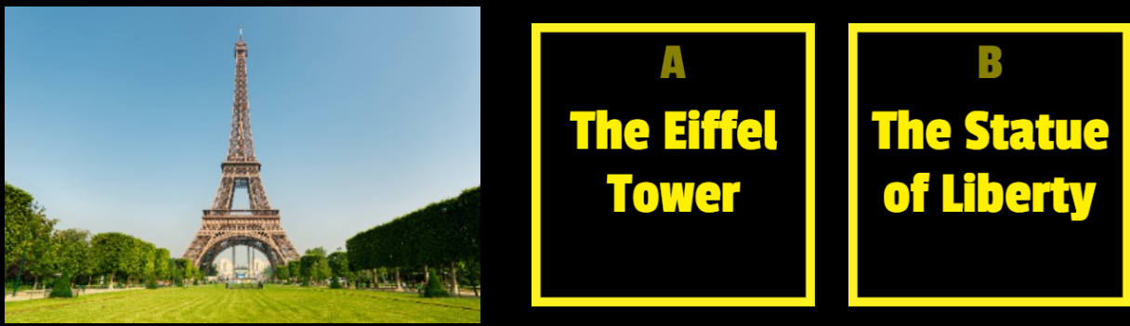

Warm-up – do you know this place?

Slide 3
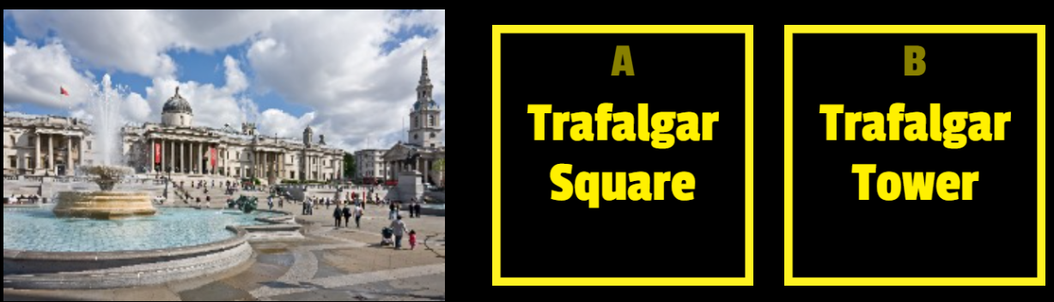
Warm-up – do you know this place?

Slide 4
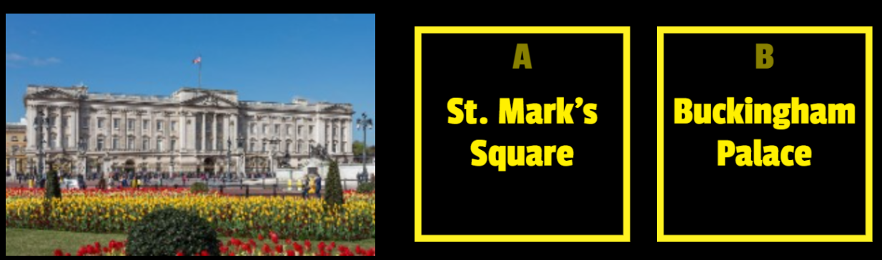
Warm-up – do you know this place?

Slide 5
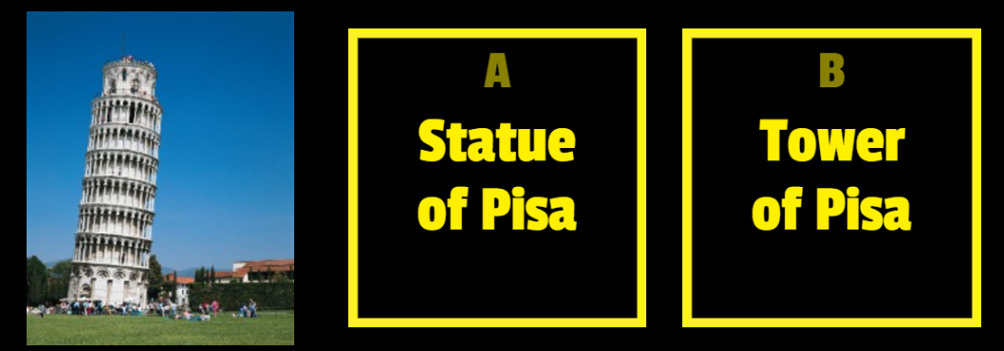
Warm-up – do you know this place?

Slide 6
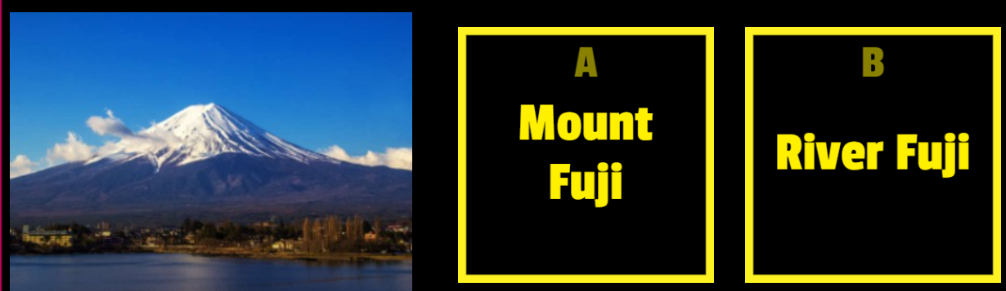
Warm-up – do you know this place?

Slide 7
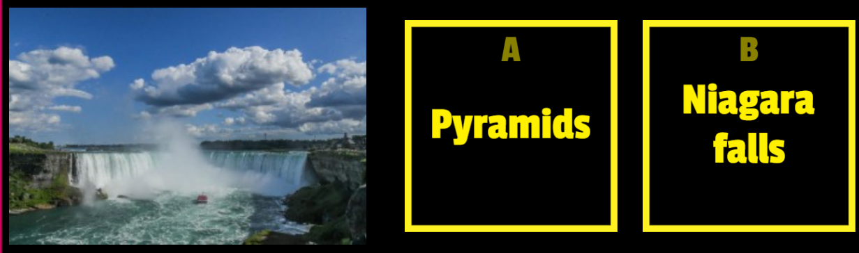
Warm-up – do you know this place?

Slide 8
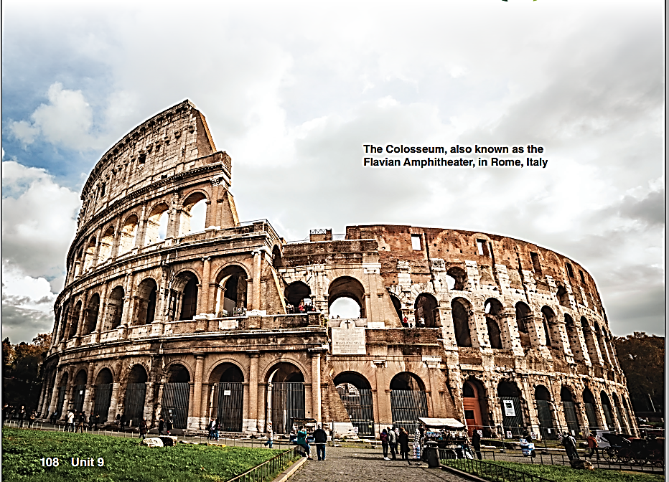
What is this place?
Where is it?
What do you know about it?
The Colosseum is one of the World Wonder

Slide 9
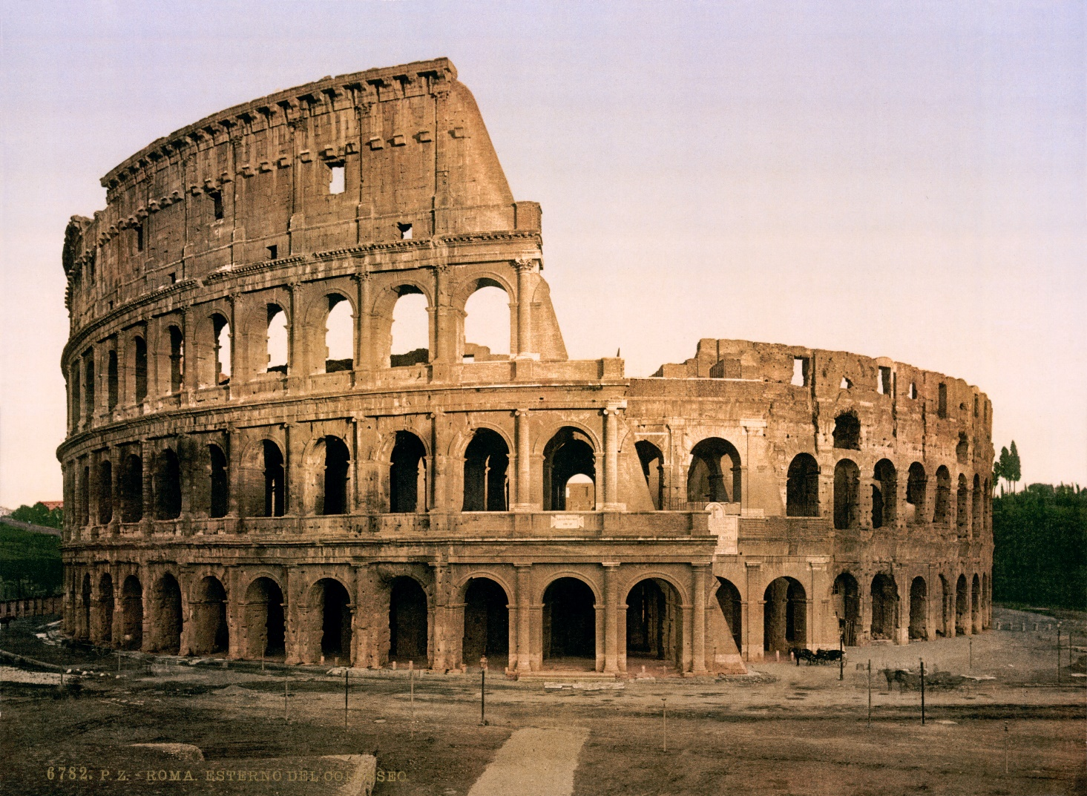
The Colosseum – A World Historical Wonder
Historical wonders are the most impressive structures known and were significant to the history

Slide 10
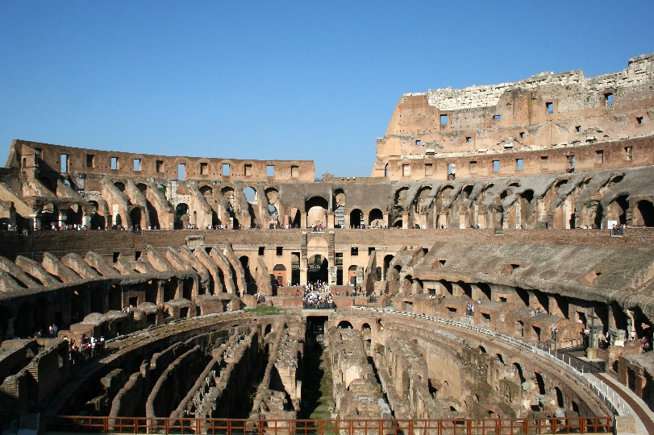
The Colosseum
Built: between AD72 and AD80
largest amphitheatre ever built. (An amphitheatre is a round performance space usually used for theatre or sports, with banks of seats for the audience around the outside.)
Structure: made of concrete and sand, damaged over time by vandalism and earthquakes.
Seating up to 80,000 spectators
Famous for gladiator contests, public executions and dramatic re-enactments of battles.
The majority of the Colosseum remains intact and remains the focal point of Rome, Italy’s capital city.
Other uses:
for drama and Greek plays.
used as an entertainment venue since medieval times
now mainly a religious venue and a tourist destination, welcoming approximately 4.2 million visitors every year.

Slide 11
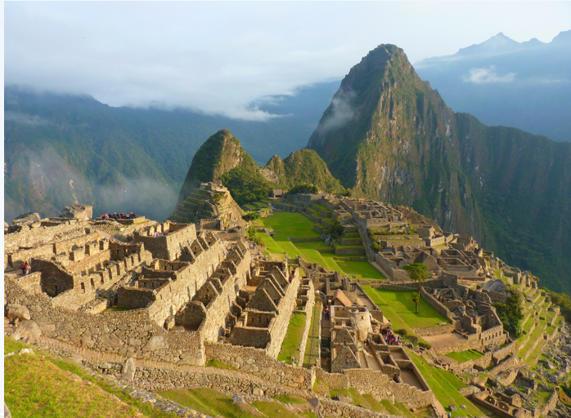
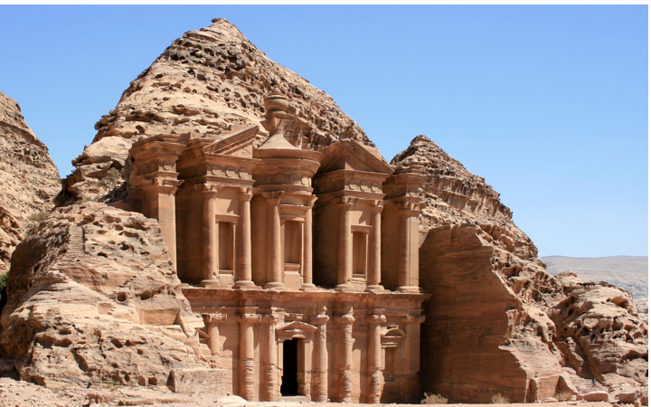
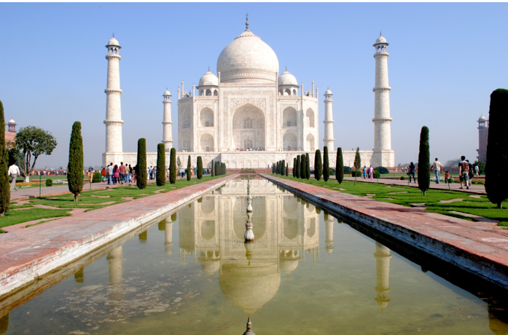



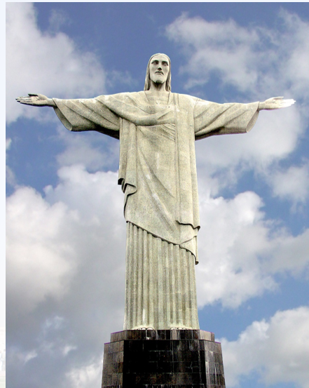
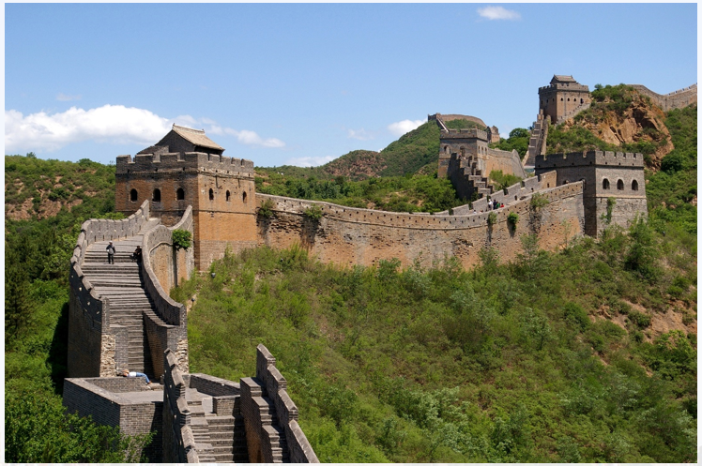
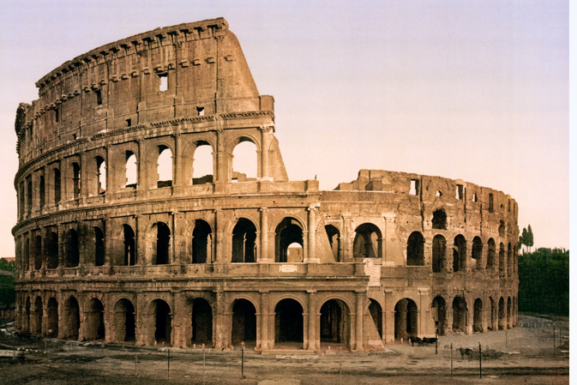


Historical wonders of the world
the citadel for an Incan Emperor in Peru

Slide 12







How can I describe my reaction to a historical wonder?
Ah, I will use these adjectives:

Slide 13
samples
Student 1: Hey, have you ever seen the Great Wall of China? I saw a picture of it in my history textbook and it looks amazing!
Student 2: Yeah, I've been there with my family. It's truly awe-inspiring. I felt so small standing next to it.
Student 1: That's so cool! I can imagine it must be overwhelming to see something so massive and ancient.
Student 2: Absolutely. It's also inspiring to think about the amount of work and dedication that went into building it.
Student 1: I totally agree. When I see these wonders, I feel a sense of gratitude towards the people who built them and preserved them over the centuries.
Student 2: Yes, and it's also intriguing to think about the stories and mysteries behind these structures. Like, who built Stonehenge and for what purpose?
Student 1: Right! I think that's what I love most about historical wonders - the sense of wonderment and fascination they inspire.
Student 2: Definitely. And another word I would add to the list is "amazement" - these wonders are just so incredible and mind-blowing.

Slide 14

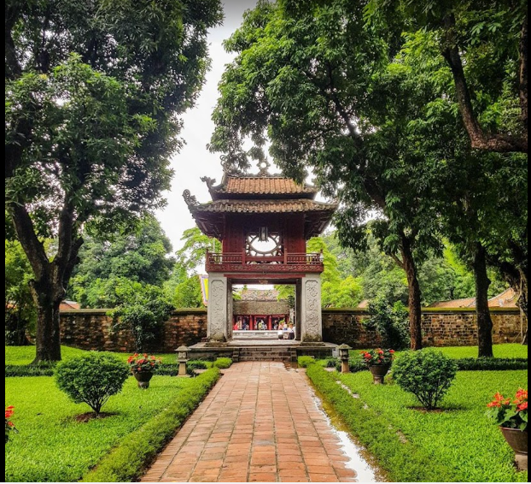

What amazing things did people create in the past?
a complex of buildings, including several courtyards, pagodas, and pavilions, as well as statues and inscriptions honoring Vietnamese scholars and sages
- It was built in 1070 during the reign of Emperor Lý Thánh Tông
- Its original purpose was to honor Confucius and his followers, and to provide a place for learning and scholarship.
When I see the Temple of Literature, I feel a sense of reverence and respect for the long history and cultural significance of this place. It's amazing to think about how it has been a center of education and scholarship for almost a thousand years.
The Temple Of Literature

Slide 15
My wonder – the temple of literature
The Temple of Literature is a complex of buildings in Hanoi, Vietnam that has a long history and cultural significance. It was built in 1070 during the reign of Emperor Lý Thánh Tông and originally served as a place of learning and scholarship to honor Confucius and his followers. The temple is designed in traditional Vietnamese style with wooden beams, red lacquered columns, and curved roofs. It also features several courtyards, pagodas, and pavilions, as well as statues and inscriptions honoring Vietnamese scholars and sages.
When I see the Temple of Literature, I feel a strong sense of reverence and respect for the long history and cultural significance of this place. It's incredible to think that it has been a center of education and scholarship for almost a thousand years. The intricate details and beautiful architecture also make me feel inspired and in awe of the skill and creativity of the people who built it. I feel proud to be Vietnamese and to have such a rich cultural heritage. Have you ever been to the Temple of Literature?

Slide 16


