Slide 1
writing
UNIT 9
LIFE NOW AND IN THE PAST

Slide 2
Warm-up
Some old villages in Hue city are picturesque.
in/are/city/old/Some/Hue/picturesque/villages.
country/a/visit/to/Vietnam/is/amazing
people/to/live/in/Hanoi/is/think/fascinating/city/a/Many.
is/the/traffic/with/Da/flow/bustling/of/city/Nang.
in/the/travel/family/my/fascinating/is/summer/to/with/It.
are/historic/buildings/because/there/visit/there/to/is/Hue/ wonderful/a/many/city.
are/bustling/and/Hanoi/city/cities/Minh/Ho/Chi.
many/Vietnam/beautiful/are/in/There/places.
Vietnam is an amazing country to visit
Many people think Hanoi is a fascinating city to live in.
Da Nang city is bustling with a flow of traffic.
It is fascinating to travel with my family in the summer.
Hue is a wonderful city to visit because there are many historic buildings there.
Hanoi and Ho Chi Minh city are bustling cities.
There are many beautiful places in Vietnam.

Slide 3
New seven wonders of the world
What does it mean to be a "wonder of the world"? Both the Seven Wonders of the Ancient World and the New Seven Wonders are examples of humankind's greatest achievements. They include historical sites that show the incredible things we are capable of creating. Of the original Seven Wonders, only the Great Pyramid in Giza, Egypt, still exists, so Swiss-Canadian filmmaker and adventurer Bernard Weber started the New Seven Wonders of the World project. He wanted the greatest achievements of the last 2,000 years to be recognized now and remembered in the future. He also wanted regular people to decide on these new wonders by voting over the phone and internet. The project began in the year 2000, and the results were announced in 2007 with nearly 100 million votes. The new wonders include the Great Wall of China, the Colosseum in Rome, and the Taj Mahal in India.

Slide 4
Complete the description using adjectives
The Great Wall of China was voted one of the New Seven Wonders of the World, and it is also a UNESCO World Heritage Site. It is really (1) ___________ - some parts were built in the 3rd century BCE – and it is (2)_______ - it is more than 20,000 kilometers (12,430 miles) long. Architecturally, it is an (3)_________ construction. The Chinese built the wall over the centuries to protect their country. At the beginning of the 13th century, China was attacked by Genghis Khan's army, because Khan wanted China to be part of the Mongol Empire. His grandson, Kublai Khan, finally achieved this in 1276. Because of historic events like this, China continued to make the wall (4) _________ and better up to the 17th century. It is now one of the world's most (5) ________ landmarks. I was very (6)__________ to read about the Wall’s history and I was (7) ____________when I saw it.
ancient
huge
amazing
stronger
famous
interested
amazed

Slide 5
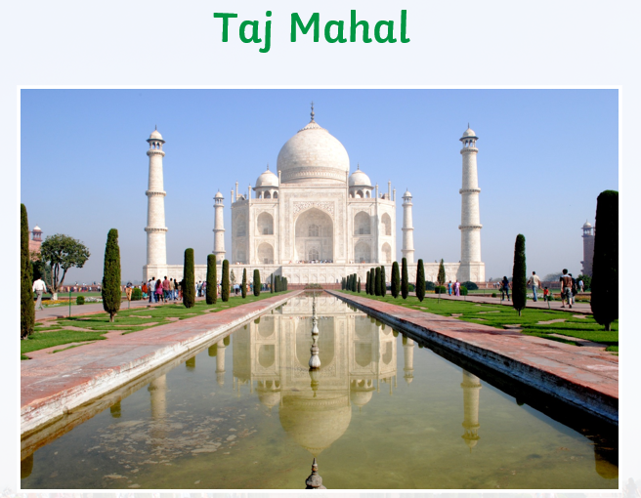
New seven wonders of the world

Slide 6
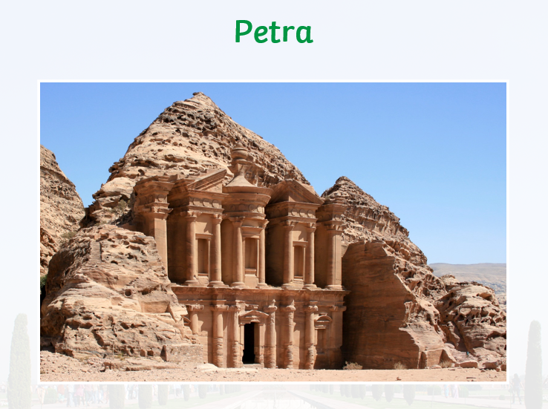
New seven wonders of the world

Slide 7
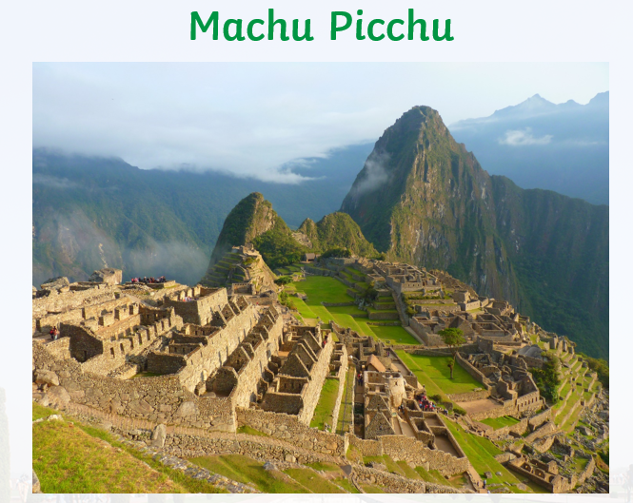
New seven wonders of the world

Slide 8
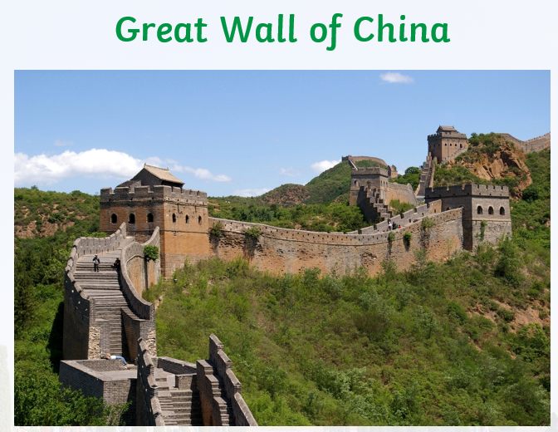
New seven wonders of the world

Slide 9
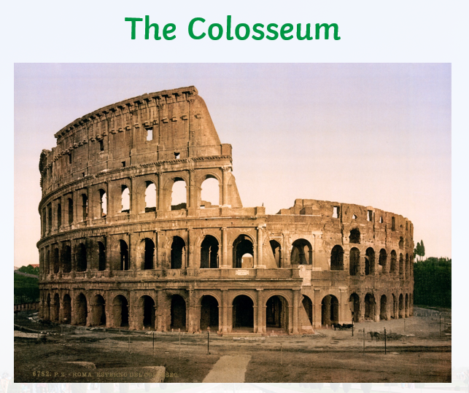
New seven wonders of the world

Slide 10
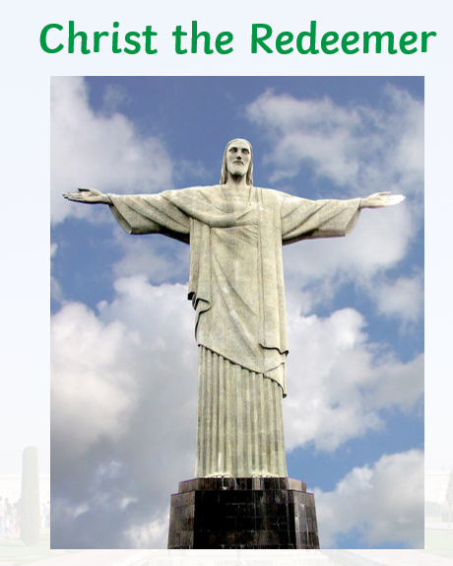
New seven wonders of the world

Slide 11
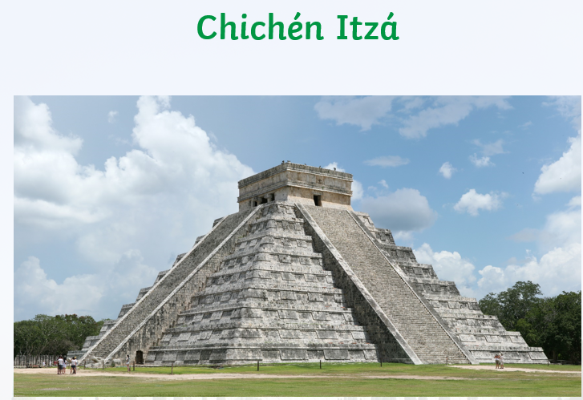
New seven wonders of the world

Slide 12
Writing – describe a historical wonder
In your notebook, write a description (150-180 words) of the site. Use your own words, including adjectives, to describe your reaction to the site. Use the paragraph in F to help you.
Share your description with a partner. Talk about the information that is interesting or surprising to you.

Slide 13
sample – describe a historical wonder
The Taj Mahal is a breathtakingly beautiful historical monument that stands as a testament to the eternal love of the Mughal Emperor Shah Jahan for his beloved wife Mumtaz Mahal. Located in the Indian city of Agra, this magnificent white marble structure is renowned for its intricate carvings, inlaid designs made of precious stones, and its peaceful surroundings.
At the center of the Taj Mahal lies the main building, with its iconic central dome and four towering minarets. The structure is surrounded by lush gardens and a tranquil reflecting pool that mirrors the grandeur of the monument. The interior of the Taj Mahal is equally impressive, with elaborate designs, intricate patterns, and calligraphy adorning the walls and ceilings.
The Taj Mahal is a symbol of timeless love, architectural brilliance, and cultural heritage. It continues to inspire awe and wonder in visitors from around the world, and its significance and beauty have earned it the status of a UNESCO World Heritage Site. A visit to the Taj Mahal is a once-in-a-lifetime experience that offers a glimpse into the grandeur of the Mughal era and the power of enduring love.

Slide 14
Peer- review Check-list
1. Appropriateness
2. Content
3. Organization
4. Format
5. Self-checking for grammar and spelling

Slide 15


