Slide 1
opener & vocabulary
UNIT 10 - TRAVEL

Slide 2
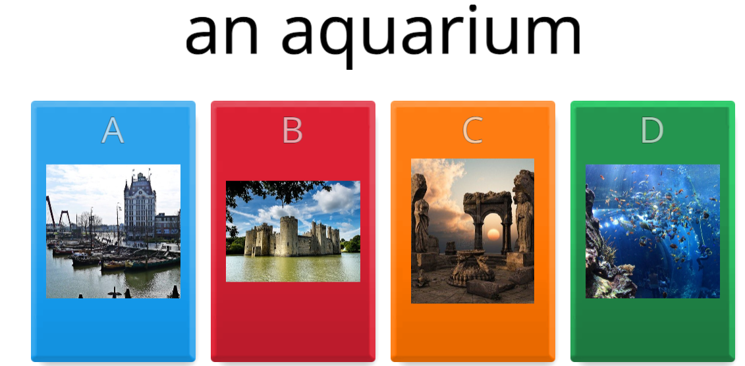
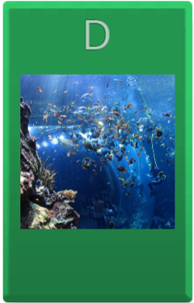
Warm-up

Slide 3
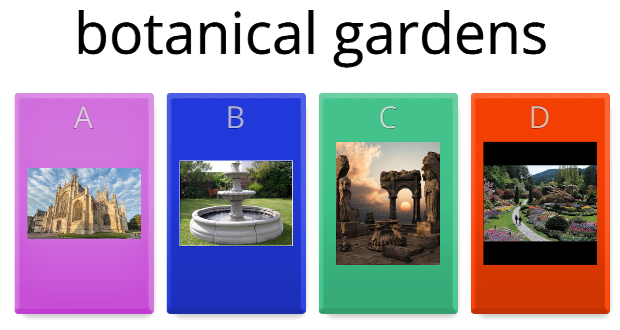

Warm-up

Slide 4
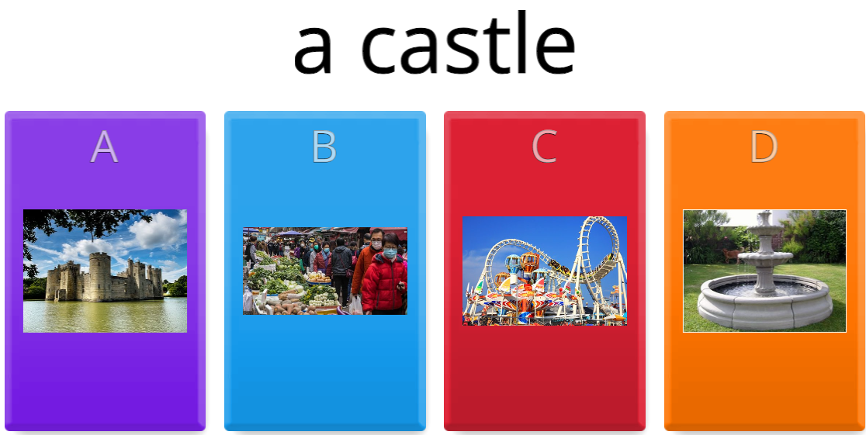
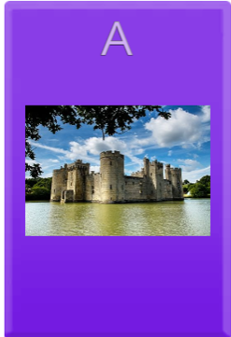
Warm-up

Slide 5
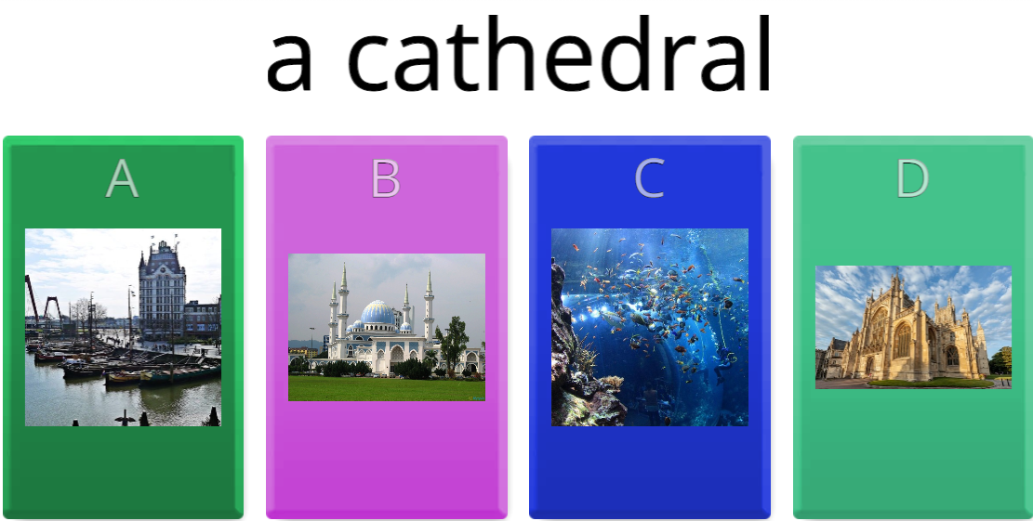
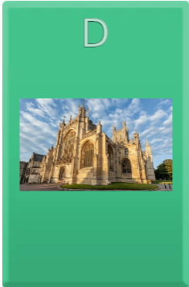
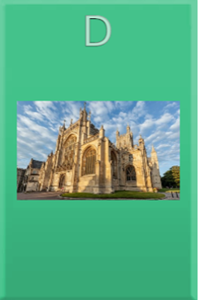
Warm-up

Slide 6
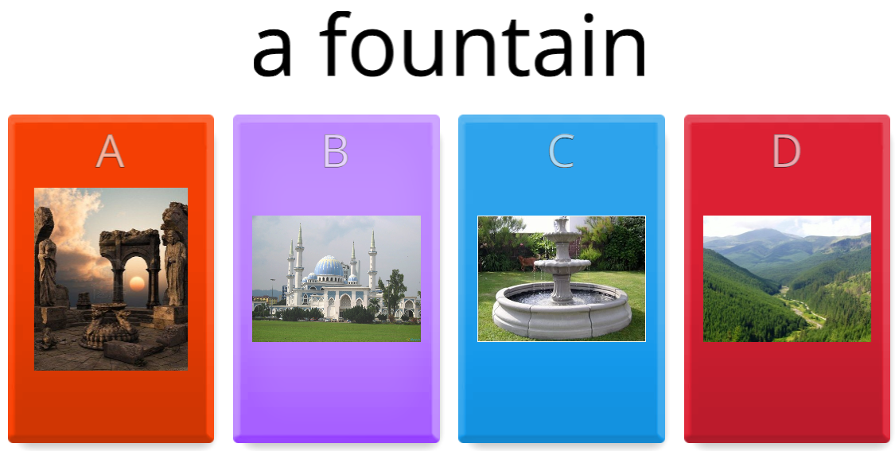
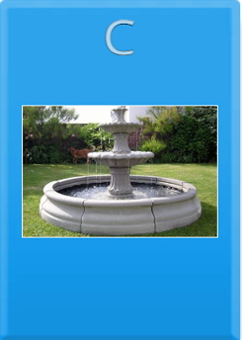
Warm-up

Slide 7
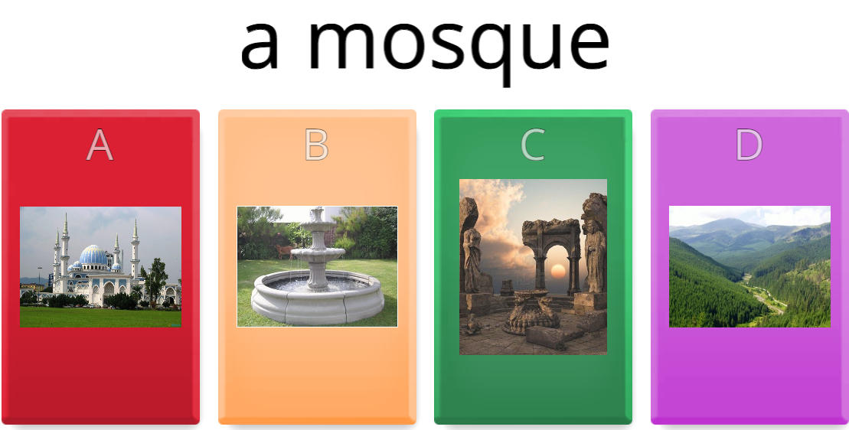
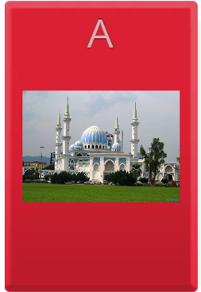
Warm-up

Slide 8
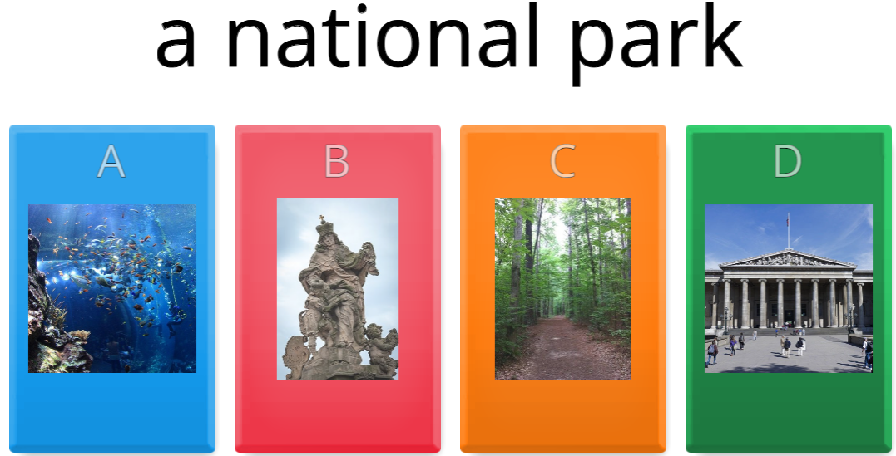
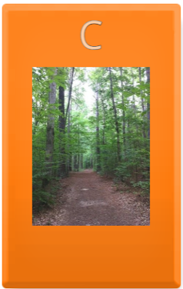
Warm-up

Slide 9
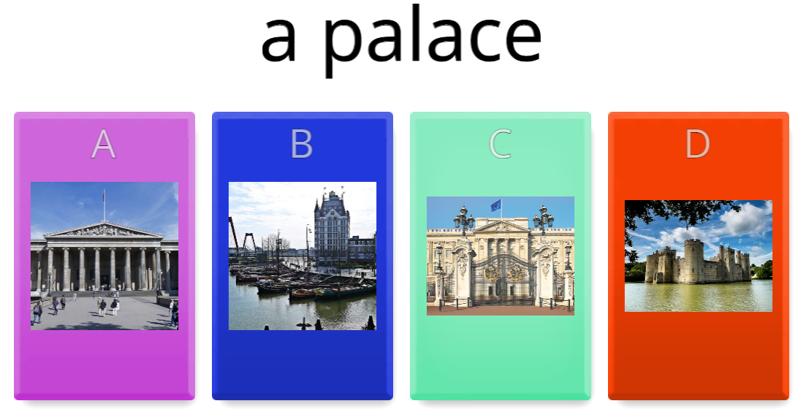
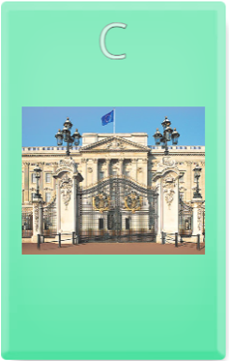
Warm-up

Slide 10
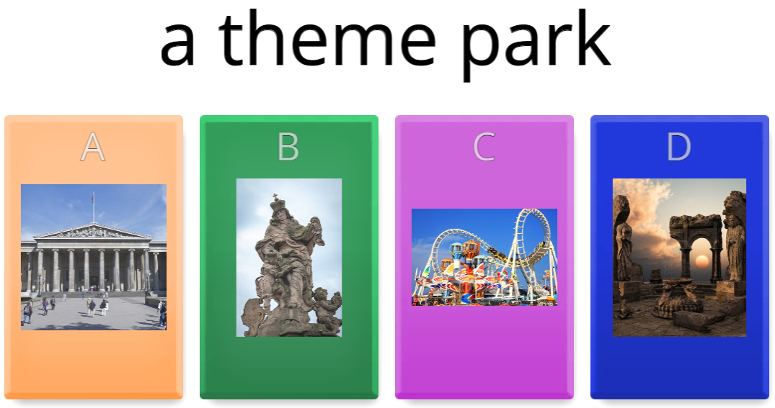
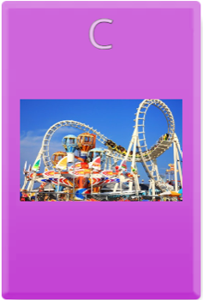
Warm-up

Slide 11
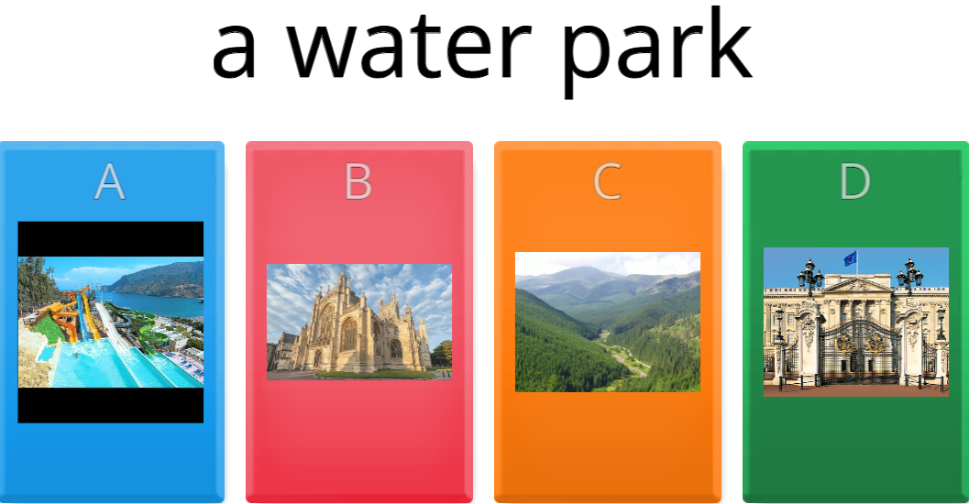
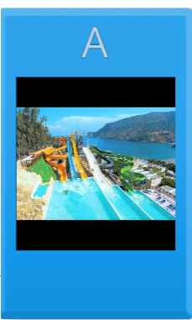
Warm-up

Slide 12
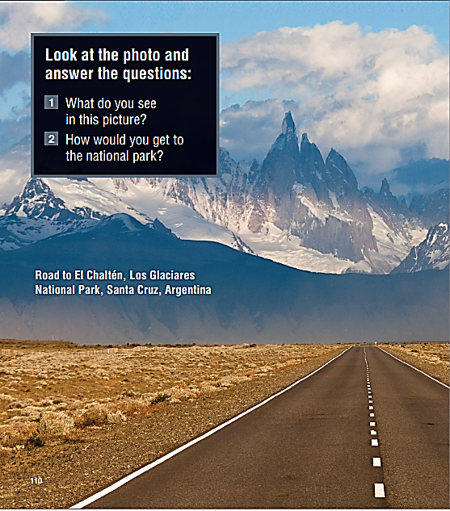
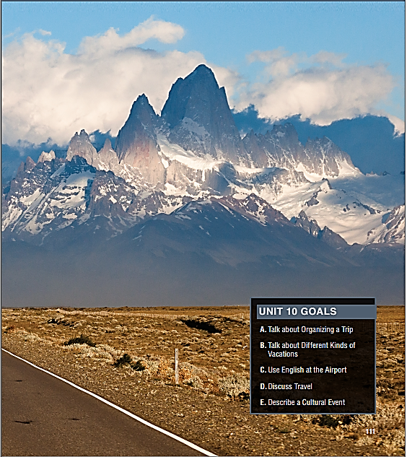
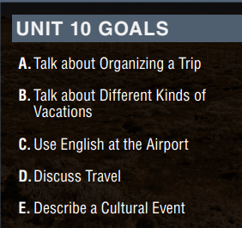

Slide 13
About the Photo
This photo shows one of the roads into Los Glaciares National Park, located in the Patagonian Andes in southwest Argentina. The park was recognized as a UNESCO World Heritage Site in 1981 because of its incredible natural beauty.
It covers an area of 600,000 hectares of magnificent mountains, huge glaciers, and glacial lakes. The most famous glacier in the park is the 200-foot-tall (70-meter-tall) Perito Moreno Glacier, which collapses into Lake Argentino every three to four years. Many tourists visit the
park in mid-March, hoping to watch the glacier fall into the water below it.

Slide 14
Planning/organizing a trip
Buy ticket(s)
Look for a hotel
Pack
Get passport
Apply for a visa (if travel abroad)
Etc.

Slide 15
Question & Answer
Why is it easier to plan a trip now?
What are the four steps for planning a trip?
The Internet makes it easier to plan a trip online.
Step 1: choose your destination
Step 2: book a flight
Step 3: make a reservation
Step 4: apply for a visa

Slide 16
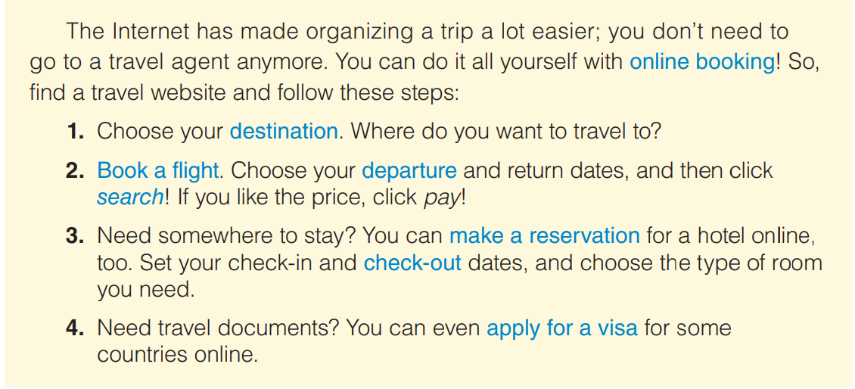
vocabulary

Slide 17
Listen and repeat
Destination (n) điểm đến du lịch
Book a flight (v phrase)
Departure (n) khởi hành
Search (v) tìm kiếm
Make a reservation (v phrase) đặt chỗ/trước
Check-out (n) thủ tục trả phòng
Apply for a visa (v phrase) xin thị thực (nhập cảnh)
Book online (n phrase) đặt trực tuyến

Slide 18
Read the text and complete each sentence with a blue word
1. When you search, you look for something.
2. You _________________ to get permission to enter a country.
3. The date you start your trip is your ___________ date.
4. _____________ is when you pay and leave the hotel you have stayed at.
5. The place you travel to is your ___________.
6. With _________________, you can buy plane tickets and find a place to stay on the Internet.
7. When you buy a plane ticket, you ______________.
8. When you __________________________, you arrange a service in advance.
apply for a visa
departure
check-out
destination
online-booking
book a flight
make a reservation

Slide 19
B. Complete each collocation with a blue word from the text.
1. ______________ a hotel
2. ______________ for a passport
3. ________________ time
4. ______________ a tour
5. ______________ for
book
apply
check-out/departure
book
search/apply

Slide 20


