Slide 1
grammar
UNIT 10 - TRAVEL

Slide 2
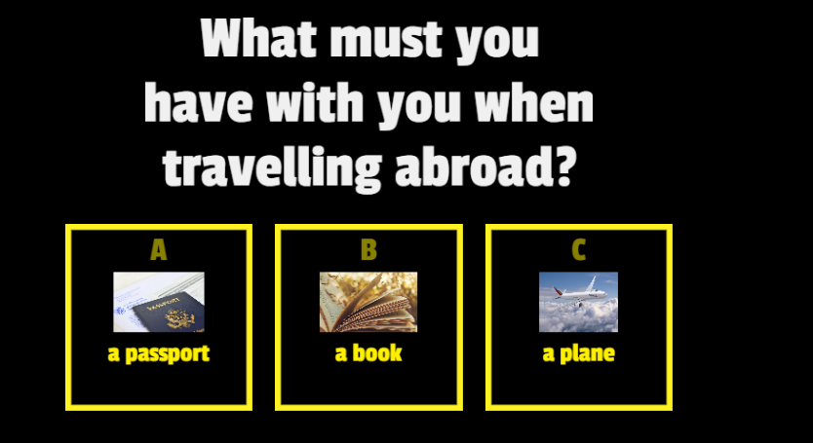

Warm-up

Slide 3
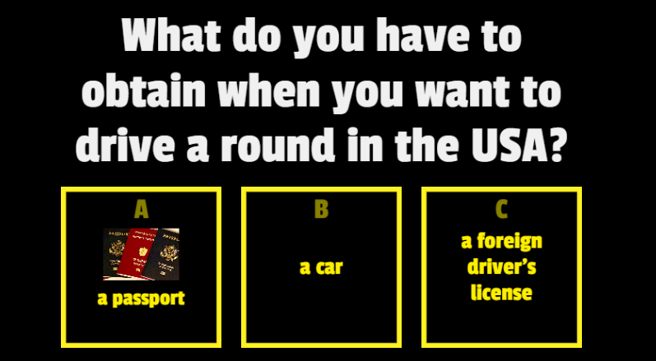
Warm-up

Slide 4
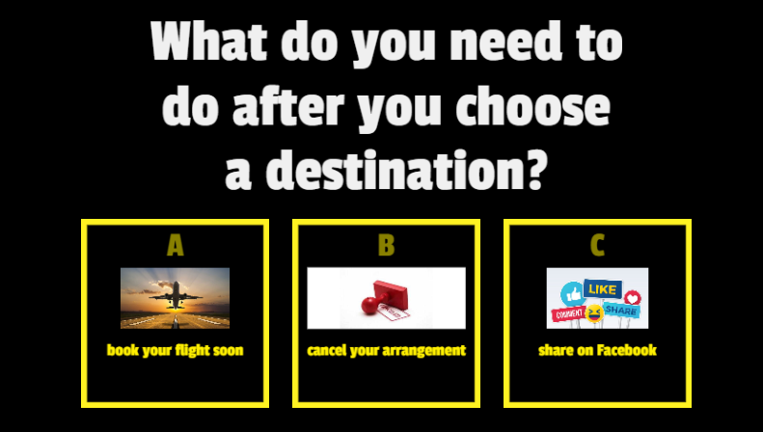
Warm-up

Slide 5
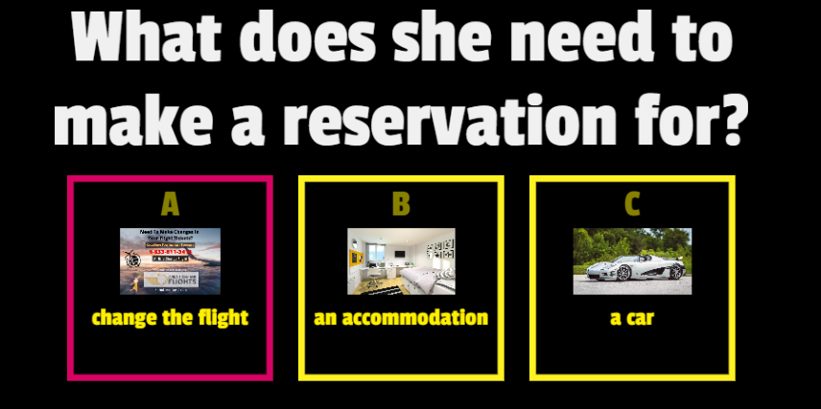
Warm-up

Slide 6
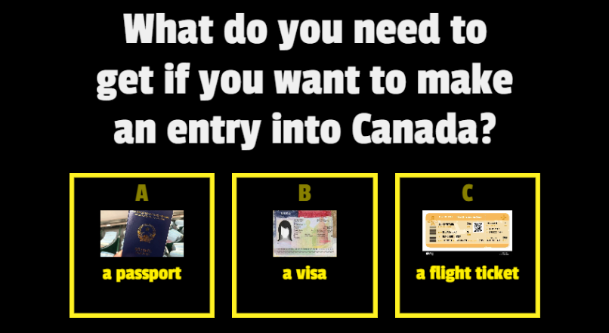
Warm-up

Slide 7
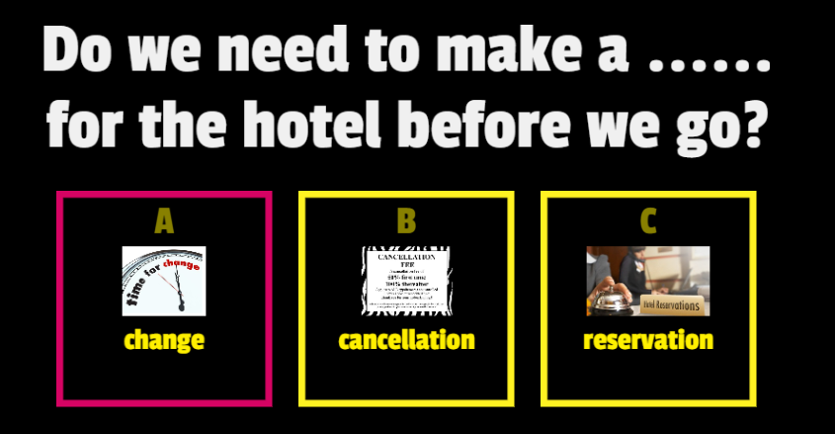
Warm-up

Slide 8
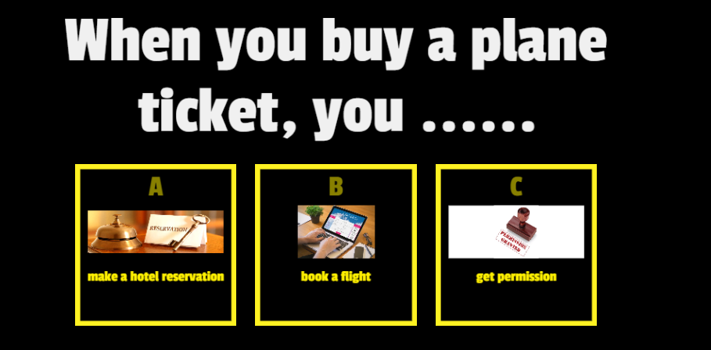
Warm-up

Slide 9
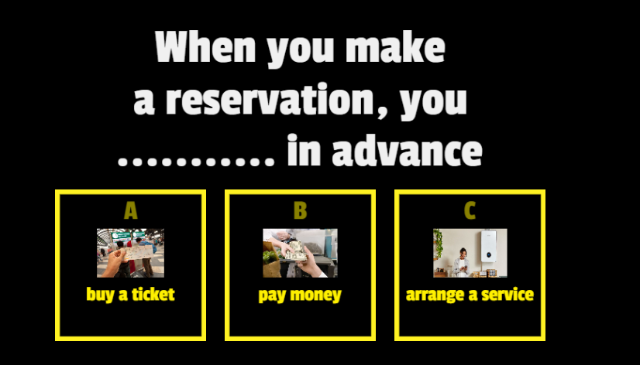
Warm-up

Slide 10
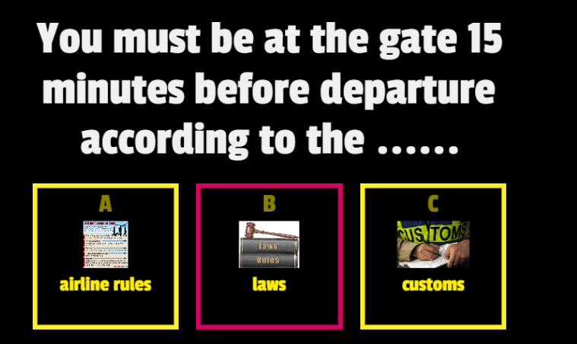
Warm-up

Slide 11
Necessity in English
I need to book my flight to (city)
I have to make a hotel reservation.
You must have a passport to travel abroad.

Slide 12
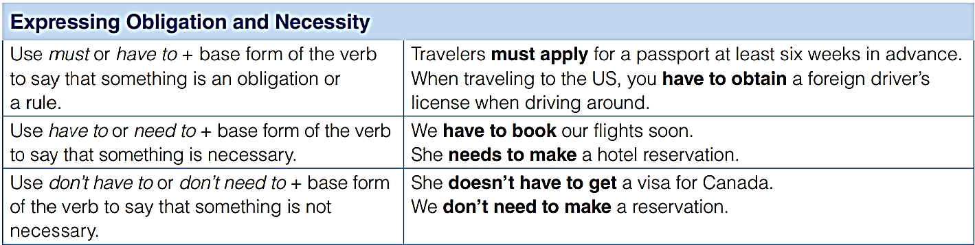
Grammar expressing obligation and necessity

Slide 13
C. Complete the sentences
must be
1. Airline rules say that passengers ______________ be at the gate 15 minutes before departure.
2. We _________________ book the tour. It's not a busy time.
3. Passengers __________ seated during take off and landing.
4. If we don't want to pay extra, we ________________ leave the hotel before the check-out time.
5. I _________________ pack my bag tonight. I leave tomorrow.
6. You ________________ make reservations for the train. You can buy the ticket on the day you travel.
don’t have to
have to
don’t have to
don’t need to
don’t have to

Slide 14

D. Complete the conversation. Then, listen to check your answers.
Ed: So, Peter, are you and Maya ready for our trip?
Peter: We will be! But first, Maya (1) ___________ get a new
passport, and I (2) ______________ apply for the visa.
Ed: You need to get started! You (3) __________________ go
to the embassy for the visa. You can get it online. I booked
our hotel online, too. It's so much easier!
Peter: OK, thanks for the tip!
needs to
need to
don’t have to

Slide 15
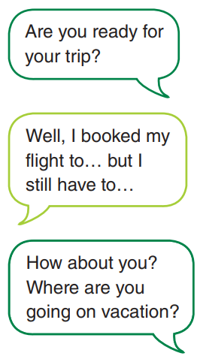
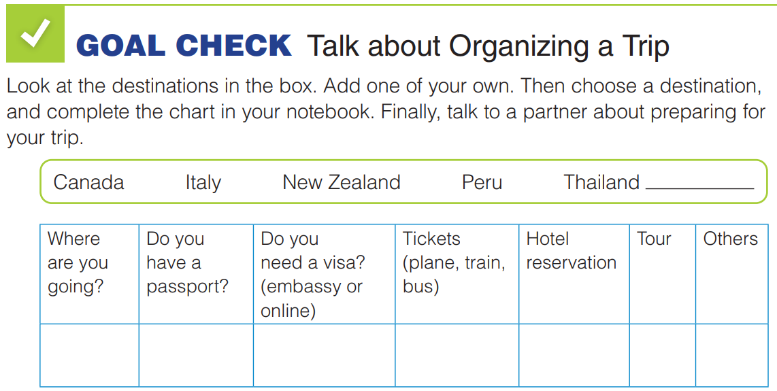

Slide 16
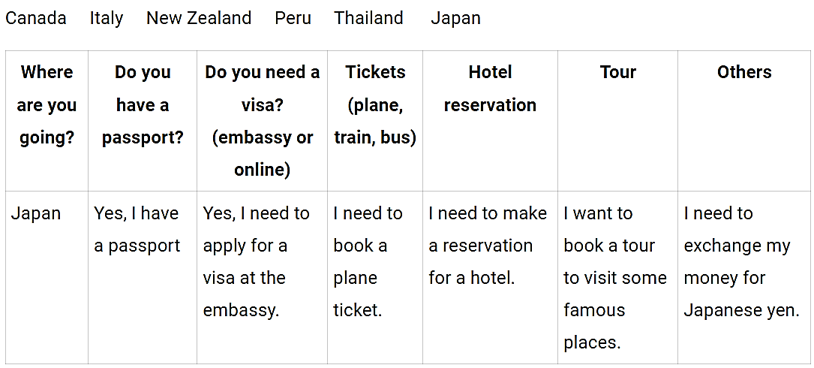
Suggested answers

