Slide 1
Listening
UNIT 10 - TRAVEL

Slide 2
Warm-up
Have students volunteer to present about their trip organization in the last class contact
Students may want to use the projector and laptop to present their plans for the trips

Slide 3
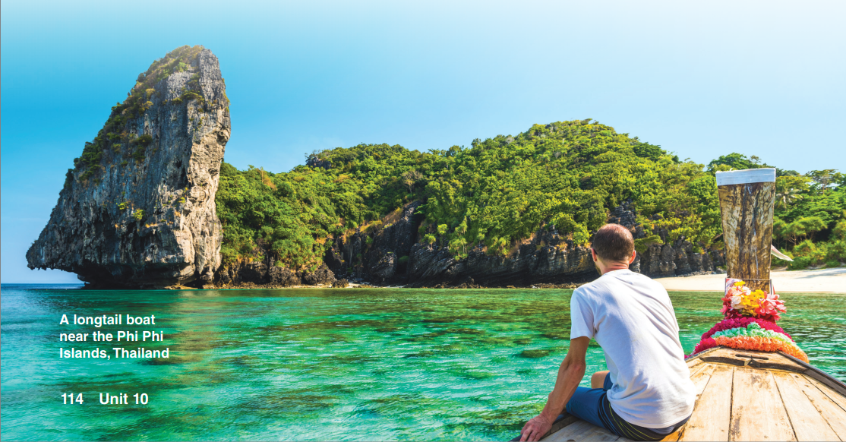
How does the picture make you feel?

Slide 4
The image depicts a serene view of a longtail boat floating on the clear blue waters near the Phi Phi Islands in Thailand.
The boat is surrounded by lush green hills and rocky cliffs, adding to the natural beauty of the scene.
The picture conveys a sense of calmness, tranquility, and the natural splendor of the Thai landscape.

Slide 5
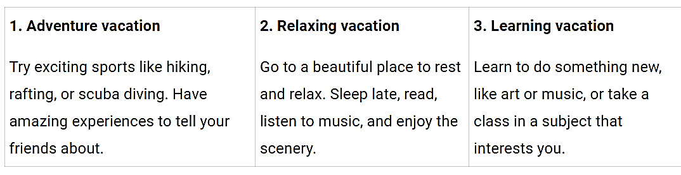
B. Read the information. What kinds of vacations do you like?

Slide 6
Suggestion
Personally, I would like to try an adventure vacation. I find the idea of trying out exciting sports and activities like hiking, rafting, or scuba diving to be thrilling and exhilarating. It would be an excellent opportunity to step out of my comfort zone and push myself to try new things. I imagine having amazing experiences that I can share with my friends and family.
If I were to choose, I would prefer a relaxing vacation. Going to a peaceful and beautiful place where I can rest, unwind, and appreciate nature sounds like a perfect getaway. It would be an excellent opportunity to disconnect from the fast-paced routine of daily life and recharge my batteries. I would love to sleep late, read books, listen to music, and take in the scenery.
Personally, I would prefer a learning vacation. I love learning new things, so going to a place where I can learn a new skill, like art or music, would be very exciting for me. I would also enjoy taking a class in a subject that interests me, such as history or philosophy. It would be an excellent opportunity to expand my knowledge and engage in intellectual pursuits while also having the chance to explore a new place.

Slide 7

C. Listen to three people talking about their vacations. Which country is each person going to?
Italy
Carla: __________________
Marcus: __________________
Thailand

Slide 8
D. Listen again and complete the chart.
 | What kind of vacation are they going to have? | What activities are they going to do?
Caria
Marcus
learning
cook
get up late, lie on the beach, look at the ocean, drink cold drinks, relax
relaxing

Slide 9
Audio track 50
Interviewer: Today’s topic is vacations, and we’re asking people about their plans for their next trip. May I have your name?
Carla: Carla.
Interviewer: And where are you going for your next vacation, Carla?
Carla: Well, my vacation isn’t until September, but I’m really excited already. I’m going to Italy!
Interviewer: So, are you planning to go sightseeing there?
Carla: Not really. I’m going to a cooking school there for two weeks. I just love Italian food, and I’ve always wanted to learn how to make it—not just the easy things like spaghetti. We’ll have cooking lessons every day and cook all of our meals.
Interviewer: Sounds like a great trip! Now let’s ask this gentleman—excuse me, what’s your name?
Marcus: My name’s Marcus.
Interviewer: Tell us, Marcus, what are your plans for your next vacation?
Marcus: I just talked to a travel agent and made my reservation yesterday. I’m going to spend a week in Thailand.
Interviewer: Thailand! Sounds great! And what are you going to do there?
Marcus: Nothing! I’m going to do absolutely nothing! I’m going to get up late, and lie on the beach, and look at the ocean, and drink cold drinks, and just relax. My job is really stressful, and I don’t want to run around during my vacation. One of my friends went to Thailand last year, and he said it was really peaceful, and that sounds perfect for me.
Interviewer: Well, we hope you have a great time.

Slide 10
My world –
Tell a partner about a recent vacation or a vacation you want to go on
Recently, I went on a vacation to Da Nang. It was a beautiful coastal city with long stretches of sandy beaches, clear blue waters, and stunning limestone mountains. One of the highlights of my trip was visiting the Marble Mountains, a cluster of five limestone hills that are named after the five elements of the universe. I also enjoyed exploring the old town of Hoi An, which is a UNESCO World Heritage Site known for its well-preserved architecture, traditional culture, and colorful lanterns. In addition, I had a chance to try some delicious local food, including Banh Mi and Pho.
Alternatively, I would love to go on a vacation to Nha Trang, Vietnam in the future. Nha Trang is a coastal resort city known for its beautiful beaches, clear waters, and excellent seafood. One of the things I'm looking forward to is visiting the Vinpearl Land Amusement Park, which is an island amusement park with various attractions like water parks, aquariums, and a cable car that offers panoramic views of the ocean. I also want to try scuba diving to explore the coral reefs and marine life in the surrounding waters. And of course, I'm excited to indulge in the delicious seafood that Nha Trang is famous for.

