Slide 1
pronunciation
UNIT 10 - TRAVEL

Slide 2
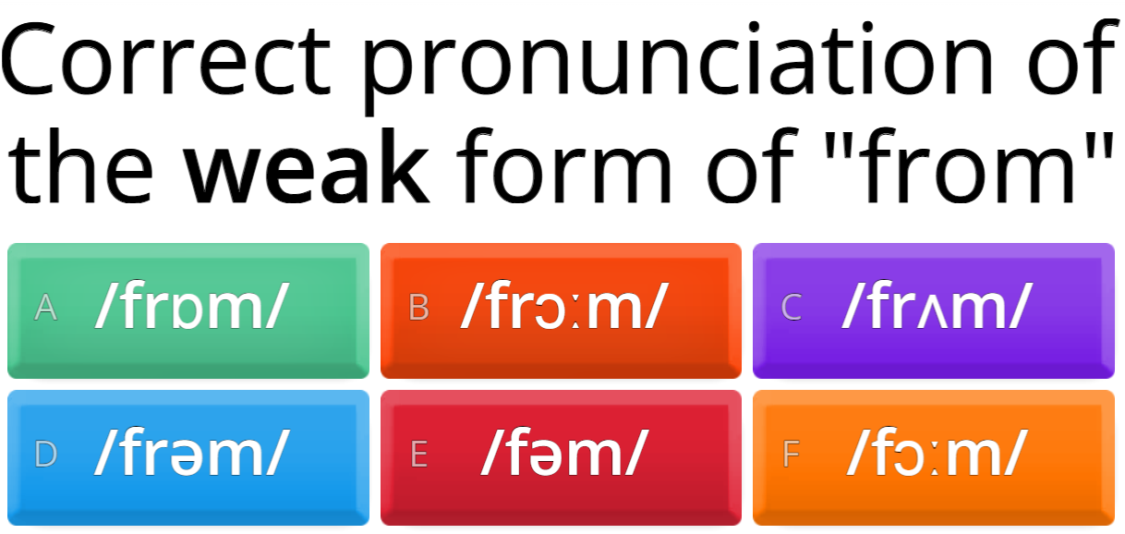

Warm-up

Slide 3
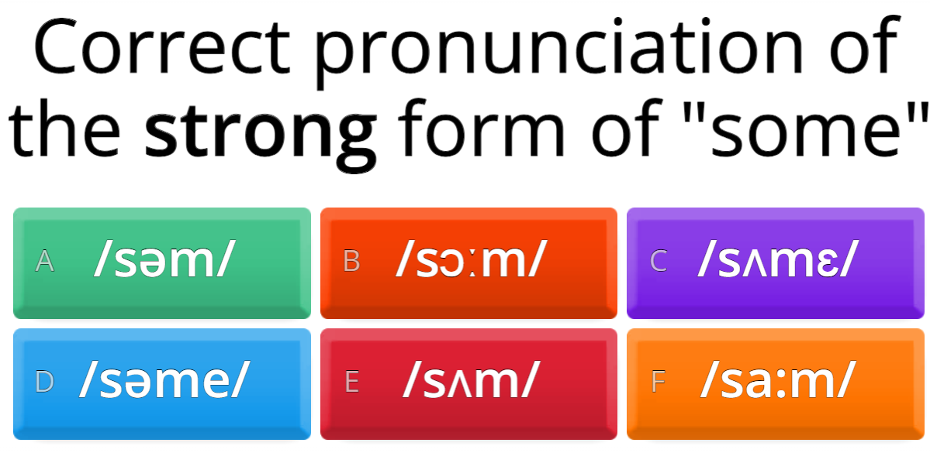

Warm-up

Slide 4
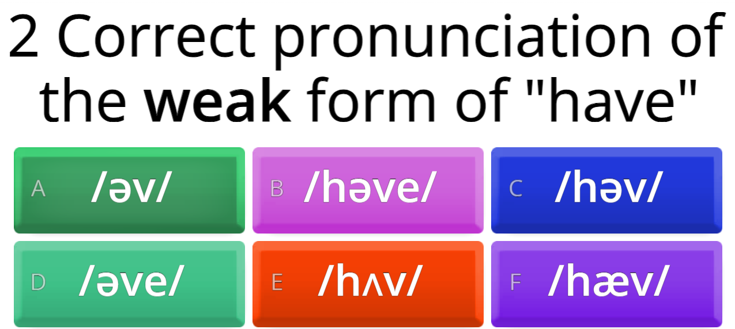


Warm-up

Slide 5
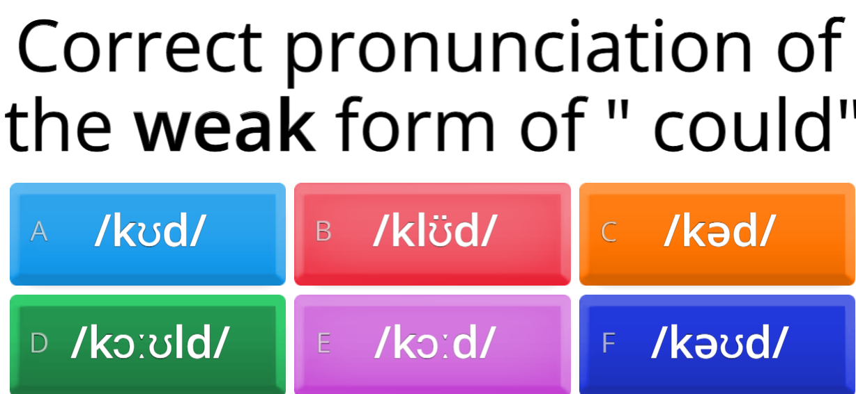

Warm-up

Slide 6
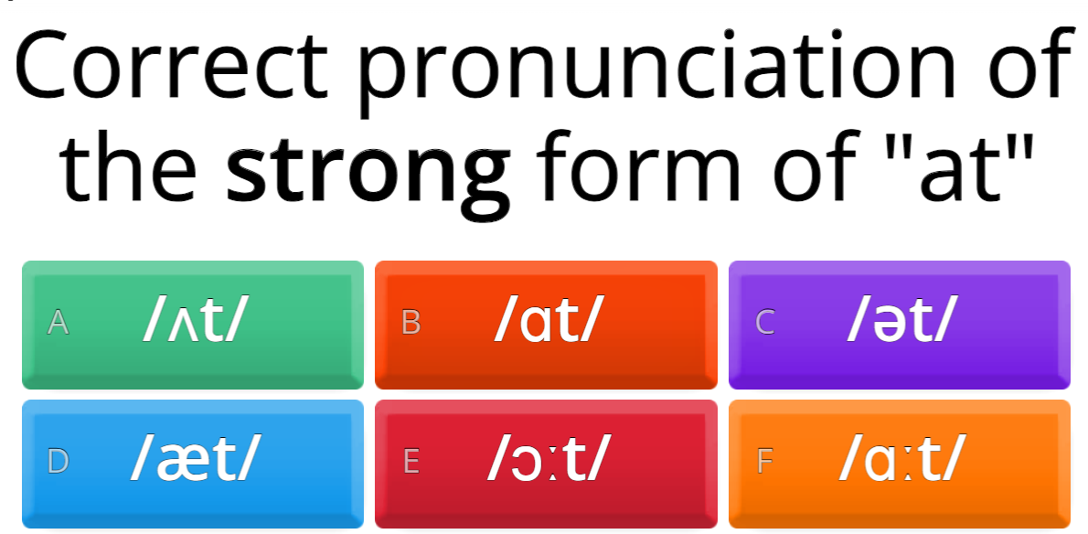

Warm-up

Slide 7
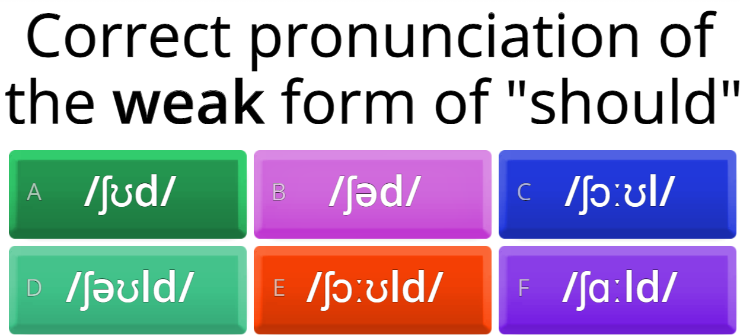

Warm-up

Slide 8
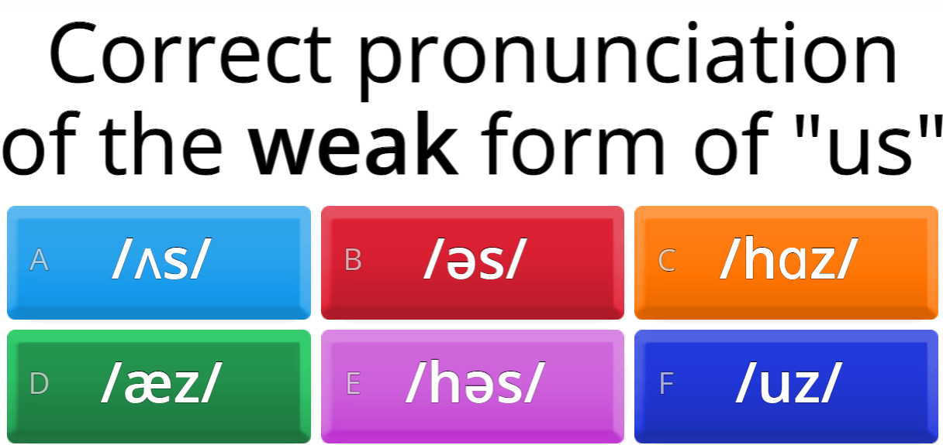

Warm-up

Slide 9


Pronunciation – weak forms of have to/ Has to
I have to attend Math class this morning.
He has to send the report right away.

Slide 10

F. Listen & practice saying them in pairs.
1. I have to apply for a passport.
2. We have to book our flights.
3. Rosa has to pack her suitcase.
4. They have to check in at six o'clock.
5. Juan has to check his hotel reservation.
6. Do you have to book the tour in advance?

Slide 11
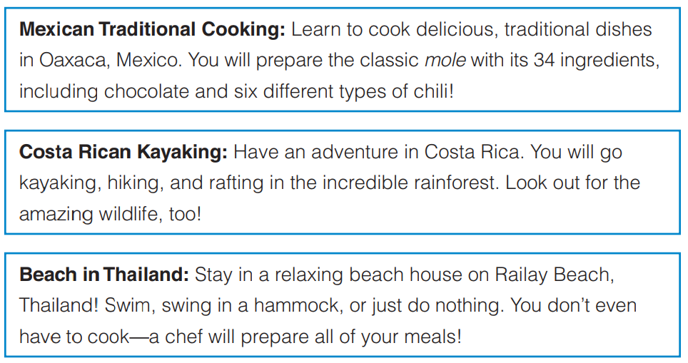
Communication

Slide 12
G. choose a trip you will take together.
Suggested solution:
Student 1: Wow, these trips all sound amazing! I can't decide which one I want to go on.
Student 2: Yeah, they all sound like so much fun. I'm leaning towards the Costa Rican kayaking trip, though. I've always wanted to go kayaking in a rainforest.
Student 1: That does sound pretty cool. But I'm more interested in the Mexican cooking trip. I love trying new foods, and learning how to make traditional Mexican dishes would be so much fun.
Student 2: That's true. I do love Mexican food. But what about the beach trip in Thailand? We could just relax and unwind, and we wouldn't have to worry about cooking or anything.
Student 1: Hmm, that does sound tempting. But I think I'd rather do something a bit more active, like the kayaking or cooking trip.
Student 2: I get it. I think I'm still leaning towards the kayaking trip, but I'm open to other ideas.
Student 1: Same here. Let's keep thinking about it and decide which one we want to do together.

Slide 13
H. What do you have to do before this trip? Think of five things.
Research the destination: Before you go on any trip, it's a good idea to do some research on the place you're visiting. Look up information about the local culture, customs, and traditions, as well as any must-see attractions or activities in the area.
Book accommodations: Depending on where you're going, you may need to book accommodations in advance. This could include a hotel, hostel, vacation rental, or other type of lodging.
Make travel arrangements: If you're traveling to a far-off destination, you may need to make travel arrangements such as booking flights, arranging transportation to and from the airport, or renting a car.
Pack appropriately: Make a packing list and ensure you have all the essentials you need for the trip, including appropriate clothing, toiletries, and any necessary medications or travel documents.
Plan your budget: It's important to have a budget for your trip so you know how much you can afford to spend. Consider the cost of accommodations, transportation, food, and any activities or attractions you plan to do while you're there.

Slide 14
I. What will you take with you? List 10 things.
Clothing appropriate for the climate
Toiletries:
Medications
Travel documents:
Money and credit/debit cards
Electronic devices (camera, tablet, phone)
Travel pillow and blanket
Comfortable shoes
Sunscreen and sunglasses
Entertainment

Slide 15
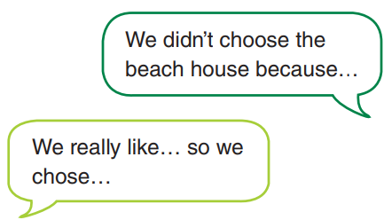
Goal check – talk about different kinds of vacations
Join another pair and talk about your vacation plans.
Explain why you chose your vacation and why you did not choose the other destinations.
Say what you have to do to prepare for it.

Slide 16
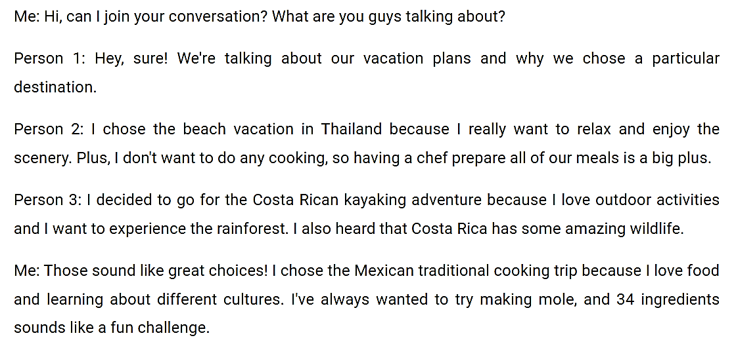
Sample answer

Slide 17


