Slide 1
language expansion at the airport
UNIT 10 - TRAVEL

Slide 2
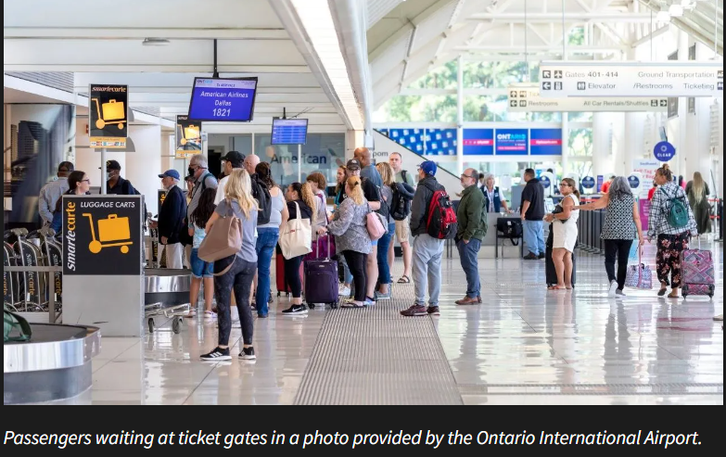
airport
What are airports like?
What can you find at an airport?

Slide 3
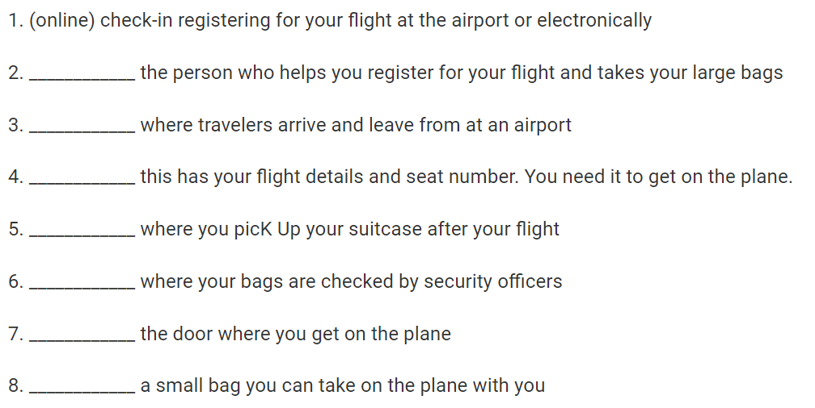
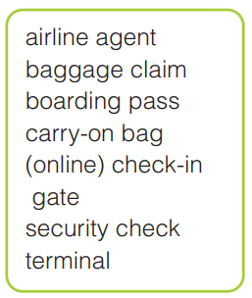
Write the words/ phrases next to their meanings
Airline agent
terminal
boarding pass
Baggage claim
Security check
gate
Carry-on bag

Slide 4
B. Complete the paragraph with the words and phrases from A.
When you get to the airport, the first thing you have to do is go to the right (1) _____________. Then, you need to find the (2) ___________ desk where an (3) ______________ will help you. They will check your passport and give you your (4) _________________ which has your flight information. If you have a large bag or suitcase, you have to check it there. If you only have a (5) _______________, you can take it on the plane with you. If you did (6) ________________, you already have your boarding pass, so you can go straight to the (7) ______ in the departure area. You will have to go through a (8) __________________ to make sure you don't have anything dangerous. Finally, when you get to your destination, you can pick up your checked bag from the (9) _______________.
terminal
check-in
airline agent
boarding pass
carry-on bag
online check-in
gate
security check
baggage claim

Slide 5
Airport vocabulary: listen and repeat
Airline agent (n) hãng hàng không
Baggage claim (n) quầy nhận hành lý
Boarding pass (n) thẻ lên máy bay
Carry-on bag (n) hành lý xách tay
(online) check-in (v) làm thủ tục (trực tuyến)
Gate (n) cửa ra máy bay
Security check (n) cửa kiểm tra an ninh
Terminal (n) cửa lên máy bay

Slide 6
Grammar – expressing prohibition
Use must not => something is not allowed
=> You must not bring a knife on the plane.
Must not/ can’t both means something is not allowed
Must not > can’t and used for rules
You must not speak during the exam hour.
You can’t take a large piece of baggage as a carry-on.

Slide 7
C. Write sentences about traveling by plane. Use 'have to', 'must', 'must not', and 'can't'.
1. When traveling by plane, you must have a valid passport and a boarding pass to board the flight.
2. Passengers must follow the safety instructions given by the flight attendants during takeoff and landing.
3. You can't bring any flammable or explosive items on the plane, as they pose a safety risk.
4. You have to put your electronic devices on airplane mode during the flight to avoid any interference with the aircraft's communication systems.
5. Passengers must not smoke on the plane, as it is strictly prohibited and can result in fines or legal action.

Slide 8
C. Write sentences about traveling by plane. Use 'have to', 'must', 'must not', and 'can't'.
6. You must arrive at the airport at least two hours before your scheduled flight departure time to allow time for security checks and boarding procedures.
7. You can bring a carry-on bag with you on the plane, but it must meet the airline's size and weight restrictions.
8. Passengers must follow the instructions given by the flight crew and can't interfere with the aircraft's equipment or operations.
9. You must fasten your seatbelt during takeoff, landing, and whenever the seatbelt sign is illuminated.
10. Passengers must not disturb others with loud noises or disruptive behavior during the flight, as it can affect the comfort and safety of other passengers.

Slide 9
Goal check use English at the airport
In pairs, write a list of the things you do at an airport.
Join another pair and compare your lists. Put the actions in order.
Prepare the dialog for a how-to video in which you show other students how to use English at the airport.

Slide 10
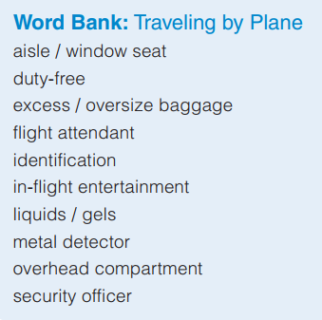
Additional Vocabulary

Slide 11
THINGS YOU DO AT THE AIRPORT | ACTIONS IN ORDER
Check in for your flight Drop off your checked baggage Go through security Wait in the departure lounge Board your flight Pick up your baggage at the baggage claim Look up your flight information on the airport monitors Purchase food and drinks Shop at duty-free stores Exchange currency Find your gate for boarding Use the restroom | Look up your flight information on the airport monitors Check in for your flight Drop off your checked baggage Go through security Purchase food and drinks Shop at duty-free stores Exchange currency Use the restroom Wait in the departure lounge Find your gate for boarding Board your flight Pick up your baggage at the baggage claim

Slide 12
Suggested Dialog for a how-to video
Presenter: Hi, everyone! In this video, I'm going to show you how to use English at the airport. First, let's start with checking in for your flight. You'll need to have your passport and your boarding pass ready. The airline agent will ask you some questions, like where you're flying to and if you have any bags to check.
(Show the process of checking in and dropping off bags)
Presenter: Next, you'll need to go through security. Make sure you have all your liquids in a clear plastic bag, and take off your shoes and any jackets or belts before going through the metal detector.
(Show the process of going through security)
Presenter: Once you're through security, you can grab a bite to eat or do some shopping at the duty-free stores. If you need to exchange currency, there are usually currency exchange booths in the airport.
(Show the process of purchasing food and drinks, shopping, and exchanging currency)
Presenter: After that, find your gate for boarding. You can check the airport monitors for your flight information. When it's time to board, the airline agent will announce the boarding time and the gate number.
(Show the process of finding the gate and waiting for boarding)
Presenter: Finally, once you've landed at your destination, you'll need to pick up your baggage at the baggage claim.
(Show the process of picking up baggage)
Presenter: And that's it! You're now ready to use English at the airport. Have a safe flight!

Slide 13


