Slide 1
reading
UNIT 10 - TRAVEL

Slide 2
Warm-up: snake game
Teachers writes/shows a word related to travel and transportation, e.g.: passport
Let students start a new word with the ending letter -t and continue this way
In 3 minutes, students can find as many words as possible.
Each time one get a word, put a tick and then count. Who has the most ticks will get a small prize.

Slide 3
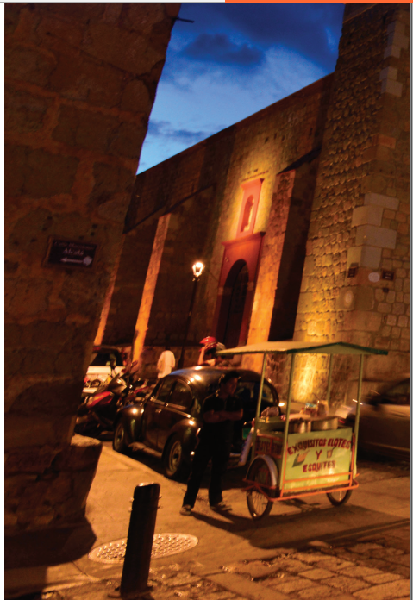
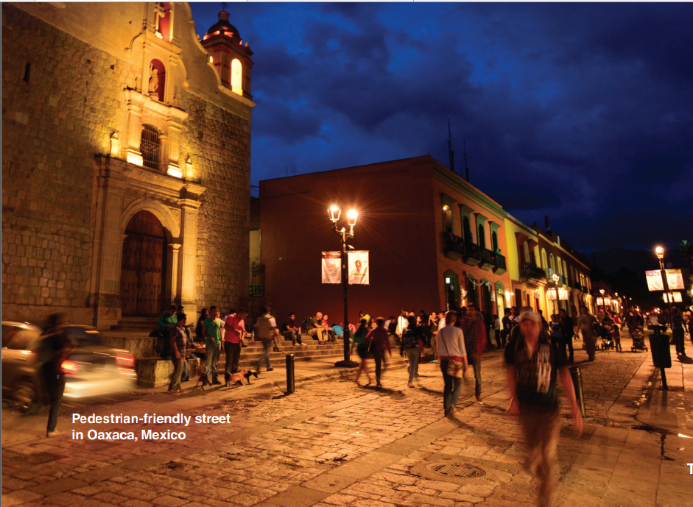

Does it look like a nice place to visit?
Would you like to go there? Why
or why not?

Slide 4
About the Photo
This photo shows a street and one of the churches in the center of the city of Oaxaca in southern Mexico. Oaxaca is a popular tourist destination for both Mexicans and people from other countries.
It is known for its beautiful, historic buildings, ancient ruins, and delicious cuisine. Mexico is well-known internationally for its cuisine; large toasted tortillas called tlayudas and the famous mole are two of the most popular dishes of this region.

Slide 5
A. MY WORLD
What do you like about traveling?
Is there anything you don't like about going somewhere you've never been before? Tell your partner.

Slide 6
TRAVELLING
LIKE | DON’T LIKE

Slide 7
Sample answer
I really enjoy traveling because it gives me the opportunity to explore new places and experience different cultures. I love trying new foods, visiting historical sites, and meeting new people. It's exciting to step out of my comfort zone and try things that I wouldn't normally do at home.
However, there are a few things that I don't like about going somewhere I've never been before. The biggest challenge for me is not knowing the language. It can be difficult to communicate and navigate my way around a new place without speaking the local language. Additionally, I sometimes get anxious about getting lost or not being able to find my way back to my hotel or accommodation. But overall, the benefits of traveling far outweigh any challenges or discomforts.

Slide 8
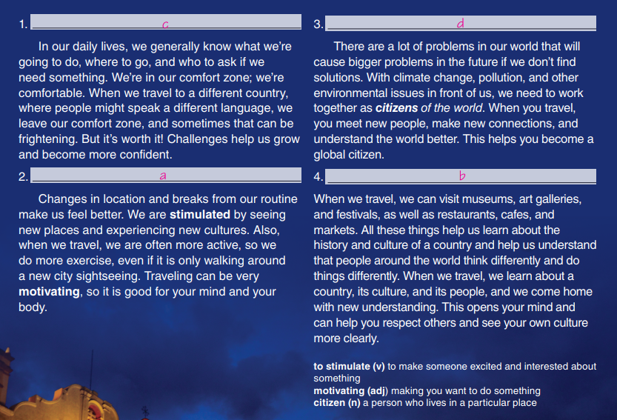

Slide 9
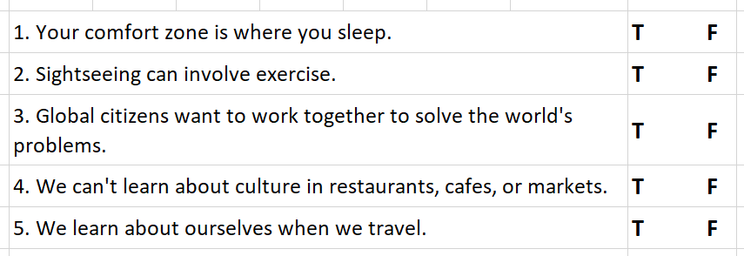
C. Read the article again. Circle T for true and F for false.

Slide 10
D. Answer the questions.
1. Why are challenging situations sometimes good for us?
2. Why is travel good for your mind and body?
3. What does the term global citizen refer to?
4. How do we learn about our own culture when we travel?
5. Why is cultural understanding important?
Because they help us grow and become more confident.
It stimulates/motivates you and makes you active
Someone who wants to work with people from different countries to solve the world’s problems
We compare it with the new culture
It teaches us to respect other people and cultures.

Slide 11
GOAL CHECK
Remember a trip you have taken. Write notes to answer the questions.
Where did you go, and how long did you stay?
What was the most challenging / interesting / frightening / unusual moment of that trip?
What did you learn during the trip?
Tell a partner about your trip.

Slide 12
Suggested answer
Where did you go, and how long did you stay?
I went to Sa Pa, a mountainous area in the northern part of Vietnam. I stayed there for three days and two nights.
What was the most challenging/ interesting/ frightening/ unusual moment of that trip?
The most interesting moment was trekking to the top of Fansipan, the highest mountain in Indochina, which took me around 8 hours. The view from the top was breathtaking. The most challenging moment was when I had to cross a bamboo bridge, which was swaying because of the wind, and the most frightening moment was when it started raining heavily and there was a risk of landslide. The most unusual moment was when I stayed with a local family in a homestay and learned about their daily life.

Slide 13
What did you learn during the trip?
I learned a lot about the culture and customs of ethnic minority groups in Sa Pa, especially the Hmong and Red Dao.
I learned how they make their traditional clothes, how they cultivate rice on the steep terraced fields, and how they preserve their unique cultural identity.
I also learned to appreciate the beauty of nature and the importance of environmental protection.
Finally, I learned that traveling is not only about visiting tourist attractions but also about experiencing the local way of life and interacting with the people.

Slide 14


