Slide 1
communication
UNIT 10 - TRAVEL

Slide 2
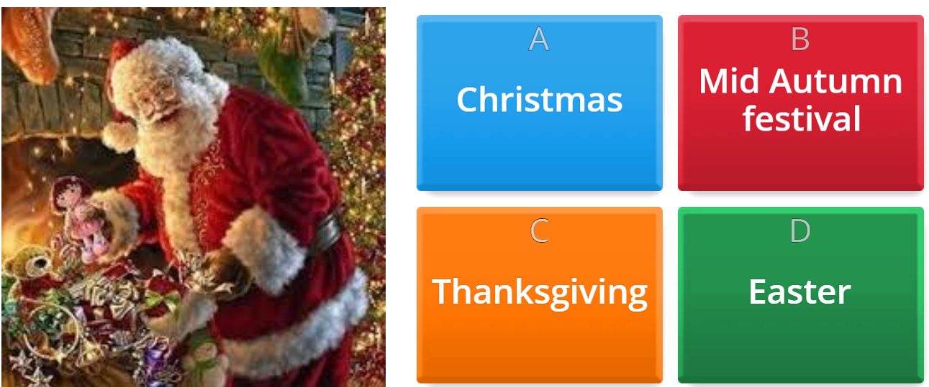

Warm-up

Slide 3
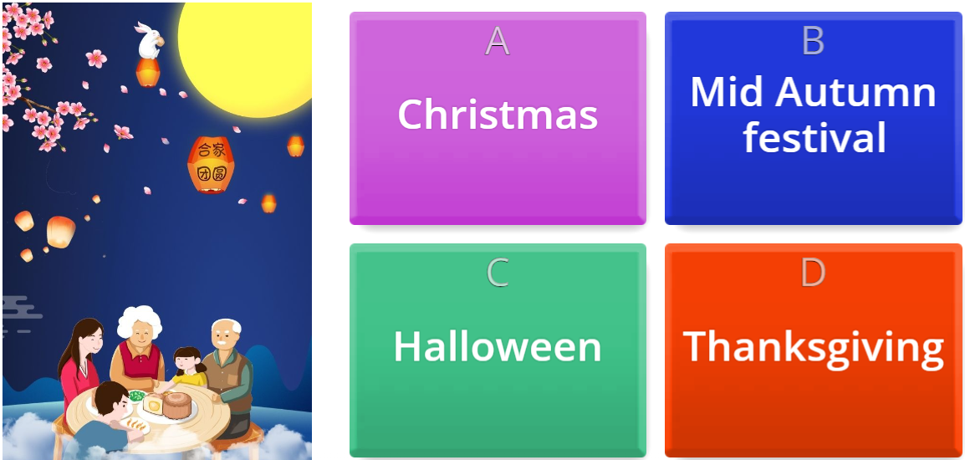
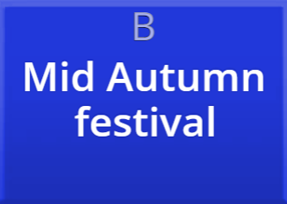
Warm-up

Slide 4
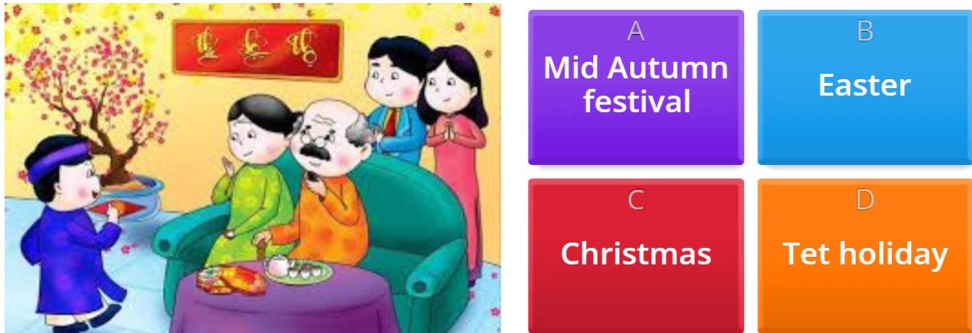
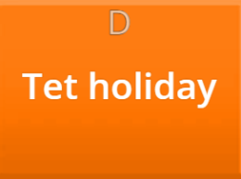
Warm-up

Slide 5
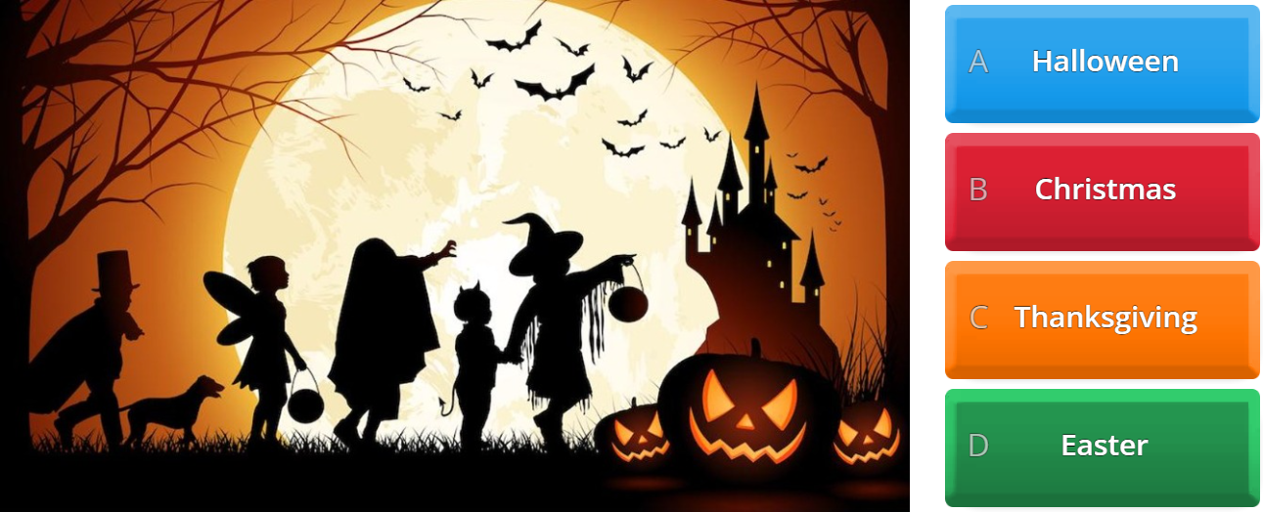

Warm-up

Slide 6
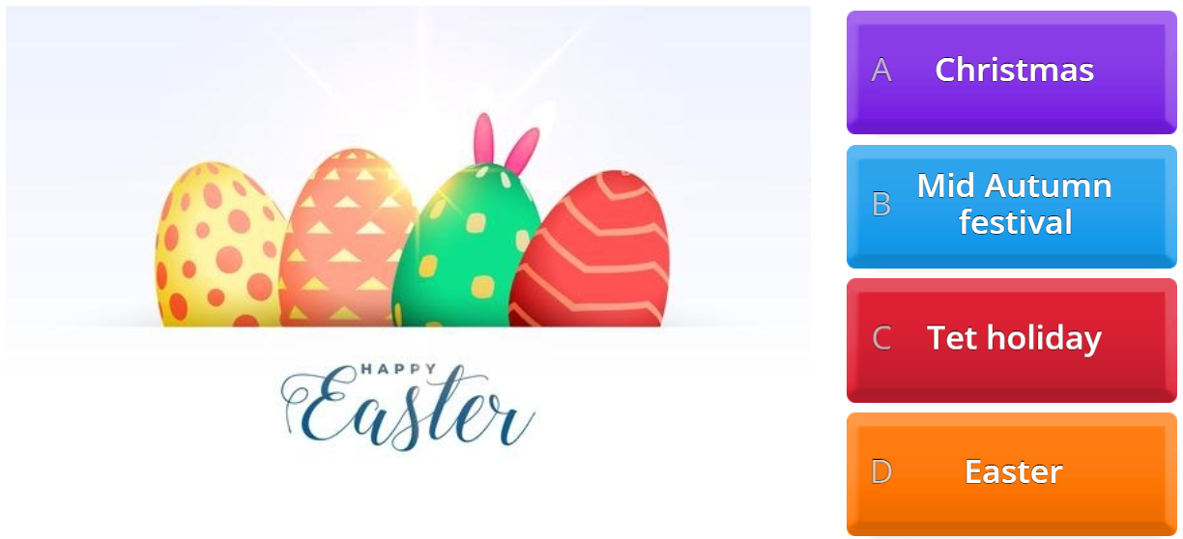

Warm-up

Slide 7
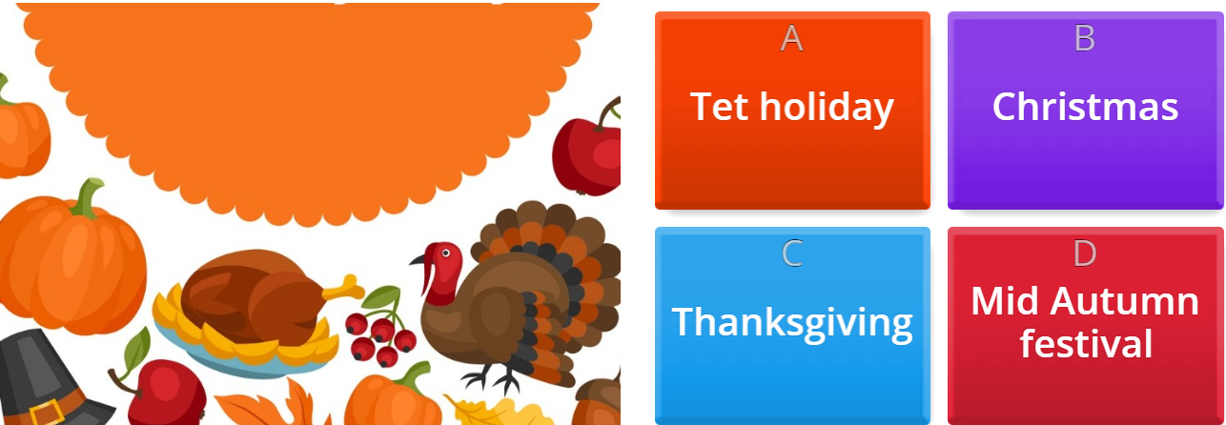
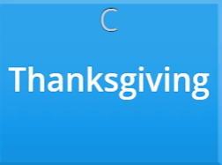
Warm-up

Slide 8
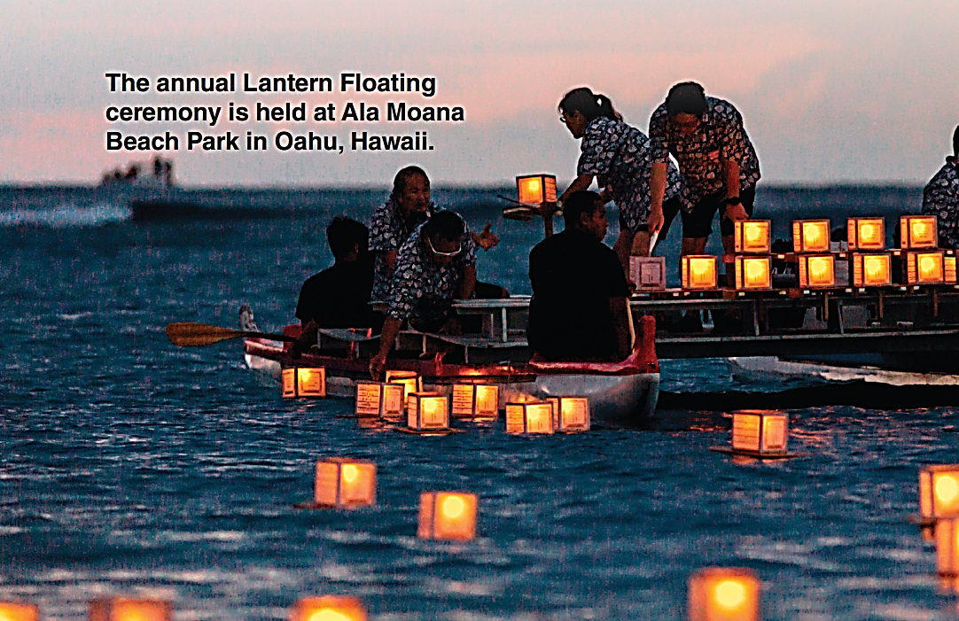
What do you think the Lantern Floating ceremony is for?
Why do people put lanterns in the water?

Slide 9
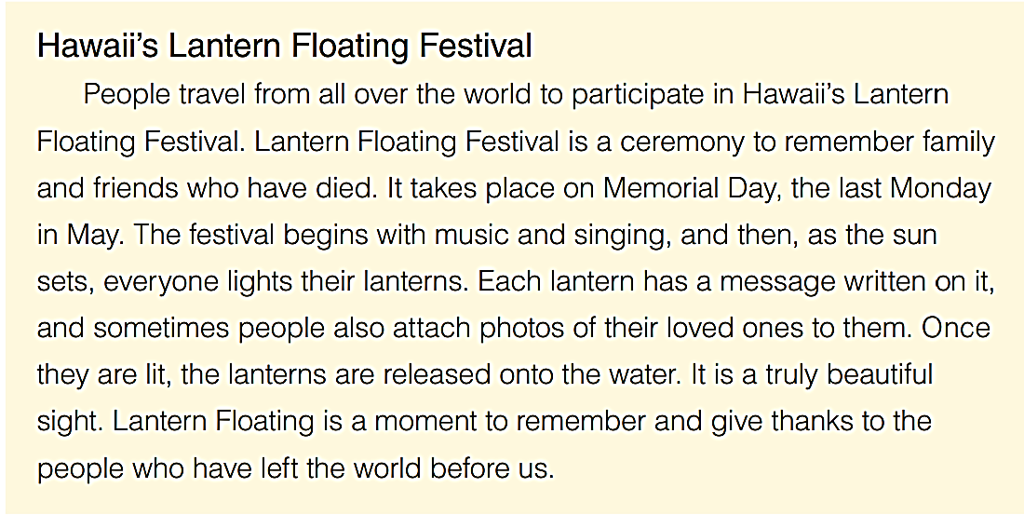
Read the text

Slide 10
Some cultural festivals and events from around the world
Carnival in Rio de Janeiro, Brazil
La Tomatina Festival in Buñol, Spain
Holi Festival in India and Nepal
Oktoberfest in Munich, Germany
Diwali Festival of Lights in India
Chinese New Year
Mardi Gras in New Orleans, USA
Running of the Bulls in Pamplona, Spain
Day of the Dead in Mexico
Songkran Water Festival in Thailand.

Slide 11
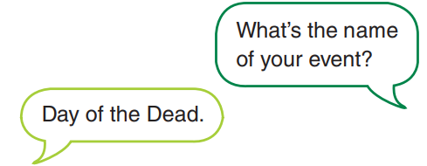
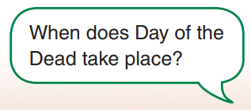
Choose an event from the list and write about it. Use questions below
1. When does it take place?
2. Where does it take place?
3. What is it for?
4. What do people do?
5. Do people come from far away to go to the event?
6. How would you describe it? Write three adjectives.

Slide 12
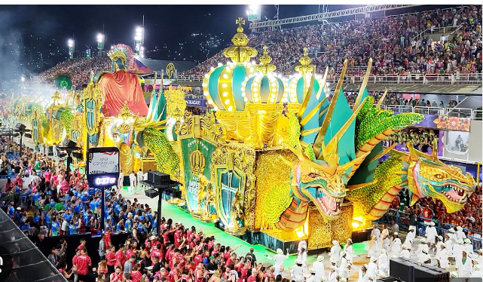
Carnival in Rio de Janeiro
takes place over five days, starting on the Friday before Ash Wednesday.
in Rio de Janeiro, Brazil, and the parade takes place in the Sambadrome.
The Rio Carnival is a celebration before the start of Lent, which is a period of abstinence and reflection for Christians. It is also an opportunity to celebrate Brazilian culture, music, and dance.
People dance, sing and parade.
Yes, people from all over the world come to Rio de Janeiro to participate in the carnival.
The Rio Carnival is vibrant, energetic, and joyful.

Slide 13
C. Ask a partner about their cultural event.
1. When does it take place?
2. Where does it take place?
3. What is it for?
4. What do people do?
5. Do people come from far away to go to the event?
6. How would you describe it? Write three adjectives.

Slide 14
