Slide 1
Writing
UNIT 10 - TRAVEL

Slide 2
Warm-up: mixed letters
teacher divides the class into 2 teams
- teacher write in pieces of paper with several words related to holidays and festivals that are mixed up
- students pick up the pieces randomly and then have to race to the board and write the correct word and earn a point for each time defining the word successfully.
- which team has more points will be the winners.

Slide 3
Lim Festival
Around mid-January of the lunar calendar every year, thousands of people from the north of Việt Nam travel to Bắc Ninh. They travel there to participate in the Lim Festival, a cultural event that dates back more than 300 years. The celebration usually starts with a parade where villagers are dressed in colorful traditional costumes. Then, many rituals take place to worship Gods and to honor the founders of the festival. In the main part of the festival, people hold many folk games such as wrestling, chess, weaving competitions, and rice cooking competitions. However, the most important activity is the art of “Quan Họ” singing, which was recognized as an Intangible Cultural Heritage by UNESCO in 2009. Male and female singers in traditional costumes challenge each other by singing a song, in which each partner must sing different lyrics to match their partner's melody. So, if you like travel, art, and unusual experiences, you should visit Bắc Ninh next spring!

Slide 4
E – write a paragraph
SAMPLE PARAGRAPH
The Rio Carnival is a world-famous event that takes place in Rio de Janeiro, Brazil, over five days starting on the Friday before Ash Wednesday. It is an annual celebration before the start of Lent, a period of abstinence and reflection for Christians. The carnival is a joyful opportunity to celebrate Brazilian culture, music, and dance, and attracts people from all over the world to participate in the festivities. The carnival is known for its vibrant, energetic, and colorful atmosphere. During the carnival, people dress up in colorful costumes, dance, sing, and participate in street parties and music concerts throughout the city. The highlight of the event is the parade of samba schools, which features elaborate floats, costumes, and dancing. If you love music, dance, and a lively atmosphere, the Rio Carnival is the perfect event to experience. Don't miss the chance to participate in one of the world's most vibrant and energetic cultural events, and to experience the joy of Brazilian culture first-hand.

Slide 5
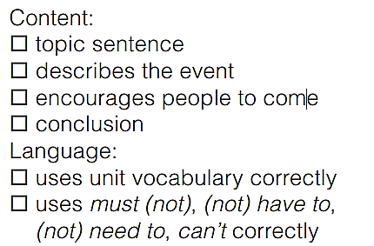
F – exchange paragraph
Use the check-list to help you review and correct your partner’s writing

Slide 6
