Slide 1
COMPARISON WITH AS…AS
GRAMMAR – UNIT 12

Slide 2
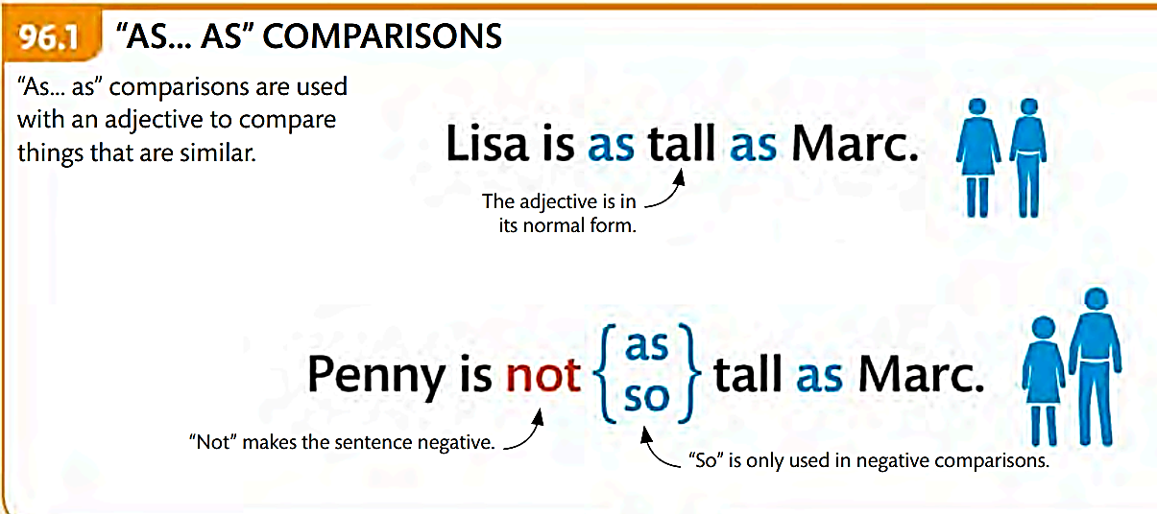
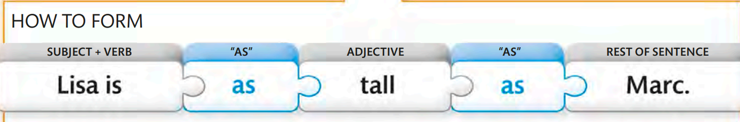
UNIT 12

Slide 3
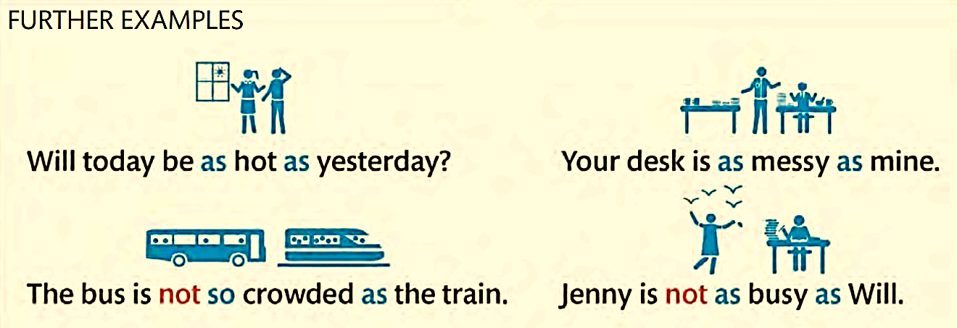

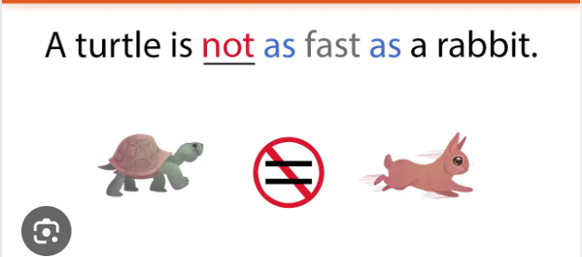

Slide 4
FURTHER EXAMPLES
=
Be + S + as + adj + as + complement?
Is a Pug as cute as a French Bulldog?

Slide 5
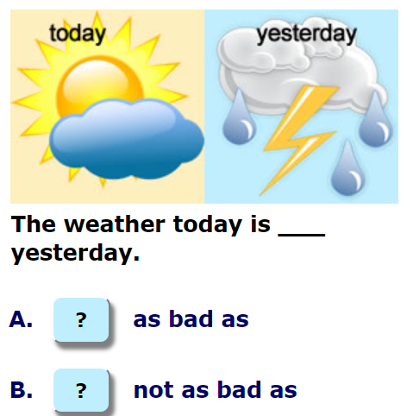
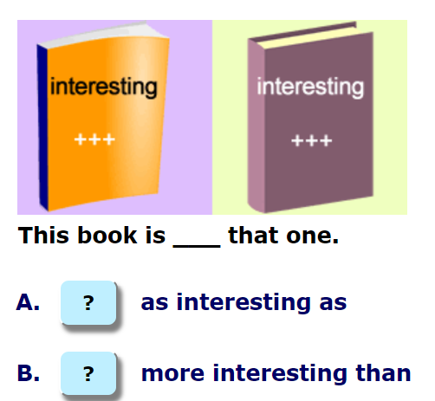
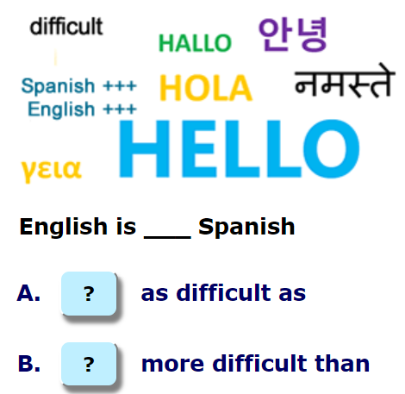

EXTRA EXERCISES

Slide 6
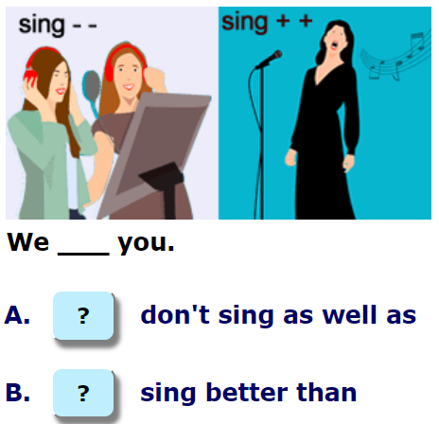
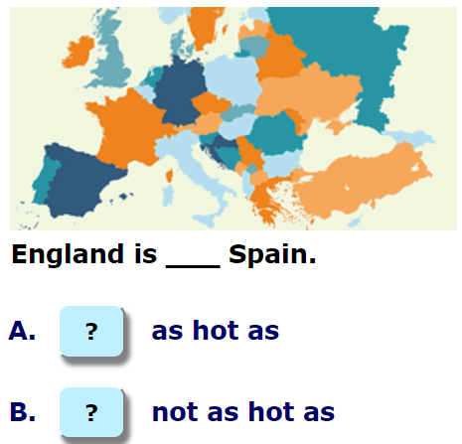
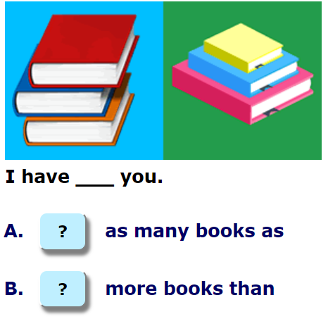
EXTRA EXERCISES

Slide 7
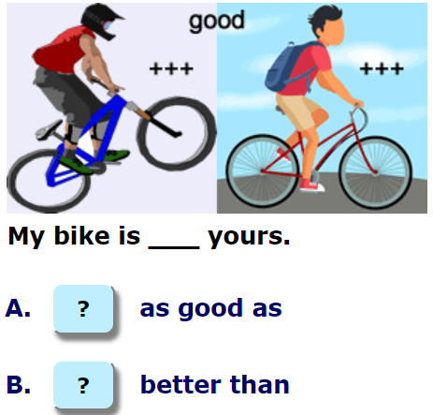
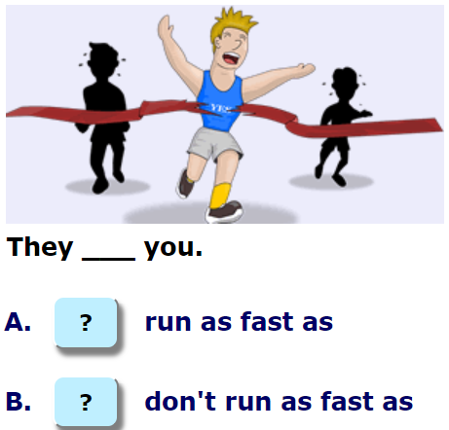
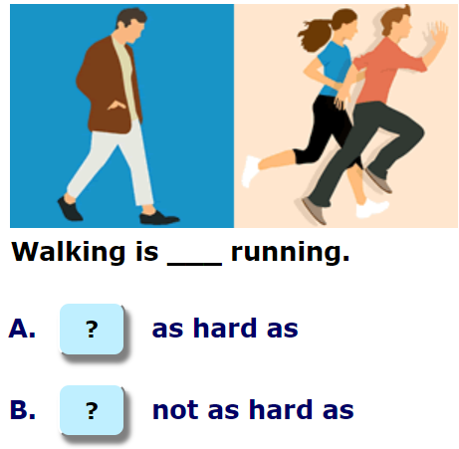
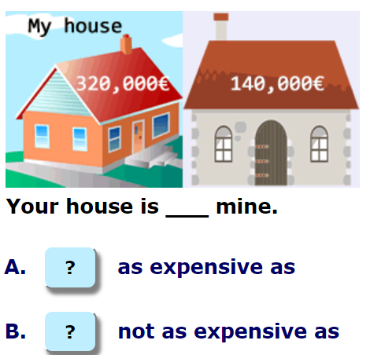
EXTRA EXERCISES

Slide 8
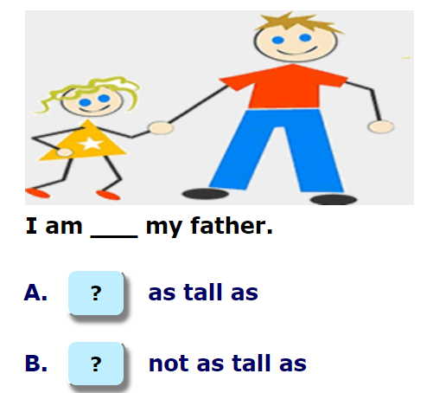
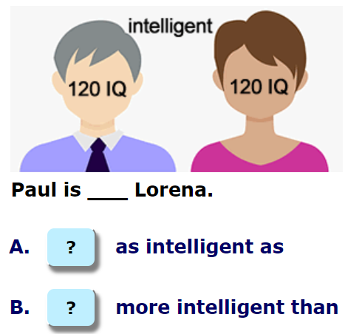
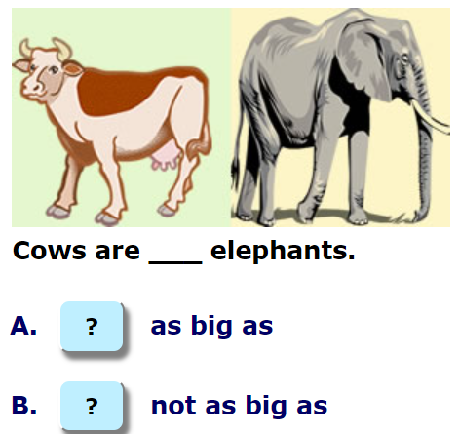
EXTRA EXERCISES

Slide 9
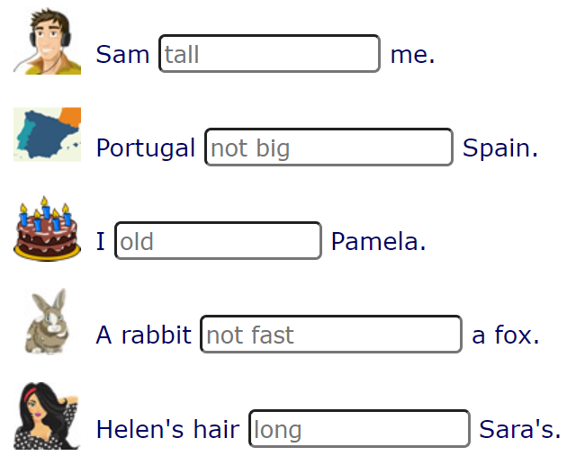
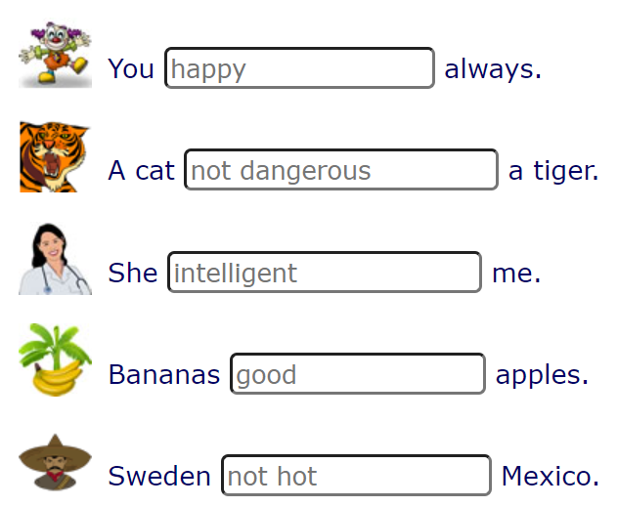
Write sentence using (not) as + adj + as
is as tall as
are as happy as
isn’t as big as
isn’t as dangerous as
am as old as
is as intelligent as
isn’t as fast as
are as good as
is as long as
isn’t as hot as

Slide 10
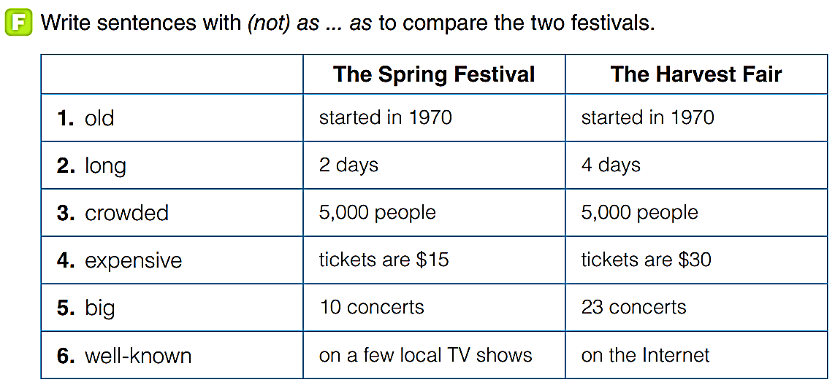
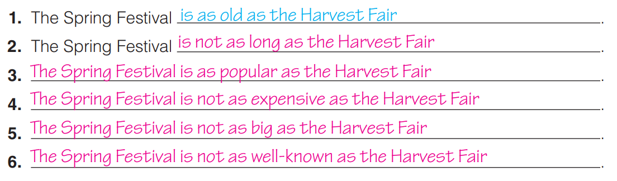

Slide 11

Correct the mistake in each sentence
as
1. The Day of the Dead is as well known thans Halloween around the world.
2. For children, Three Kings' Day is most exciting as Christmas.
3. The New Year's crowd in Trafalgar Square, London, is as bigger as the crowd in Times in Square, New York.
4. The traditions in one culture are as important the it traditions in another culture.
5. Old celebrations are as more important as new celebrations.
as
big
as

Slide 12
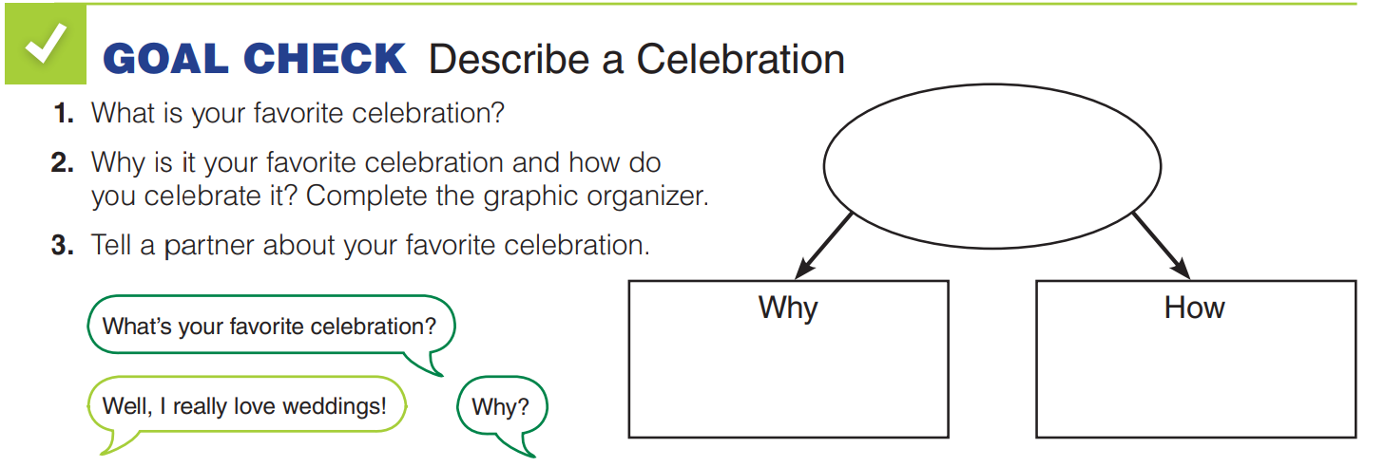

Slide 13


