Slide 1
pronunciation
UNIT 12 - CELEBRATIONS

Slide 2

INTONATION
is the way the pitch (highness / lowness) of your voice changes to give a certain meaning.
Did we talk about a celebration in South Africa or Japan?

Slide 3


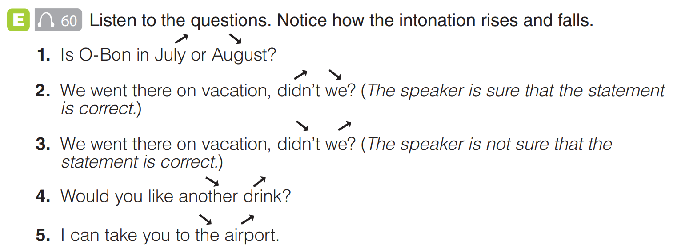

Slide 4

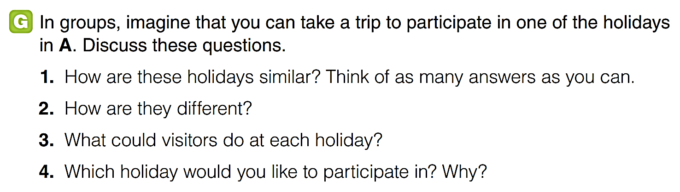

Slide 5
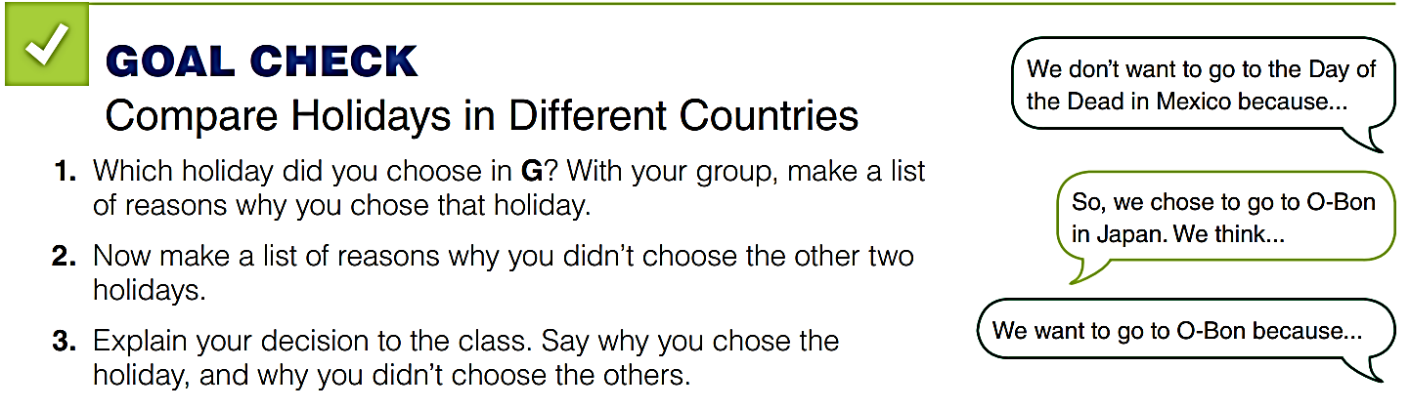

Slide 6


