Slide 1
Language expansion
& grammar
UNIT 12 – CELEBRATIONS

Slide 2
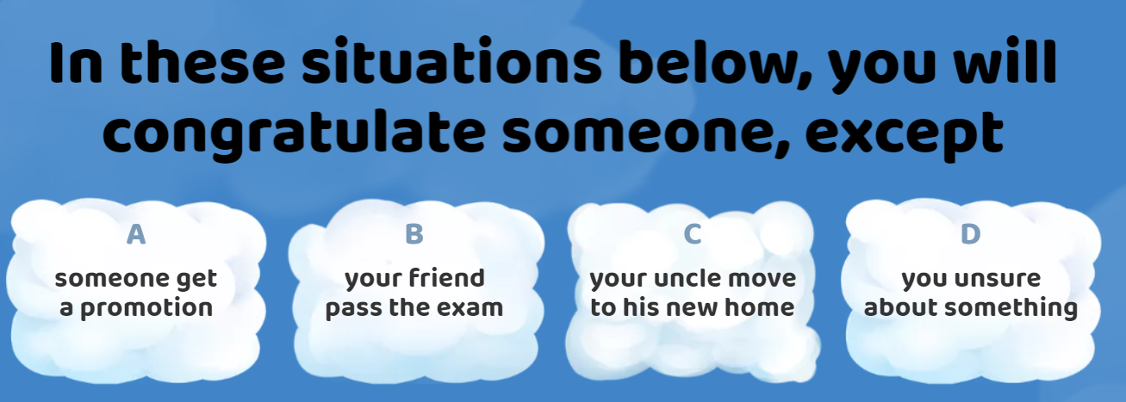

Warm-up

Slide 3
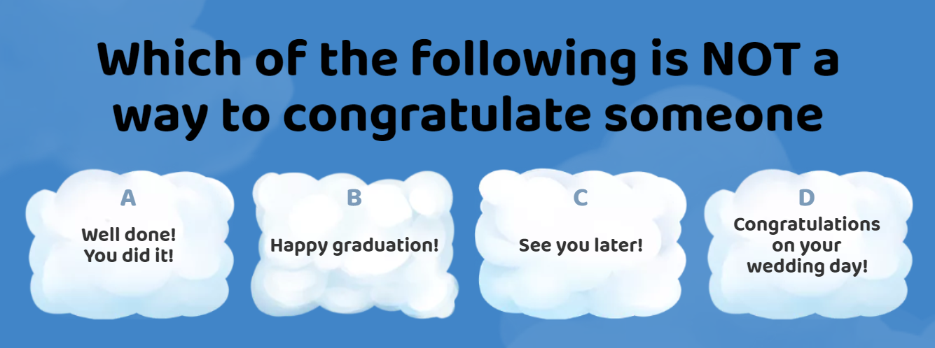
Warm-up

Slide 4
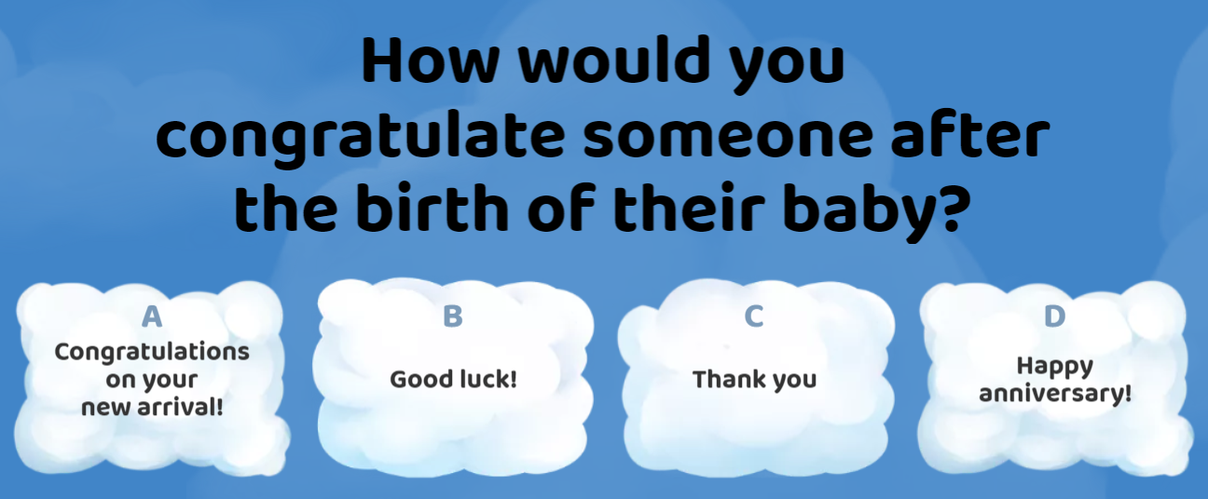
Warm-up

Slide 5
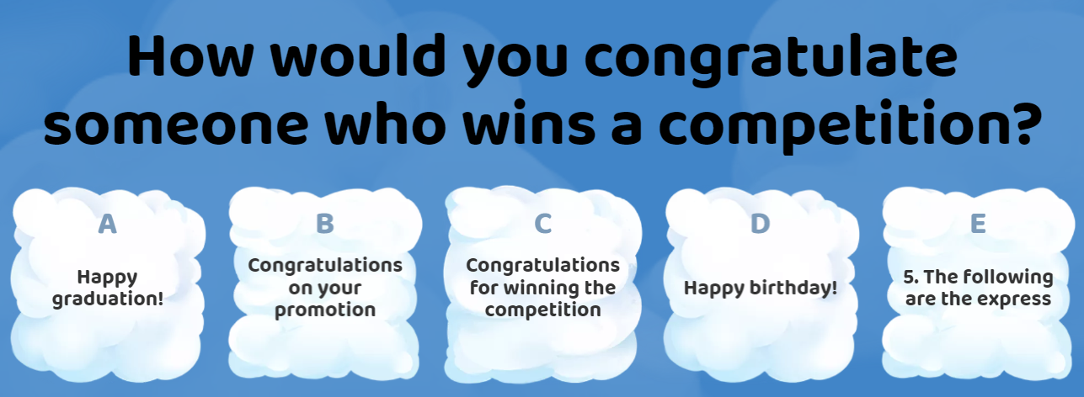
Warm-up

Slide 6
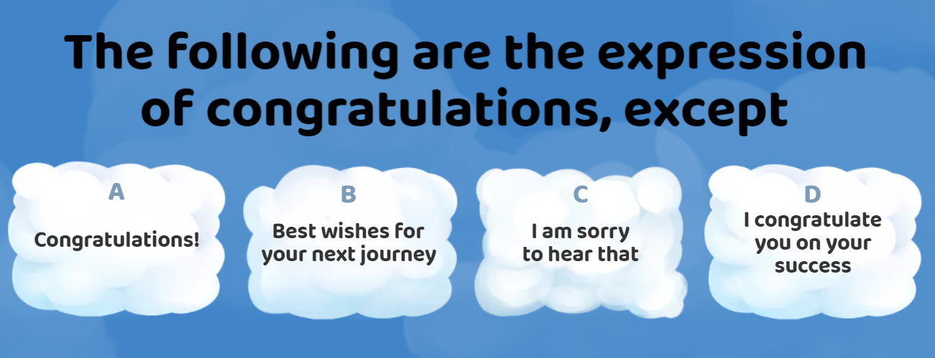
Warm-up

Slide 7
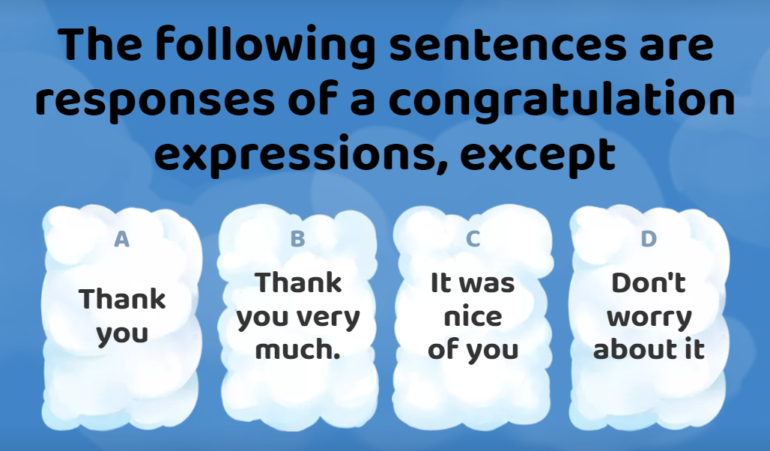
Warm-up

Slide 8
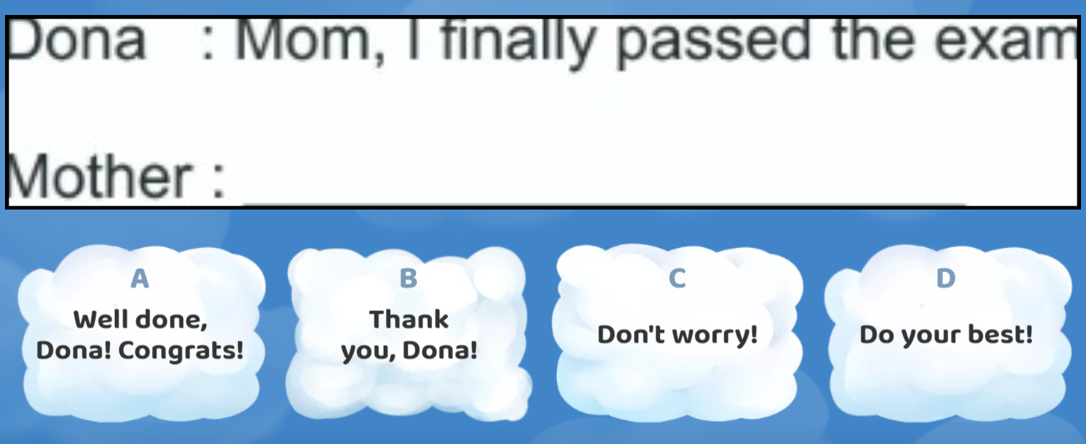
Warm-up

Slide 9
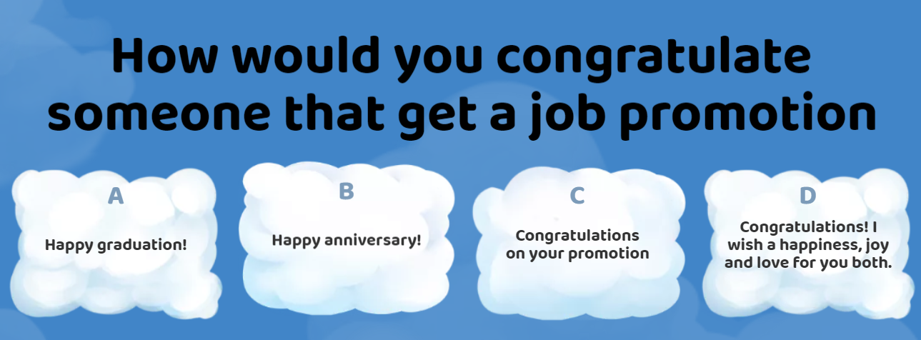
Warm-up

Slide 10
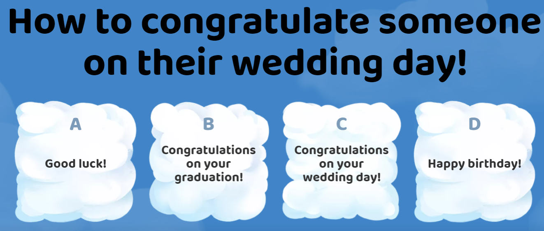
Warm-up

Slide 11
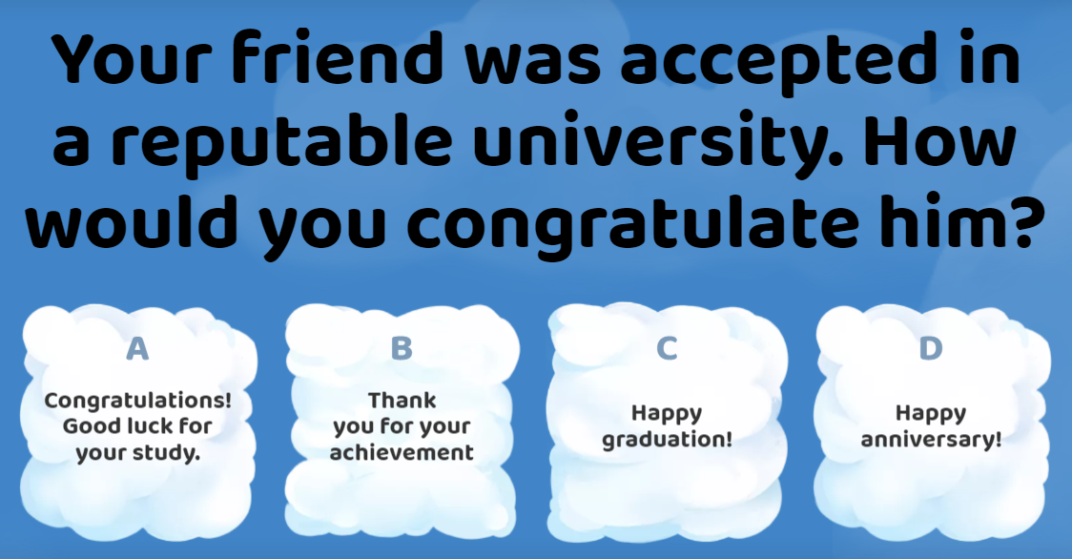
Warm-up

Slide 12
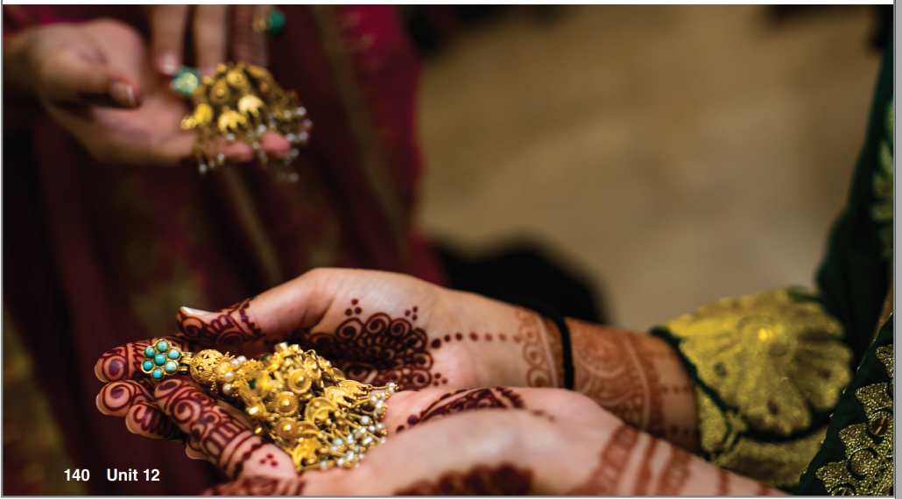
What do you say to someone when they get married?
What about on somebody’s birthday?

Slide 13
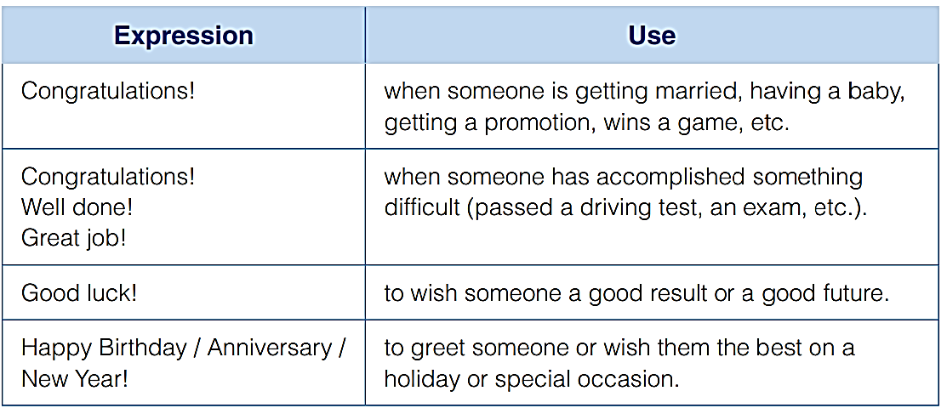
Language Expansion:
Expressions for Celebrations

Slide 14
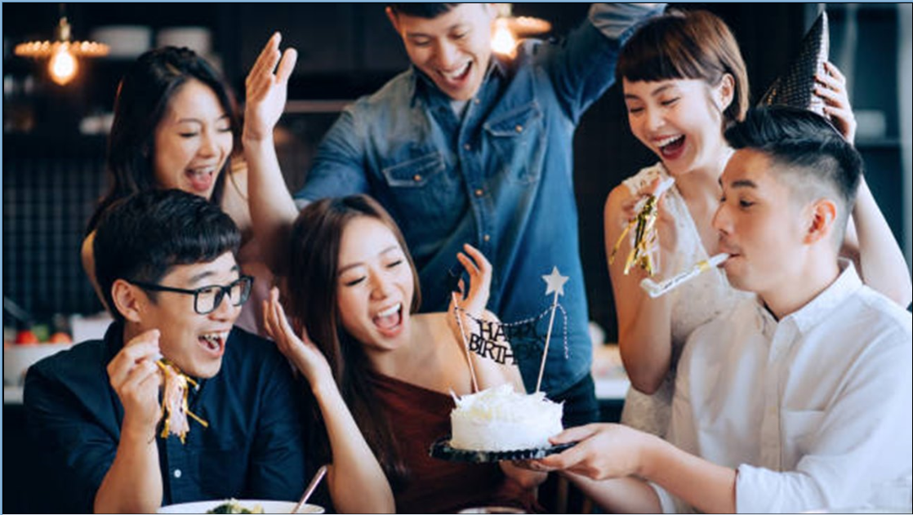
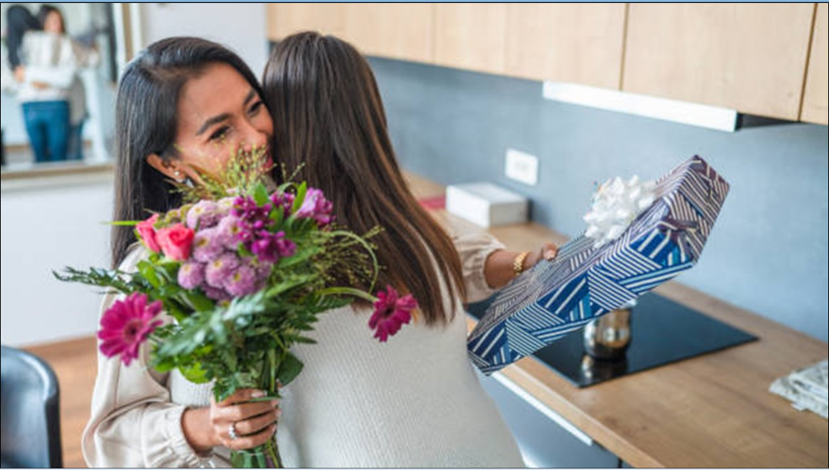
Happy birthday! Thanks for having/inviting us!
Thank you! You’re welcome!
Congratulations on your promotion!
It’s very kind of you! Thank you!

Slide 15
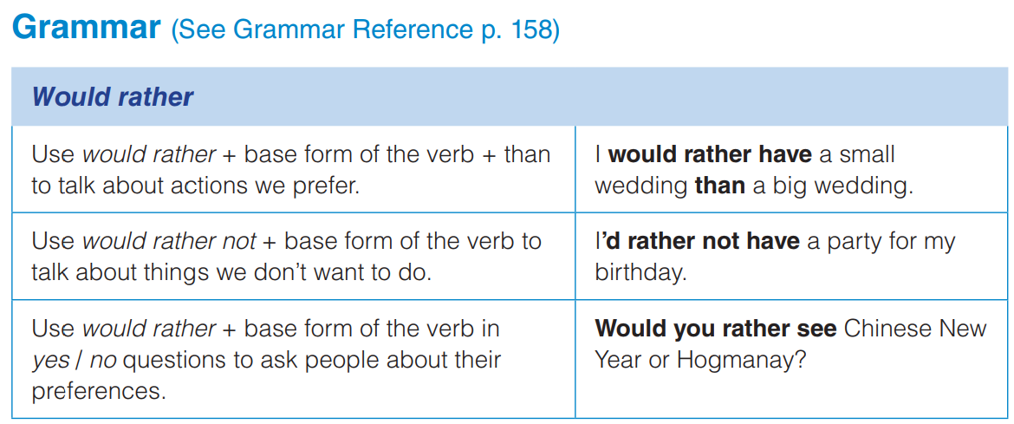
I’d rather have
one

Slide 16
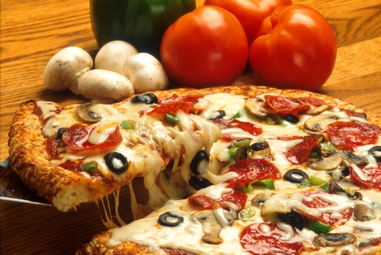
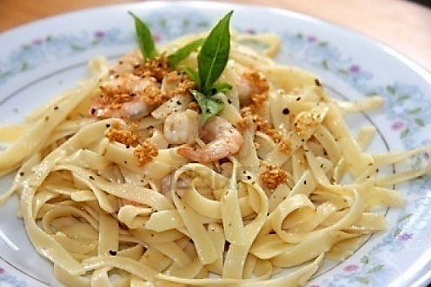
Use
Subject + Would Rather + Base Verb
Would rather is used to show a choice from different options.
Would you rather eat pizza or pasta?
I would rather eat pizza.
Would Rather + Subject + Base Verb?
v.s

Slide 17
Would rather …than
show PREFERENCE
He would rather wear T-shirts than shirts.
She would rather have studied online than offline.

Slide 18
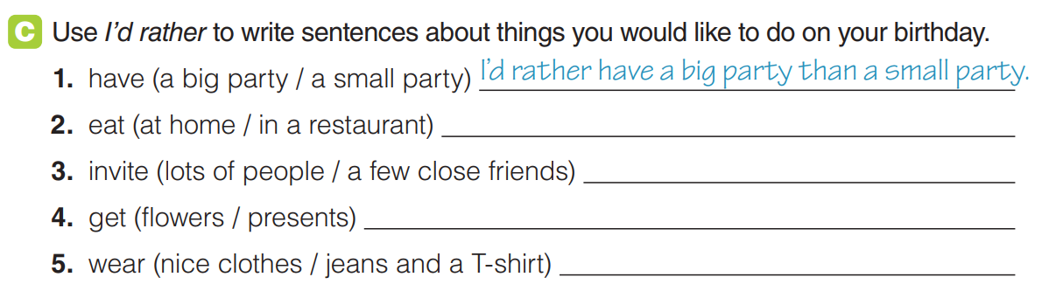
practice
I’d rather eat at home than in a restaurant.

Slide 19
Extra exercise
Rewrite sentences using would rather/ ‘d rather:
(drive motorbike/walk home)
Mike’d rather ……………………………………………………
(leave now/wait a few minutes)
I’d rather …………………………………………………………
(play tennis/go for a swim)
I’d rather …………………………………………………………
(think about this problem for a while/appreciate now)
He’d rather ………………………………………………………
(eat at home/go to a restaurant)
I’d rather……………………………………………………………
drive a motorbike than walk home.
leave now than wait for more.
play tennis than go for a swim.
think about this problem for a while than appreciate
it now.
eat at home than go to a restaurant.

Slide 20
CHOOSE A CORRECT OPTION
1. I would rather . . . at home tonight.
A. stay B. stayed C. had stayed
2. Chris’d rather . . . to the cinema this evening.
A. go B. went C. had gone
3. I’d rather come with you . . . here alone.
A. than staying B. than stay C. to stay
4. I’d rather go in July . . . in June.
A. to B. that C. than
5. I would rather . . . her go for a walk than stay at home.
A. has invited B. invite C. invites

Slide 21
CHOOSE A CORRECT OPTION
1. I would rather . . . at home tonight.
A. stay B. stayed C. had stayed
2. Chris’d rather . . . to the cinema this evening.
A. go B. went C. had gone
3. I’d rather come with you . . . here alone.
A. than staying B. than stay C. to stay
4. I’d rather go in July . . . in June.
A. to B. that C. than
5. I would rather . . . her go for a walk than stay at home.
A. has invited B. invite C. invites

Slide 22


