Slide 1
communication
UNIT 12 - CELEBRATION

Slide 2
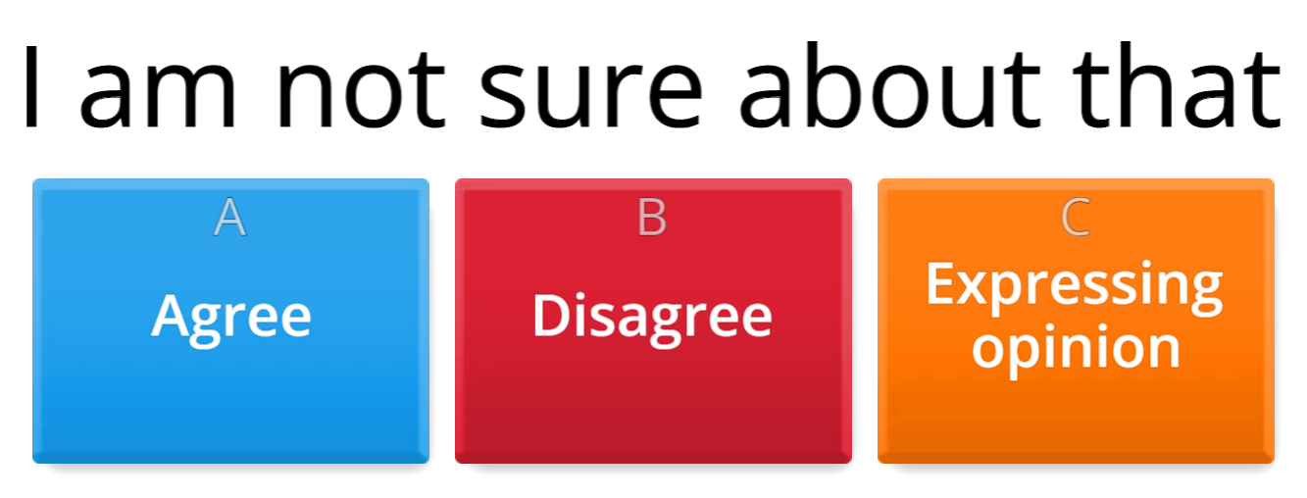
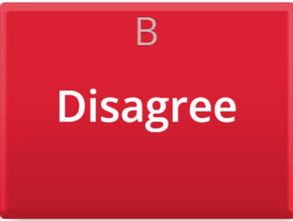
Warm-up: agree/disagree/expressing opinions

Slide 3
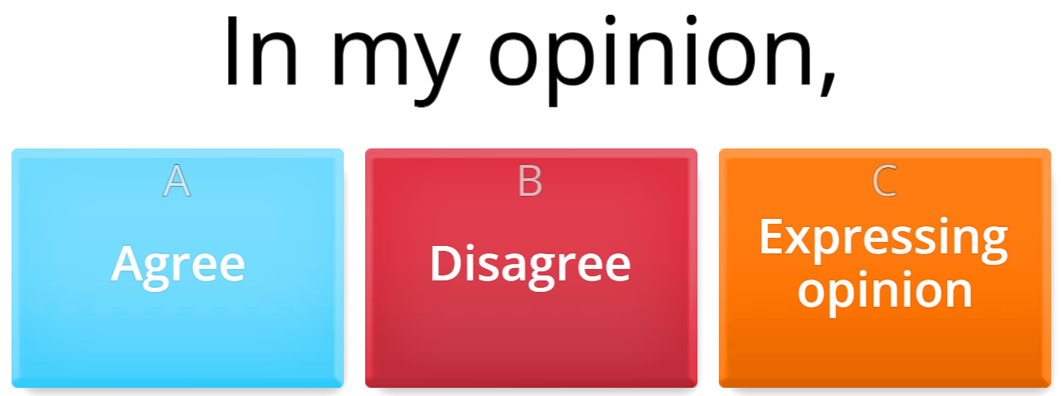
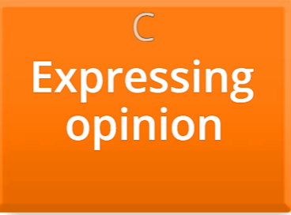
Warm-up: agree/disagree/expressing opinions

Slide 4
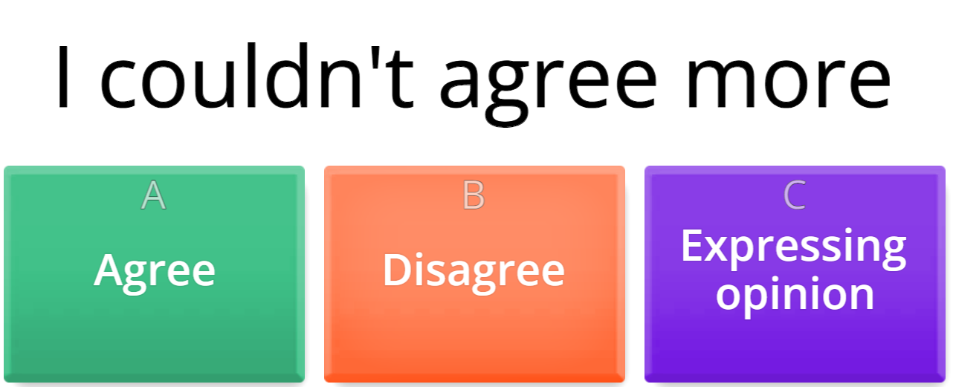
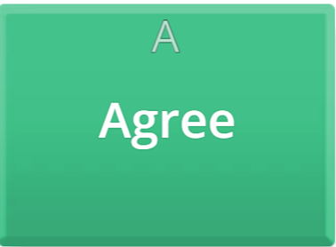
Warm-up: agree/disagree/expressing opinions

Slide 5
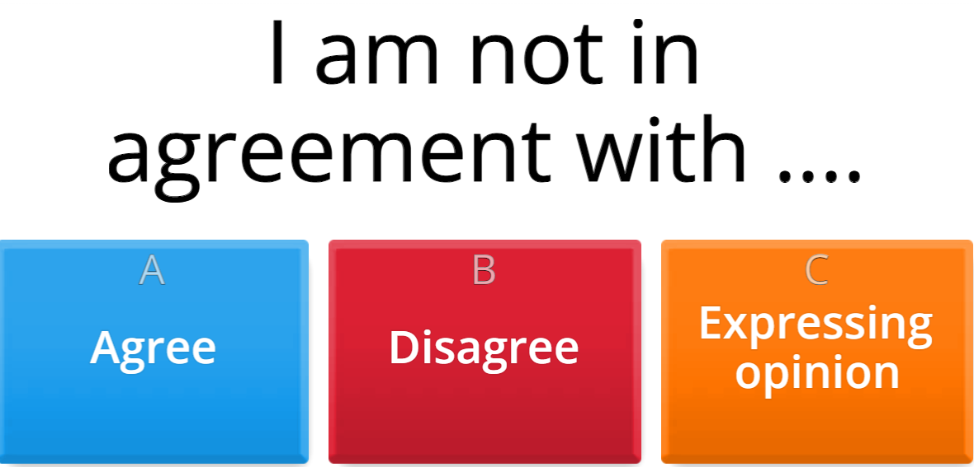
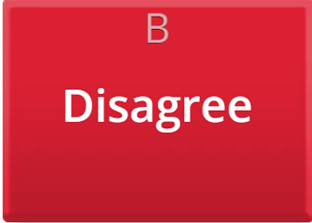
Warm-up: agree/disagree/expressing opinions

Slide 6
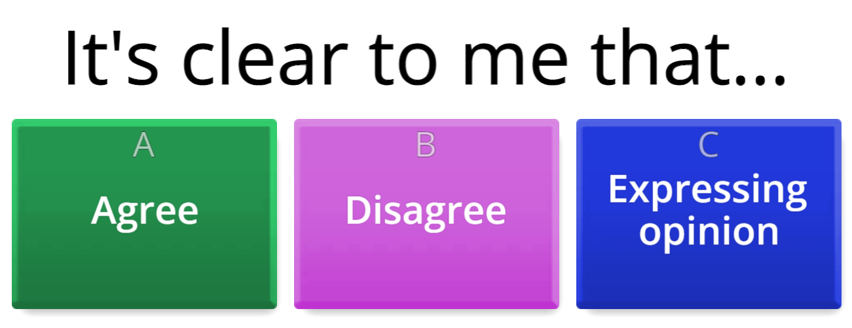
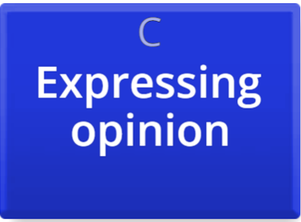
Warm-up: agree/disagree/expressing opinions

Slide 7
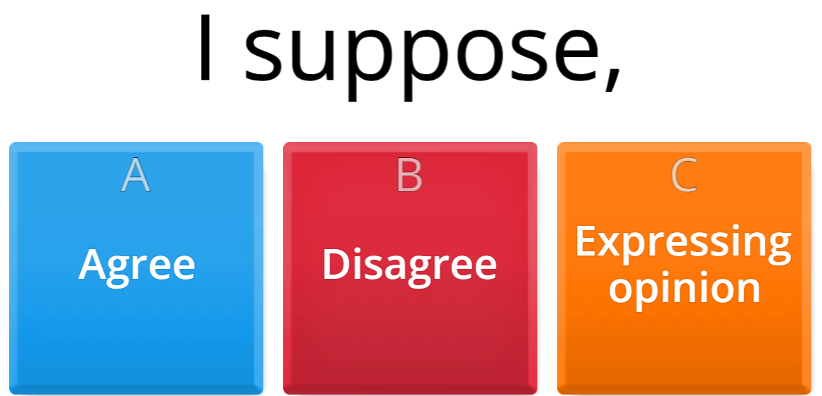

Warm-up: agree/disagree/expressing opinions

Slide 8
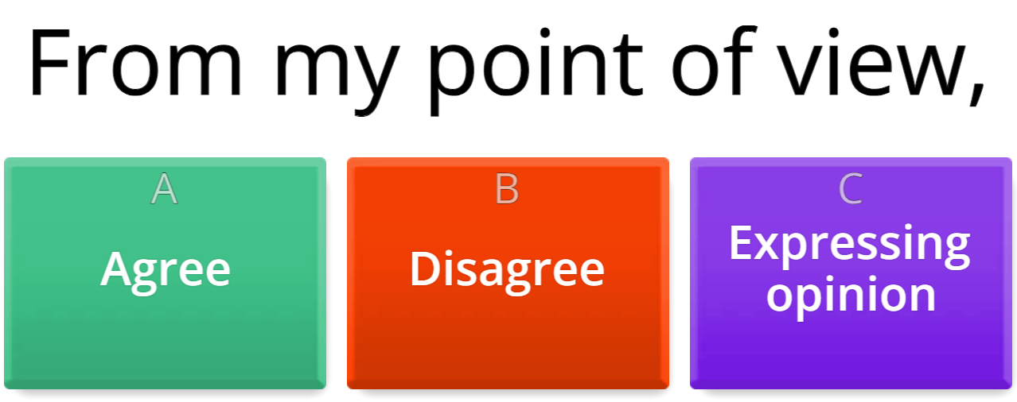
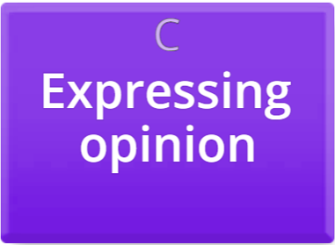
Warm-up: agree/disagree/expressing opinions

Slide 9
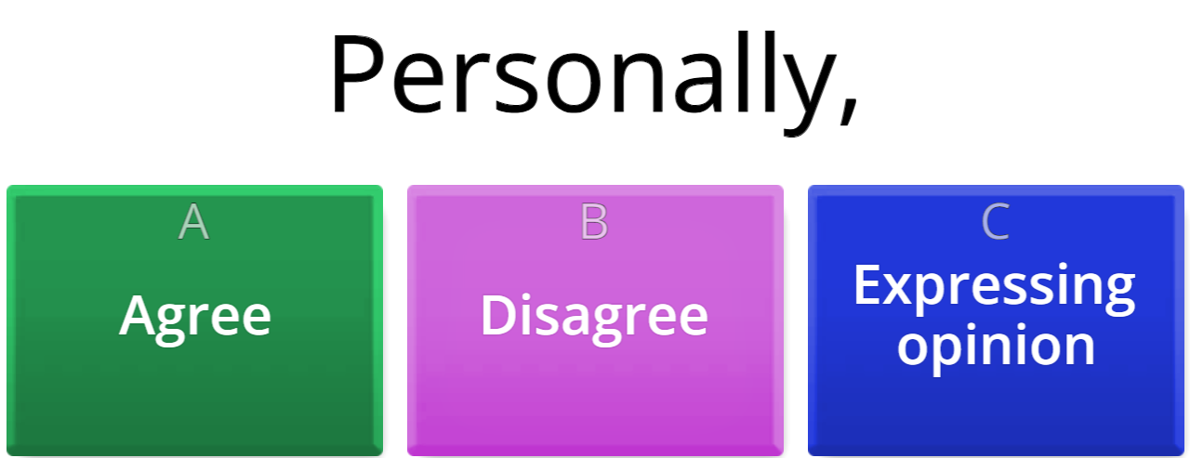
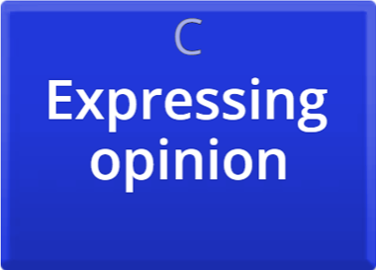
Warm-up: agree/disagree/expressing opinions

Slide 10
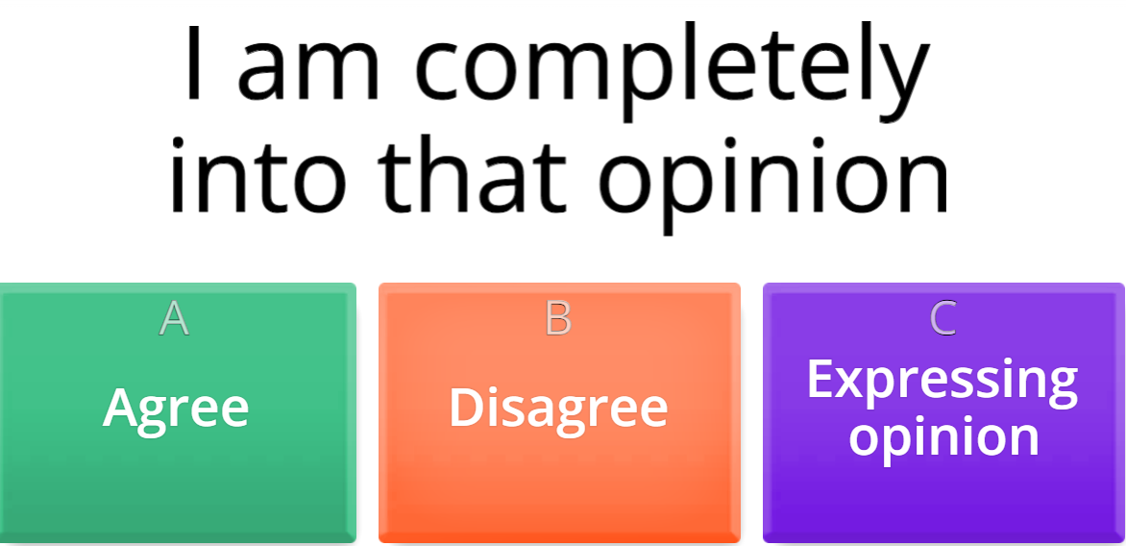
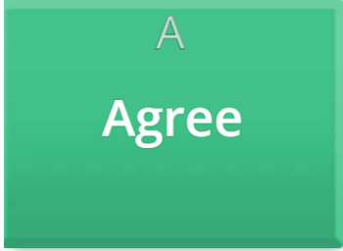
Warm-up: agree/disagree/expressing opinions

Slide 11
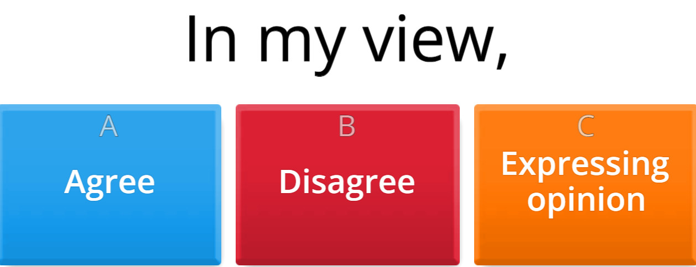
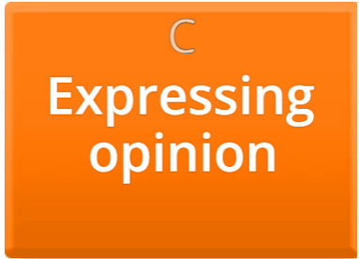
Warm-up: agree/disagree/expressing opinions

Slide 12
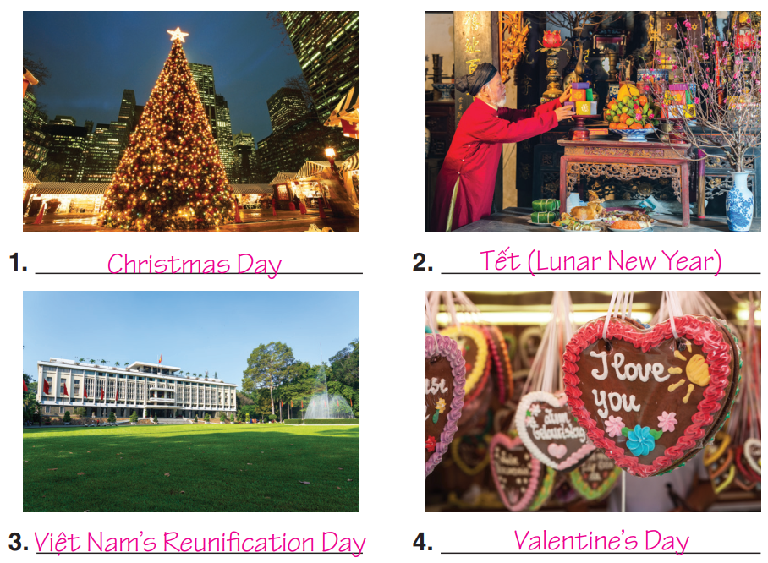

Match the holidays to the photos. When are these holidays? Say which one you like best and why.
Tết (Lunar New Year)
Việt Nam’s Reunification Day
Christmas Day
Valentine’s Day

Slide 13
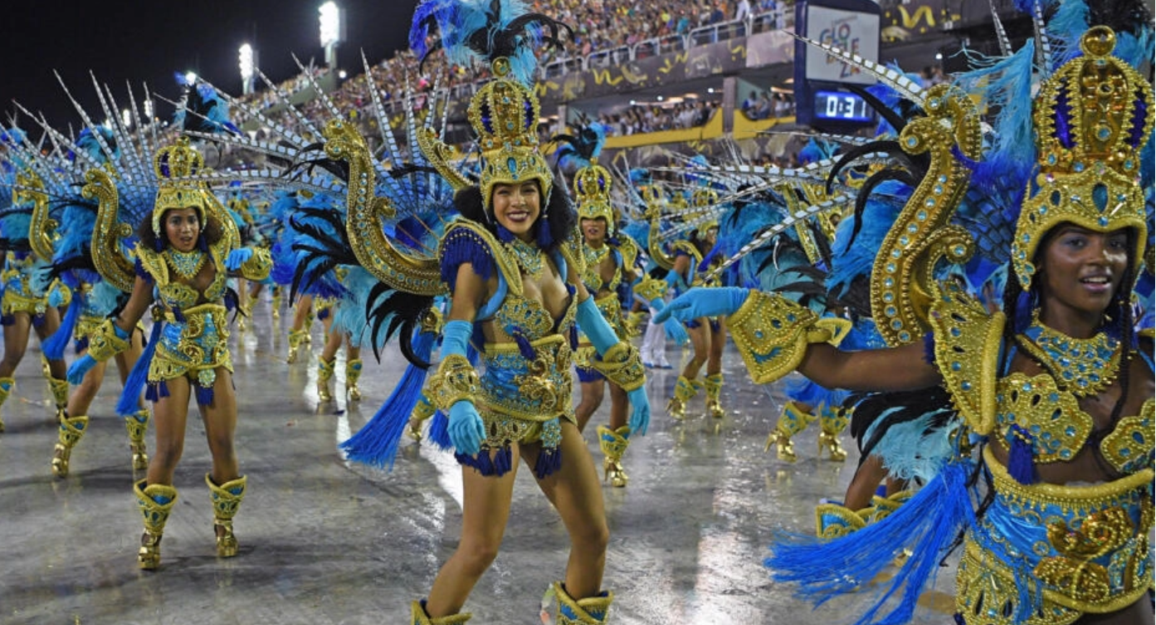
What holiday are these people celebrating?
A CARNIVAL

Slide 14
Where is it? How are they celebrating?
Places: many in the world
Rio de Janeiro, Brazil
New Orleans, US
Venice, Italy
A carnival includes public celebrations
parades
public street parties
other entertainments
Adjectives:
Colourful
Enjoyable
Exciting
Entertaining
Incredible
happy
neon light
vibrant

Slide 15
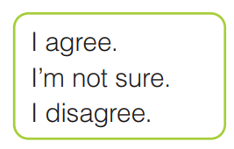
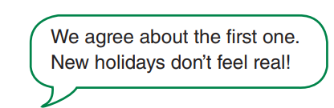
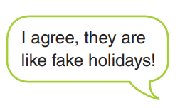
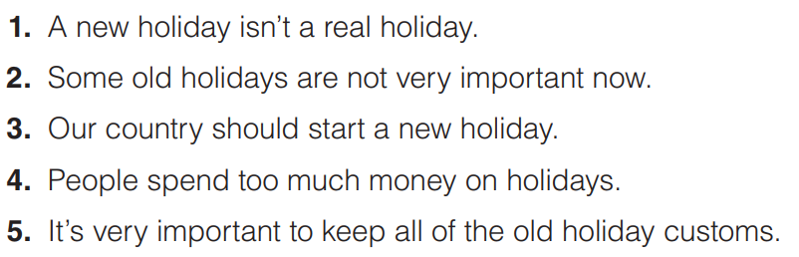
What’s your opinion?

Slide 16


