Slide 1
Writing
UNIT 12 - CELEBRATIONS

Slide 2

TOPIC: COLLEGE
WRITING A PARAGRAPH
Topic sentence
CONTROLLING IDEA:
(ENJOY GOING…) FOR MANY REASONS
I enjoy going to college for so many reasons. You get to meet new people and make friends. I find the subject I’m studying quite challenging, but interesting. I really enjoy it!
Supporting sentences
End sentence

Slide 3
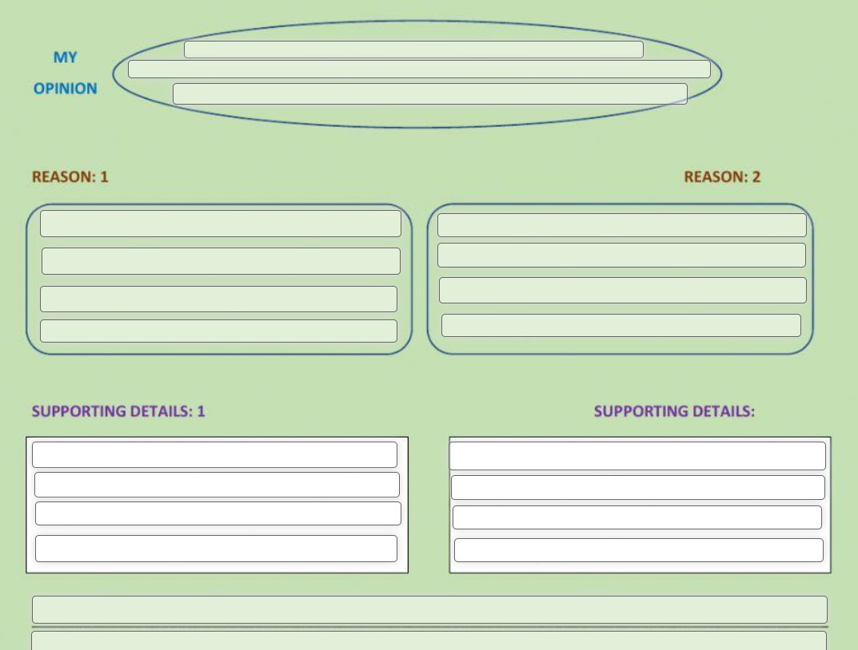
WRITING AN OPPINION PARAGRAPH
Topic sentence
Concluding sentence

Slide 4
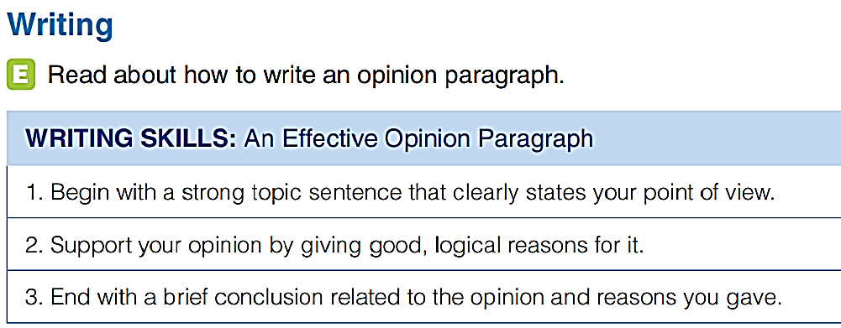

Slide 5
It is important to remember old holiday customs.
Old holiday customs are an important connection to our present and past culture, so we should not forget them. A culture is built upon a lot of values, beliefs, and practices. The customs, especially those shown in holidays and celebrations, are often the easiest parts to see in a culture. They form parts of our identities and help to distinguish one community from another. Therefore, practicing these customs is an easy way to let others know who we are. Moreover, the old customs also provide a connection between different generations. In today's busy world, members of a family may only gather during a holiday or a celebration. Then, during the preparation and practice of the old customs, we may see the older members explaining to the younger ones the meaning of the customs and the steps involved. In so doing, they not only pass on the traditional knowledge and beliefs within the customs but also strengthen the connections between the old and the young. That is why it is important to remember and practice old customs.

Slide 6
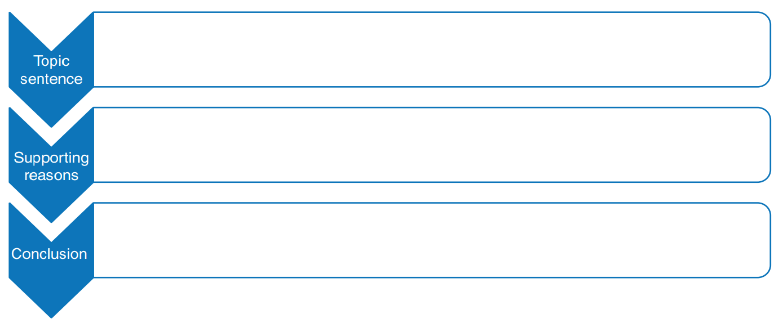

Slide 7


