Slide 1
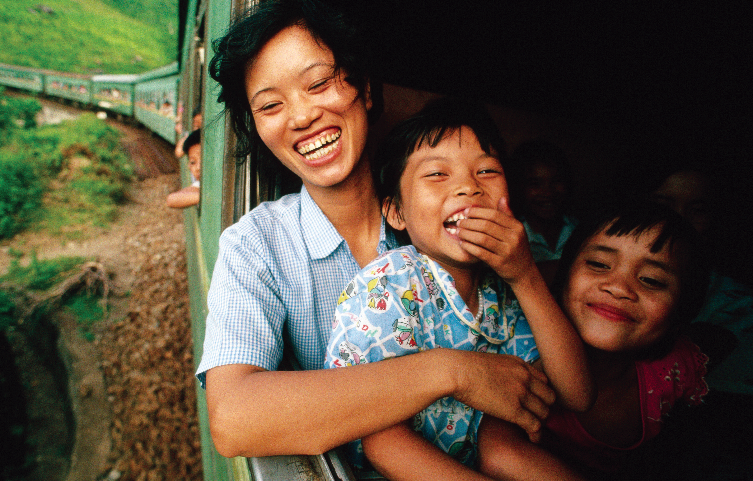

Unit 3
My Family
Bringing the world to the classroom and the classroom to life
ELTNGL.COM
A PART OF CENGAGE

Slide 2
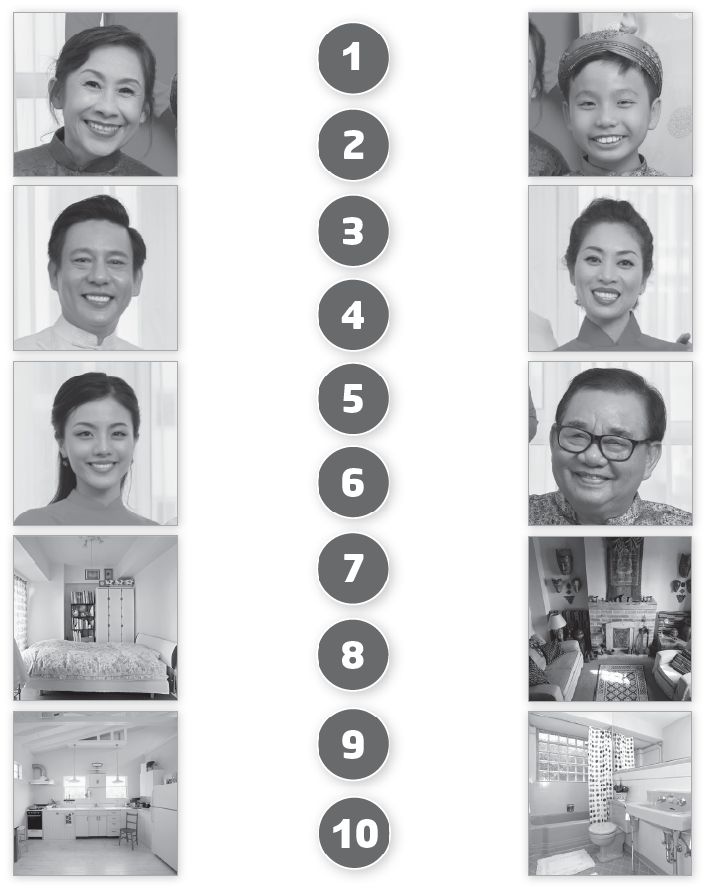

1 Listen and Look. Draw a line.
TR: A32
U3 p. 20

Slide 3
Script
TR: A32
Unit 3
Activity 1
Listen and look. Draw a line.
1. sister sister
2. grandpa grandpa
3. mother mother
4. brother brother
5. grandma grandma
6. father father
7. living room living room
8. kitchen kitchen
9. bathroom bathroom
10. bedroom bedroom

Slide 4

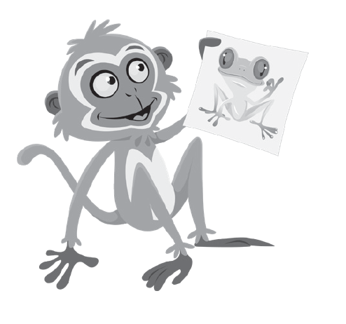
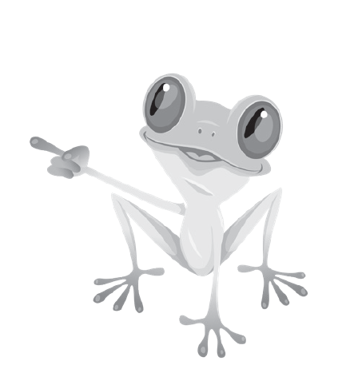

2 Listen and say.
TR: A33
U3 p. 21

Slide 5
Script
TR: A33
Activity 2
Listen and say.
(Monkey) Who’s this?
(Frog) It’s my sister.

Slide 6
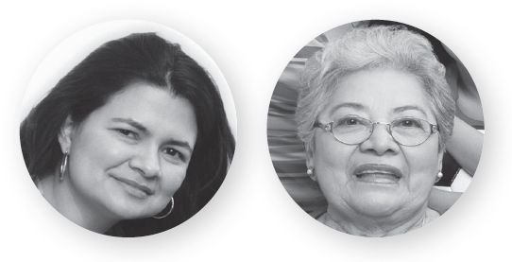
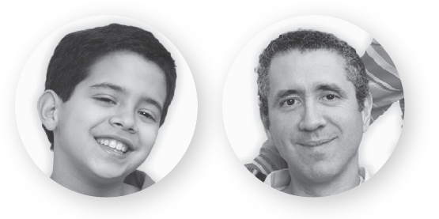
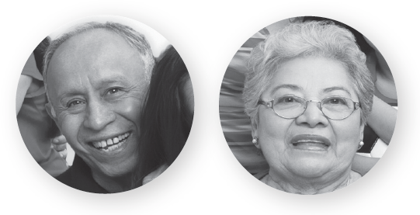
3 Listen and circle.
TR: A34
1.
2.
3.
U3 p. 21

Slide 7
Script
TR: A34
Activity 3
Listen and circle.
1. Who’s this? It’s my mother.
2. Who’s this? It’s my father.
3. Who’s this? It’s my grandpa.

Slide 8




4 Listen and say.
TR: A35
U3 p. 21

Slide 9
Script
TR: A35
Activity 4
Listen and say.
(Parrot) Where’s Mother?
(Elephant) In the living room.

Slide 10


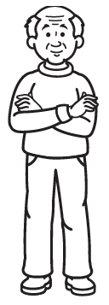
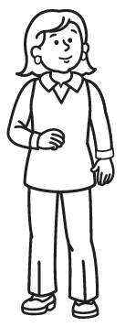

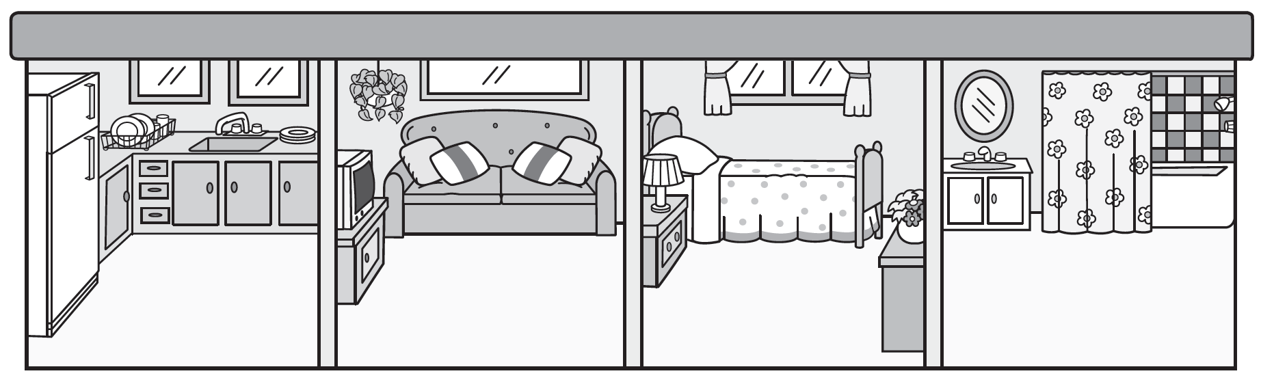
5 Cut out the cards on page 37. Listen. Where’s the family? Glue the cards. Say.
TR: A36
U3 p. 21

Slide 11
Script
TR: A36
Activity 5
Cut out the cards on page 37. Listen. Where’s the family? Glue the cards. Say.
1. Where’s Grandpa? In the kitchen.
2. Where’s Mother? In the bedroom.
3. Where’s Father? In the bathroom.
4. Where’s Grandma? In the living room.

Slide 12



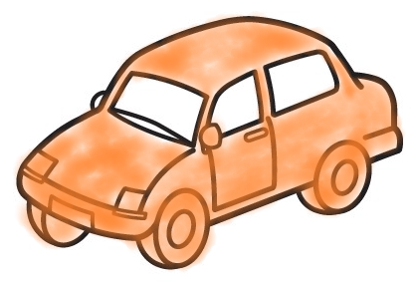




6 Listen. Color and say.
TR: A37
1.
2.
3.
4.
U3 p. 22

Slide 13
Script
TR: A37
Activity 6
Listen. Color and say.
1. a black pen
2. an orange car
3. a white balloon
4. a green book

Slide 14
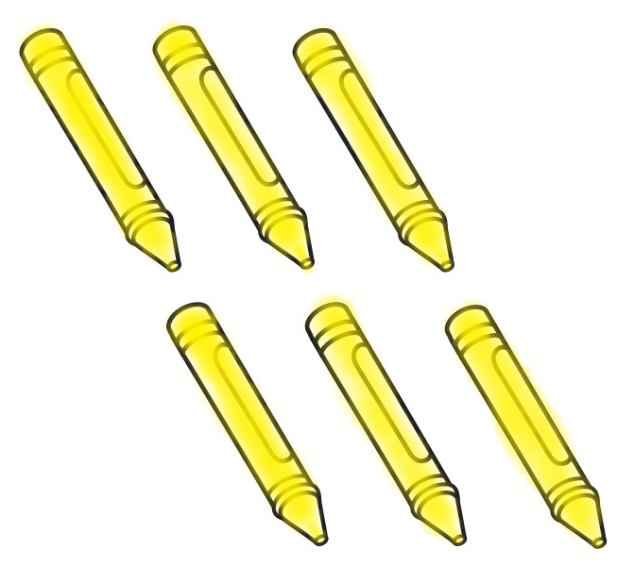
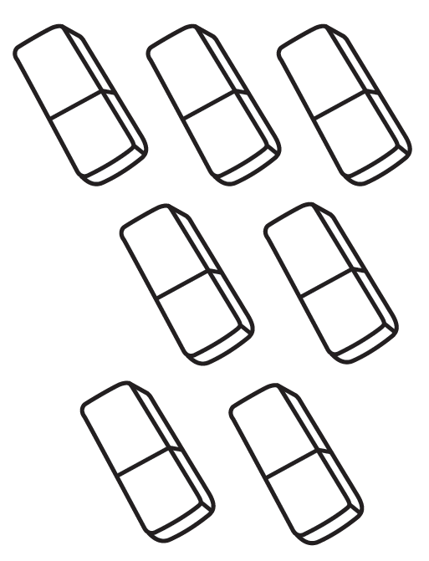


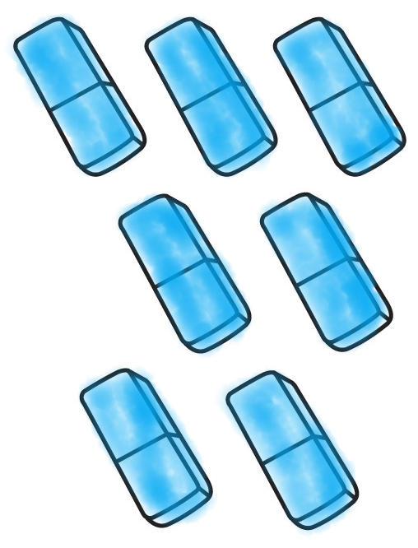

7 Listen. Color. Count and say.
TR: A38
U3 p. 22

Slide 15
Script
TR: A38
Activity 7
Listen. Color. Count and say.
six yellow crayons;
eight black pens;
seven blue erasers

Slide 16
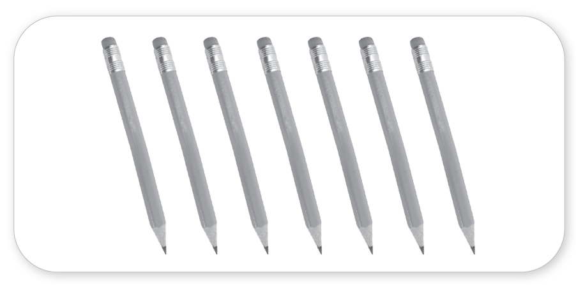
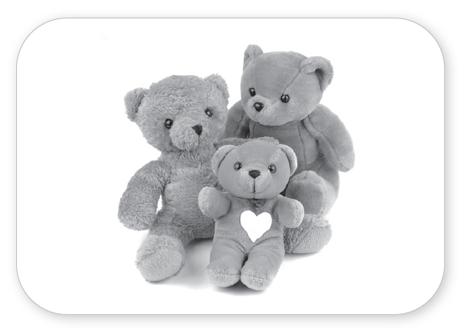
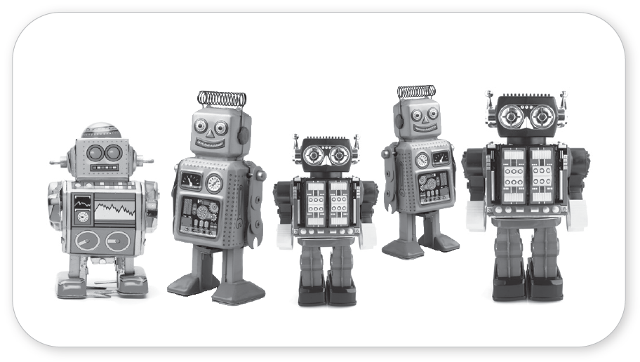

8 Listen. Count and write.
TR: A39
_______
7
_______
3
_______
_______
5
8
U3 p. 22

Slide 17
Script
TR: A39
Activity 8
Listen. Count and write.
How many pencils?
How many teddy bears?
How many robots?
How many books?

Slide 18
9 Listen and say.
TR: A40
Script
Activity 9
Listen and say.
1. Y /j/ /j/ Yellow Yellow
2. A /æ/ /æ/ Apple Apple
3. I /ɪ/ /ɪ/ Sit Sit
U3 p. 23

Slide 19



10 Listen and look. Which word is different? Circle.
TR: A41
1.
2.
3.
U3 p. 23

Slide 20
Script
TR: A41
Activity 10
Listen and look. Which word is different? Circle.
1. /j/ yes /j/ yellow /j/ kitchen
2. /æ/ love /æ/ apple /æ/ arrow
3. /ɪ/ sit /ɪ/ do /ɪ/ fish

Slide 21
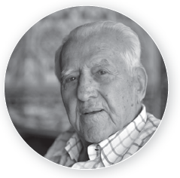
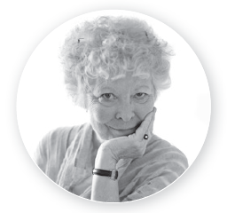
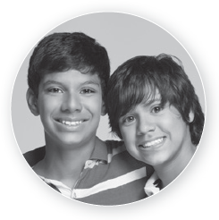

11 Listen and chant. Say a new verse.
TR: A42
I love my
Oh yes, I do.
My and my
love him, too.
I love my
Oh yes, I do.
My and my
love her, too.
U3 p. 23

Slide 22
Script
TR: A42
Activity 11
Listen and chant. Say a new verse.
I love my grandpa!
Oh yes, I do.
My brothers and
my sisters love him, too.
I love my grandma!
Oh yes, I do.
My sisters and
my brothers love her, too.

Slide 23
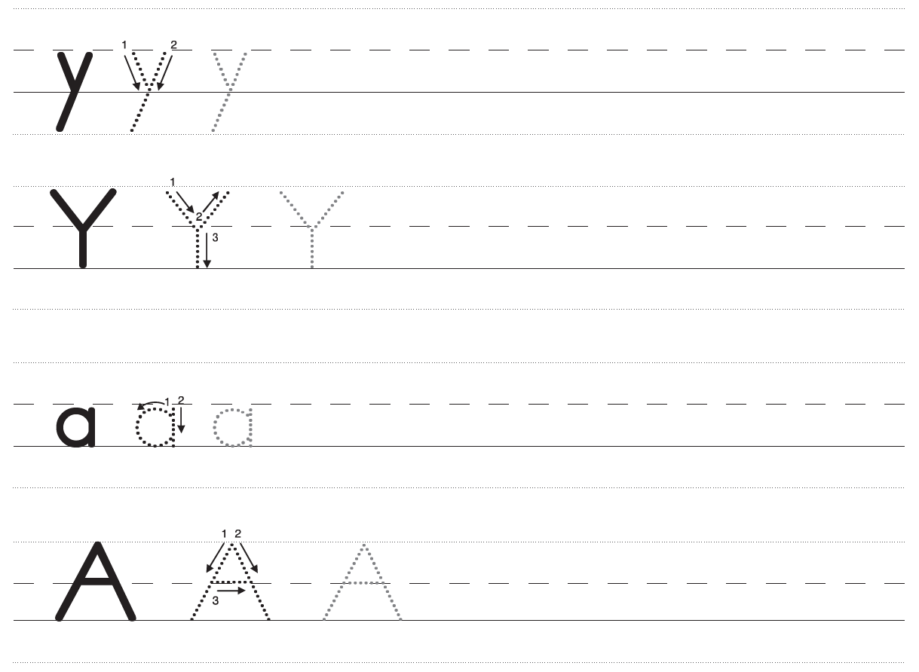
12 Trace and write.
U3 p. 24

Slide 24
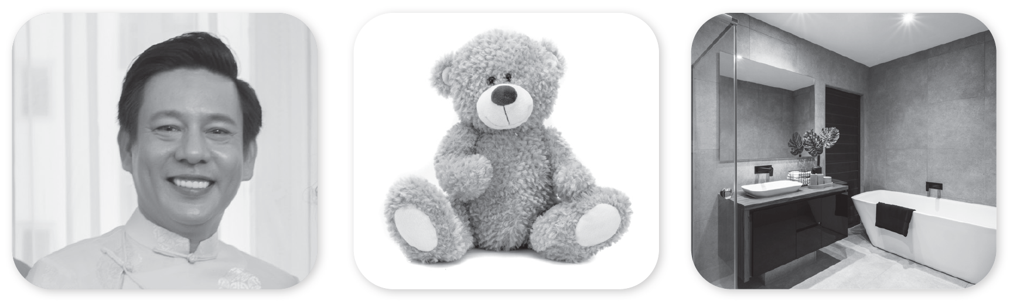



12 Trace and write.
U3 p. 24

Slide 25
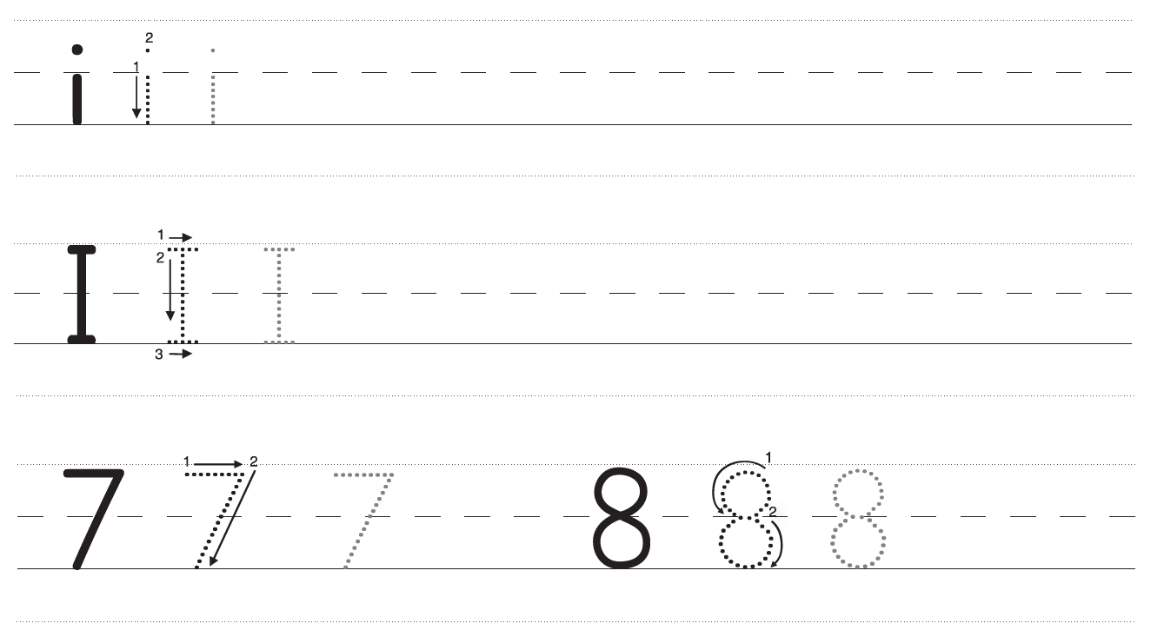
12 Trace and write.
U3 p. 25

Slide 26




12 Trace and write.
U3 p. 25

