Slide 1

Unit Review

Slide 2
PROJECT 1

Slide 3
English Time Chant
English, (clap) English, (clap)
English (clap) today! (clap, clap)
English, (clap) English, (clap)
Hip, hip, (clap) hooray! (clap, clap)
Notes:
Say Good morning/afternoon, class. How are you
today?
Get students ready to use the English Time chant.
Lead the class in the chant.

Slide 4
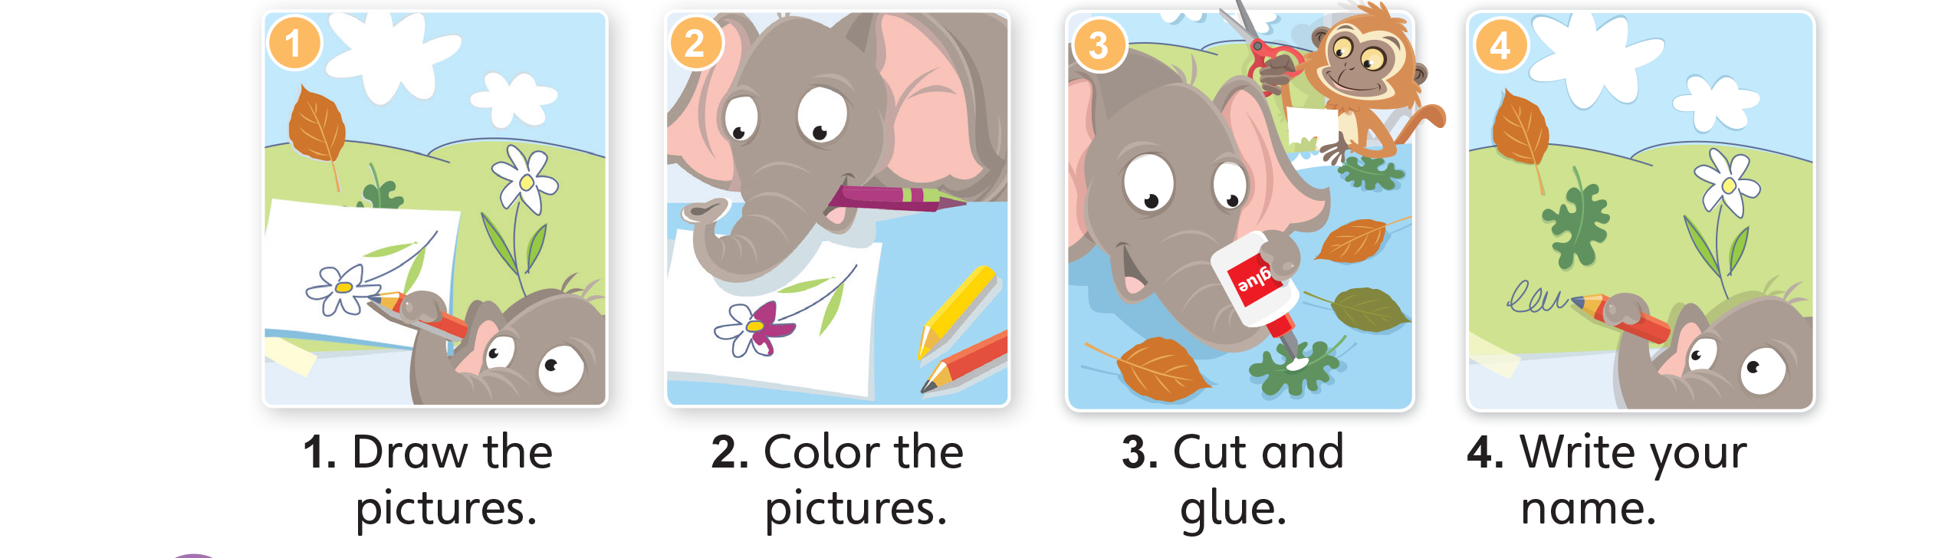
Notes:
Say Today, we’re going to make a poster
about nature. Have students open their books to
p. 45 and look at the pictures.
On the board, write the following steps: 1. Draw.
2. Color. 3. Cut and glue. 4. Write your name.
Read them aloud, and then have students read
them with you. Model doing the steps.
Place students in groups of four. Give them 15
minutes to do the project. Walk around the room
to provide help as needed.

Slide 5

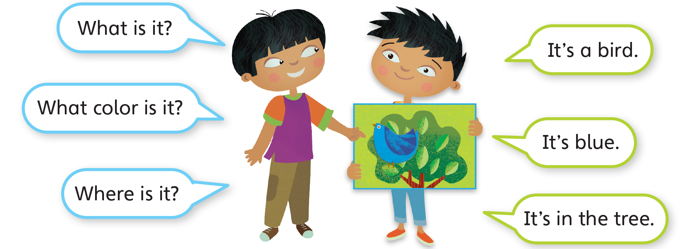
Notes:
Have students look at Activity 2 on p. 45. Call
on two students to read the model dialogue. Write
the questions What is it? What color is it? Where is
it? on the board. Then draw students’ attention to
the posters. Point to an object in a poster and ask
the three given questions in turn. Have the group
members who made that poster stand up and give
answers.
When students are more comfortable, have the
groups discuss one another’s poster.

Slide 6
What is it?
It’s a bird.
What color is it?
It’s blue.
Where is it?
It’s on the tree.
Notes:
Point to an object in a poster and ask
the three given questions in turn. Have the group
members who made that poster stand up and give
answers.
When students are more comfortable, have the
groups discuss one another’s poster.

Slide 7

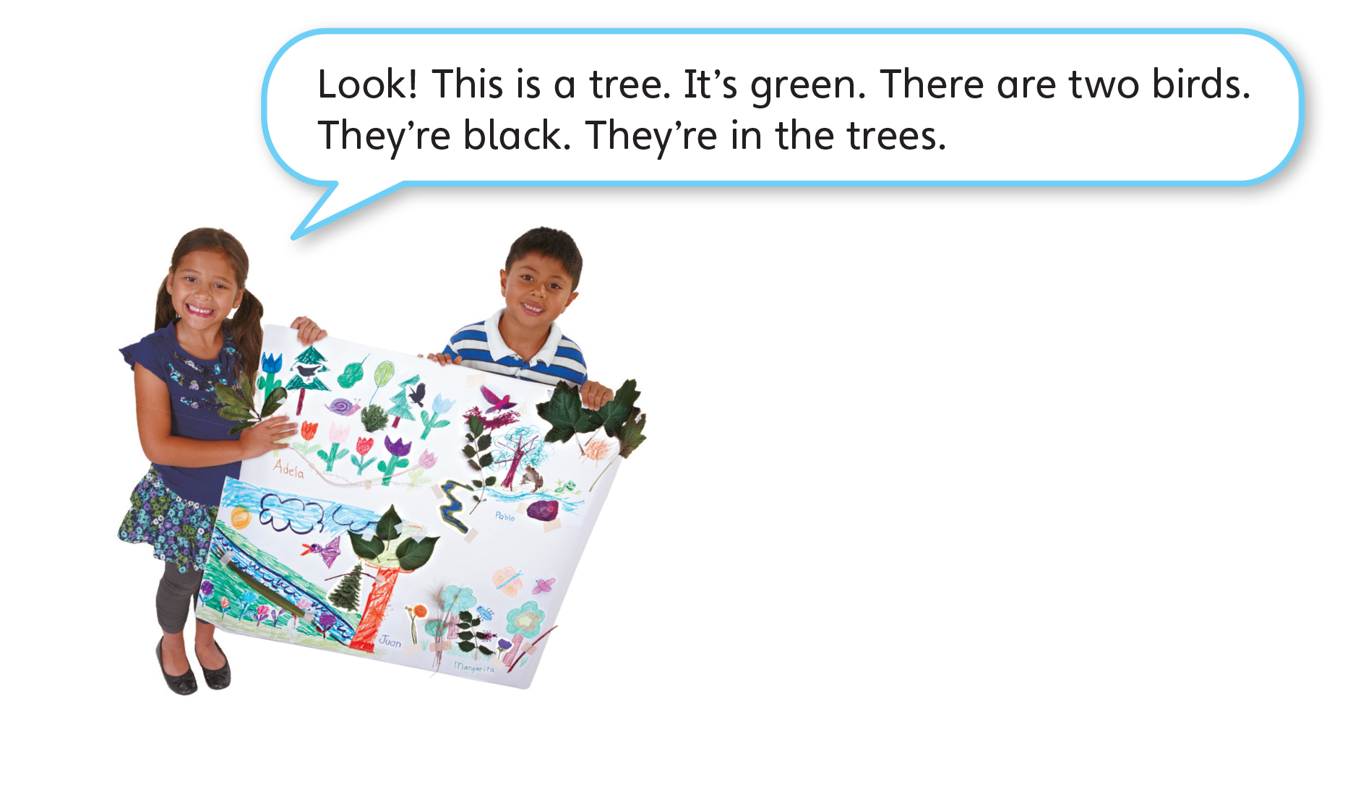
Notes:
Have students look at the girl in the example.
Read out what she is saying. Then say Now you
talk about your poster.
Give each group 2-3 minutes to prepare the
presentation. Invite a representative from each
group to present their project.

Slide 8
Now let’s tell us about your poster.
Notes:
Have students look at the girl in the example.
Read out what she is saying. Then say Now you
talk about your poster.
Give each group 2-3 minutes to prepare the
presentation. Invite a representative from each
group to present their project.

Slide 9
Goodbye Chant
Good work, class.
Hip hip, hooray!
Goodbye for now.
Have a nice day!
Notes:
Say Nice work today, class. Now let’s chant.
Lead the class in the Goodbye chant.

Slide 10

Let’s Check
What are some things in nature?
What color is it?
Where is it?
Where are they?
Notes:
Can students talk about things in nature?
As students leave the class, ask them some questions
such as What are some things in nature? What color is
it? Where is it? Where are they?

Slide 11
Stop and Check
1A

Slide 12
English Time Chant
English, (clap) English, (clap)
English (clap) today! (clap, clap)
English, (clap) English, (clap)
Hip, hip, (clap) hooray! (clap, clap)
Notes:
Say Good morning/afternoon, class. How are you
today?
Get students ready to use the English Time chant.
Lead the class in the chant.

Slide 13

Rock, Paper, Scissors
Win
= 2 spaces
Lose
= 1 space
Notes:
Direct students’ attention to the word Start on
p. 46. Demonstrate how to put a playing piece
over the word to begin the game. Ask two students
to model playing the game. Tell them to play rock,
paper, scissors to determine who goes first.
The winner can move the playing piece forward
two spaces. Point to the picture of 5 pens and
prompt that student to ask What are they? or How
many? The other student should say They’re pens.
or Five.
The loser can move forward one space. Point to
the picture of six erasers and prompt that student
to ask What are they? or How many? The other
student should say They’re erasers. or Six.
Tell students that they need to keep moving along
the game route until they reach the word Finish.

Slide 14
Ask and Answer
What is it? It’s __________.
What are they? They’re __________.
Is it a _______? Yes, it is. / No, it isn’t.
What color is it? It’s __________.
How many? __________.
Where is _______? It’s on/in _________.
Where are _______? They’re on/in _____.
Notes:
Have students read the model dialogue on p. 47.
Then say Now it’s your turn. Play! Take turns. When it’s your turn, move one or two spaces. Then ask a
question.
Have students play the game in pairs. Give a playing
piece to each pair. Remind them to take turns asking
and answering questions.
If students need help when thinking of questions and
answers, write examples on the board:
What is it? It’s __________.
What are they? They’re __________.
Is it a _______? Yes, it is. / No, it isn’t.
What color is it? It’s __________.
How many? __________.
Where is _______? It’s on/in _________.
Where are _______? They’re on/in _________.

Slide 15
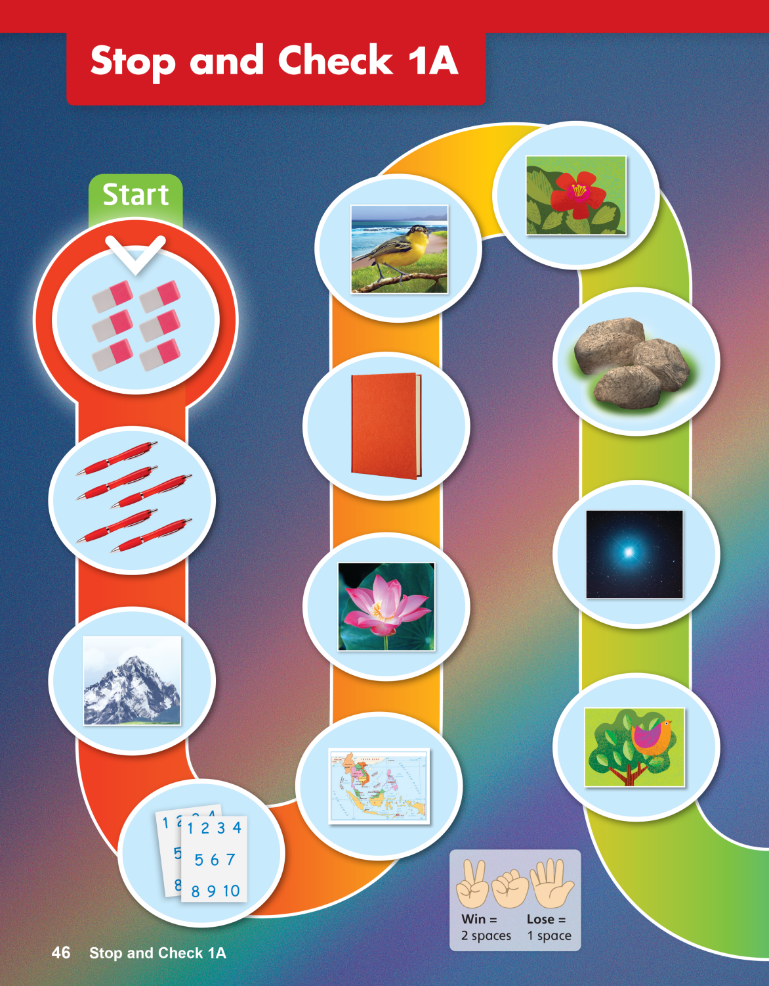
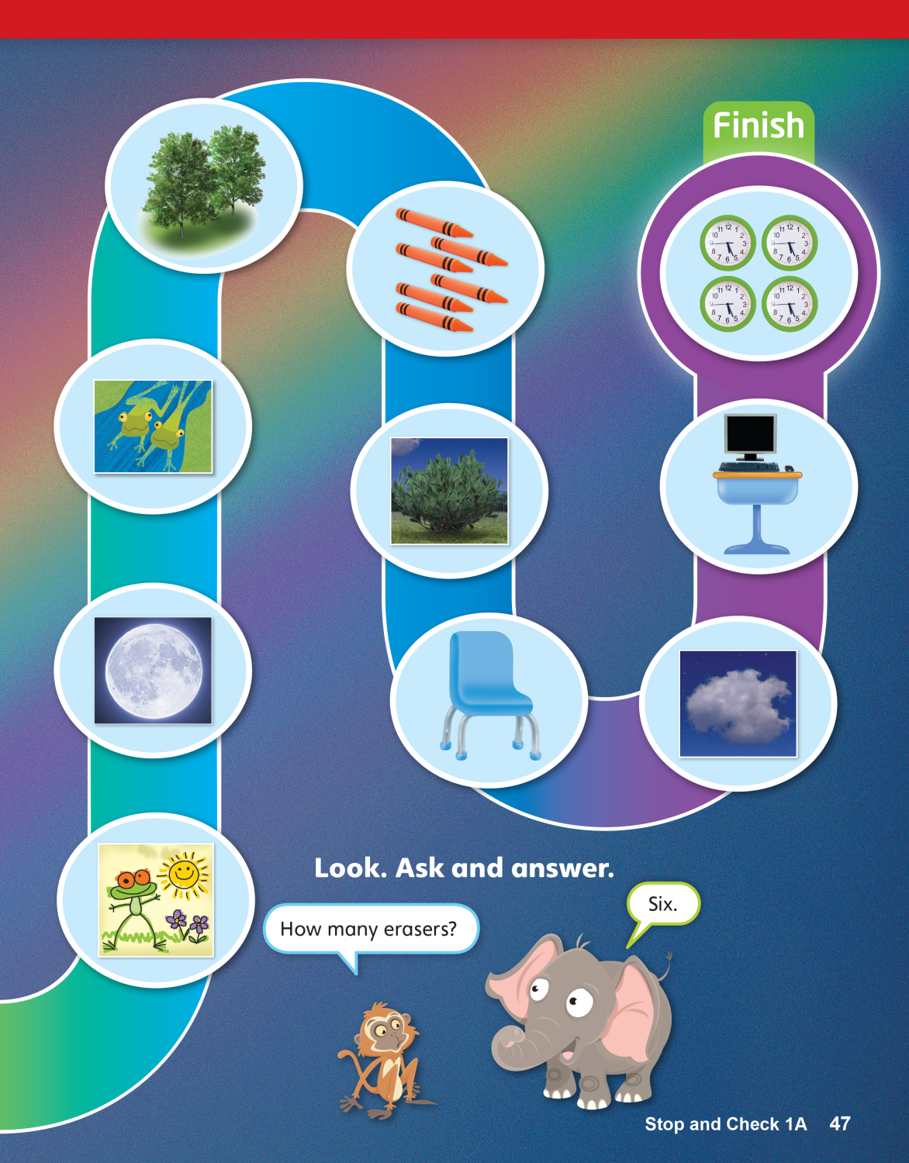
Notes:
Monitor students as they play the game.
Accept responses such as the following: A flower; a
pink flower; birds; six crayons; The stars are in the sky.
When students finish, ask each pair to come to the
front of the room. Choose some random flash cards of
Units 1–2 and have the two students ask and answer
questions about the photos.

Slide 16
Goodbye Chant
Good work, class.
Hip hip, hooray!
Goodbye for now.
Have a nice day!
Notes:
Say Nice work today, class. Now let’s chant.
Lead the class in the Goodbye chant.

Slide 17

Let’s Check
Make a sentence with
a new word you learned.
Notes:
Can students remember and use the new words
they’ve learned?
As students leave the class, ask them to make a
sentence with one word they remember from Units 1–2.

Slide 18
Stop and Check
1B

Slide 19
English Time Chant
English, (clap) English, (clap)
English (clap) today! (clap, clap)
English, (clap) English, (clap)
Hip, hip, (clap) hooray! (clap, clap)
Notes:
Say Good morning/afternoon, class. How are you
today?
Get students ready to use the English Time chant.
Lead the class in the chant.

Slide 20



Notes:
Have students look at the pictures in Activity 1
and talk about them. Point to the first one and
prompt students to say They’re pencils. Point to
other pictures and elicit responses.
Say Listen and circle. Play TR: A71 twice and have
students do the activity. Call on a few students to
say their answers aloud.

Slide 21

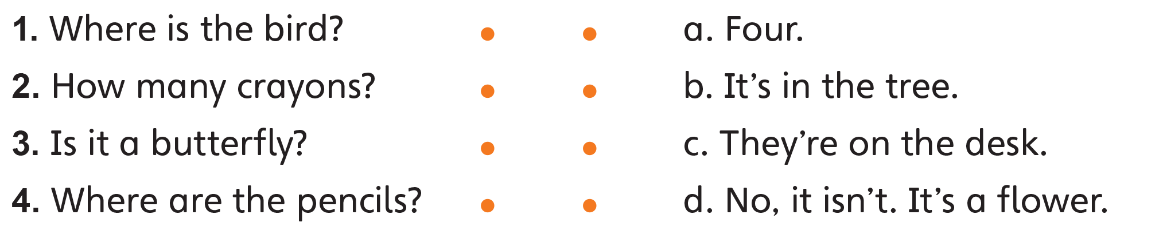
Notes:
Have students look at the four questions and
read them aloud. Say Now draw lines. Have them
do the task on their own. Elicit answers by saying
each question and having students answer it
together.

Slide 22
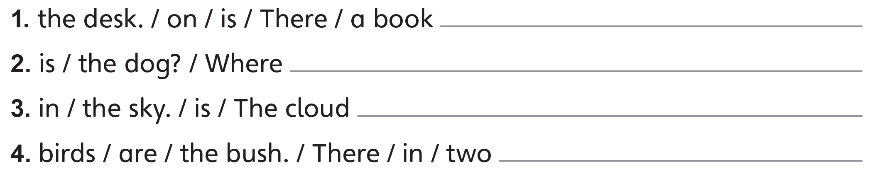
There is a book on the desk.
Where is the dog?
The cloud is in the sky.
There are two birds in the bush.
Notes:
Tell students to reorder the words to make
sentences. Have them do the task.

Slide 23
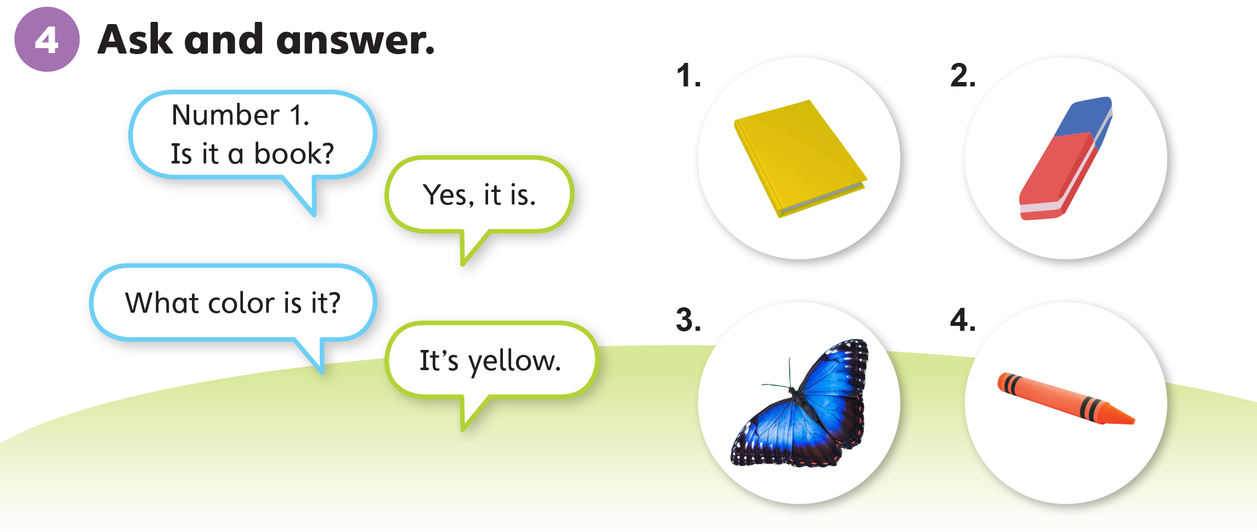
Notes:
Place students in pairs. Have them look at the
four pictures.
Write the following structures on the board, read
them aloud, and have students repeat after you:
Is it a book? Yes, it is.
What color is it? It’s yellow.
Place students in pairs. Have them do the task. Walk
around the room and check students’ work.

Slide 24
Goodbye Chant
Good work, class.
Hip hip, hooray!
Goodbye for now.
Have a nice day!
Notes:
Say Nice work today, class. Now let’s chant.
Lead the class in the Goodbye chant.

Slide 25
Let’s Check
Make a sentence with
a new word you learned.
Notes:
Can students remember and use the new words
they’ve learned?
As students leave the class, ask them to make a
sentence with one word they remember from Units 1–2.

