Slide 1

Unit Review

Slide 2
PROJECT 3

Slide 3
English Time Chant
English, (clap) English, (clap)
English (clap) today! (clap, clap)
English, (clap) English, (clap)
Hip, hip, (clap) hooray! (clap, clap)
Notes:
Say Good morning/afternoon, class. How are you
today?
Get students ready to use the English Time chant.
Lead the class in the chant.

Slide 4

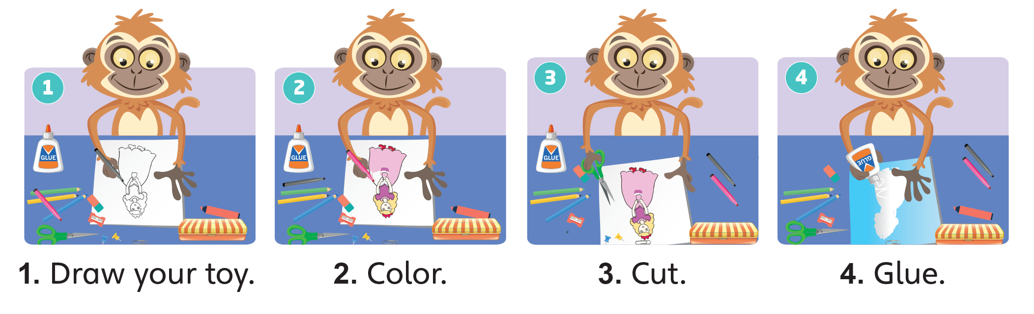
Notes:
Say Today, we’re going to do a project.
Have students open their books to p. 111 and look
at the pictures. Describe the step shown in each
picture and ask students to follow the steps to do
the project.
Have students make their own toys. Give them 15
minutes to draw, color, cut, and glue to complete
the project.
Walk around to provide help if necessary.

Slide 5

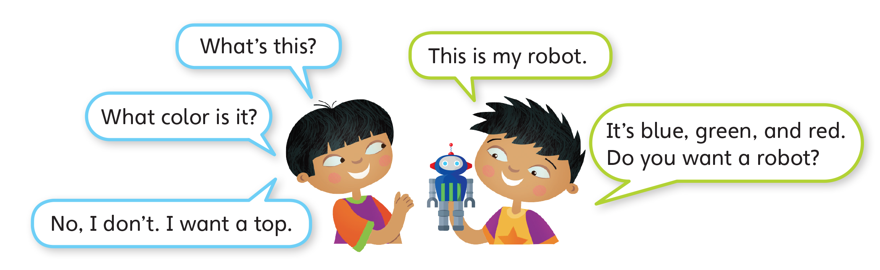
Notes:
Have students read the model dialogue on p. 111.
Place students in pairs. Then say Now it’s your turn.
Look at your project and take turns to ask and answer
questions about it.
Have students conduct conversations in pairs. Walk
around and check their progress.

Slide 6

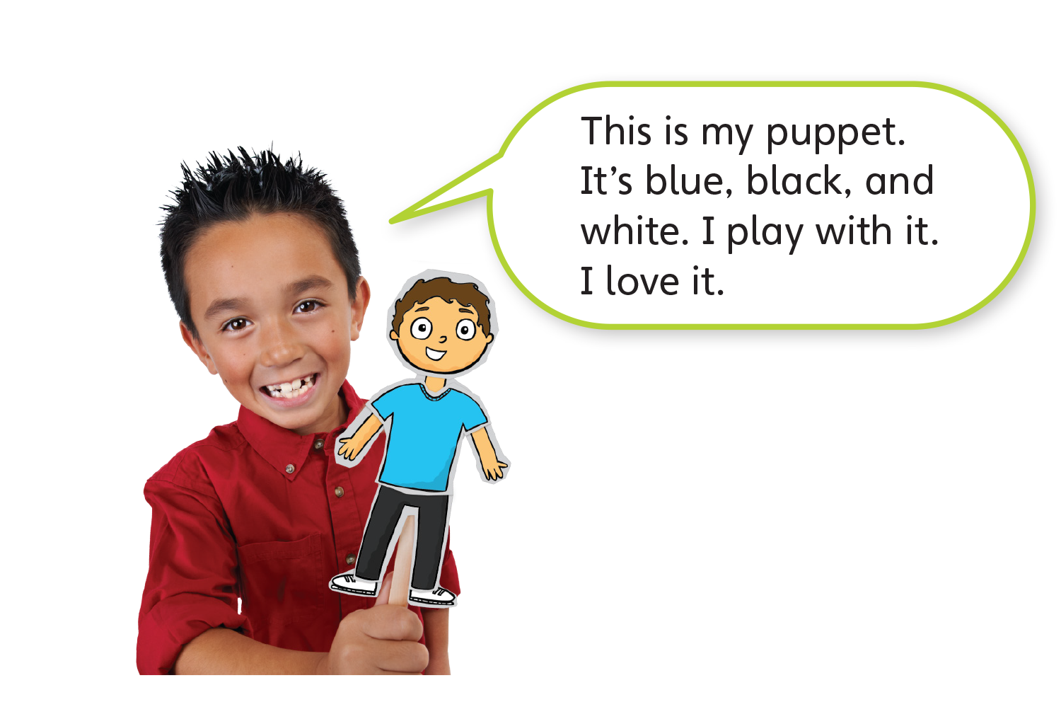
Notes:
Have students read what the girl in Activity 3 is
saying. Hold up a student’s poster and model giving
a short presentation about the house. Then give
students two to three minutes to prepare their own
presentation. Invite some students to present their
projects to the class.

Slide 7
Now let’s tell us about your toy.
Notes:
Give students two to three minutes to prepare their
presentation. Invite students to present their projects.

Slide 8
Goodbye Chant
Good work, class.
Hip hip, hooray!
Goodbye for now.
Have a nice day!
Notes:
Say Nice work today, class. Now let’s chant.
Lead the class in the Goodbye chant.

Slide 9

Let’s Check
Tell us about your toy.
Notes:
Can students remember and use the new words
they’ve learned?
As students leave the class, ask them to tell you
about their toys.

Slide 10
Stop and Check
3A

Slide 11
English Time Chant
English, (clap) English, (clap)
English (clap) today! (clap, clap)
English, (clap) English, (clap)
Hip, hip, (clap) hooray! (clap, clap)
Notes:
Say Good morning/afternoon, class. How are you
today?
Get students ready to use the English Time chant.
Lead the class in the chant.

Slide 12

Rock, Paper, Scissors
Win
= 2 spaces
Lose
= 1 space
Notes:
Say Today, we’re going to play a game.
Have students open their books to pp. 112–113 and
look at each picture.
Guide students to form the questions for one to two
images. Point to the first picture of a truck. Ask Do
you want a truck? Students can say Yes, I do. or No,
I don’t.
Model playing a game with a student.
Play rock, paper, scissors to determine who goes
first. The winner can move the playing piece forward
by two spaces. The loser can move forward by one
space. Both have to take turns asking and answering
questions about the pictures the playing pieces land
in. Remind students to use the words and structures
learned in Units 5–6.

Slide 13
Ask and Answer
What do you want? I want ______.
What’s that? That’s ______.
What color is it? It’s ______.
Notes:
Have students read the model dialogue on p. 113.
Then say Now it’s your turn. Play! Take turns. When
it’s your turn, move one or two spaces. Then ask a
question.
Have students play the game in pairs. Give a playing
piece to each pair. Remind them to ask and answer a
question about the picture in each space.
If students need help when thinking of questions and
answers, write examples on the board:
What do you want? I want ______.
What’s that? That’s ______.
What color is it? It’s ______.

Slide 14
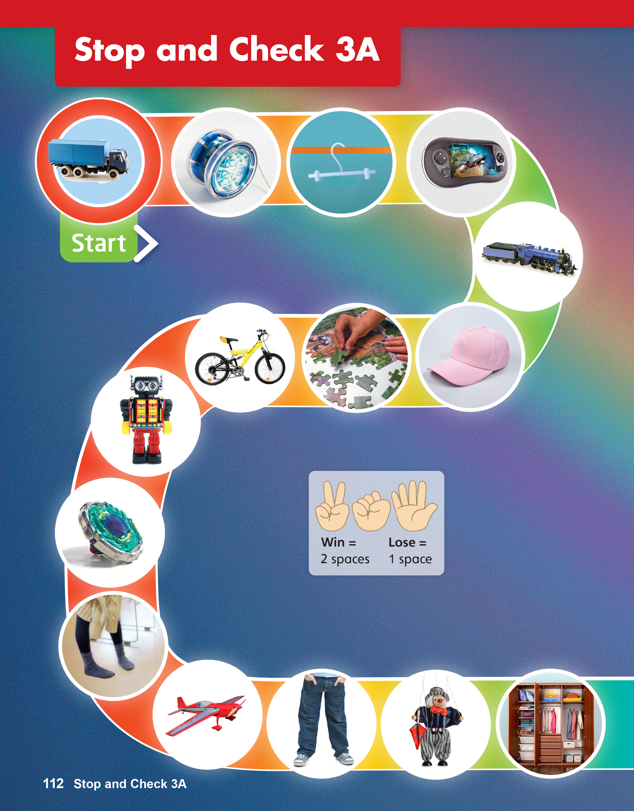
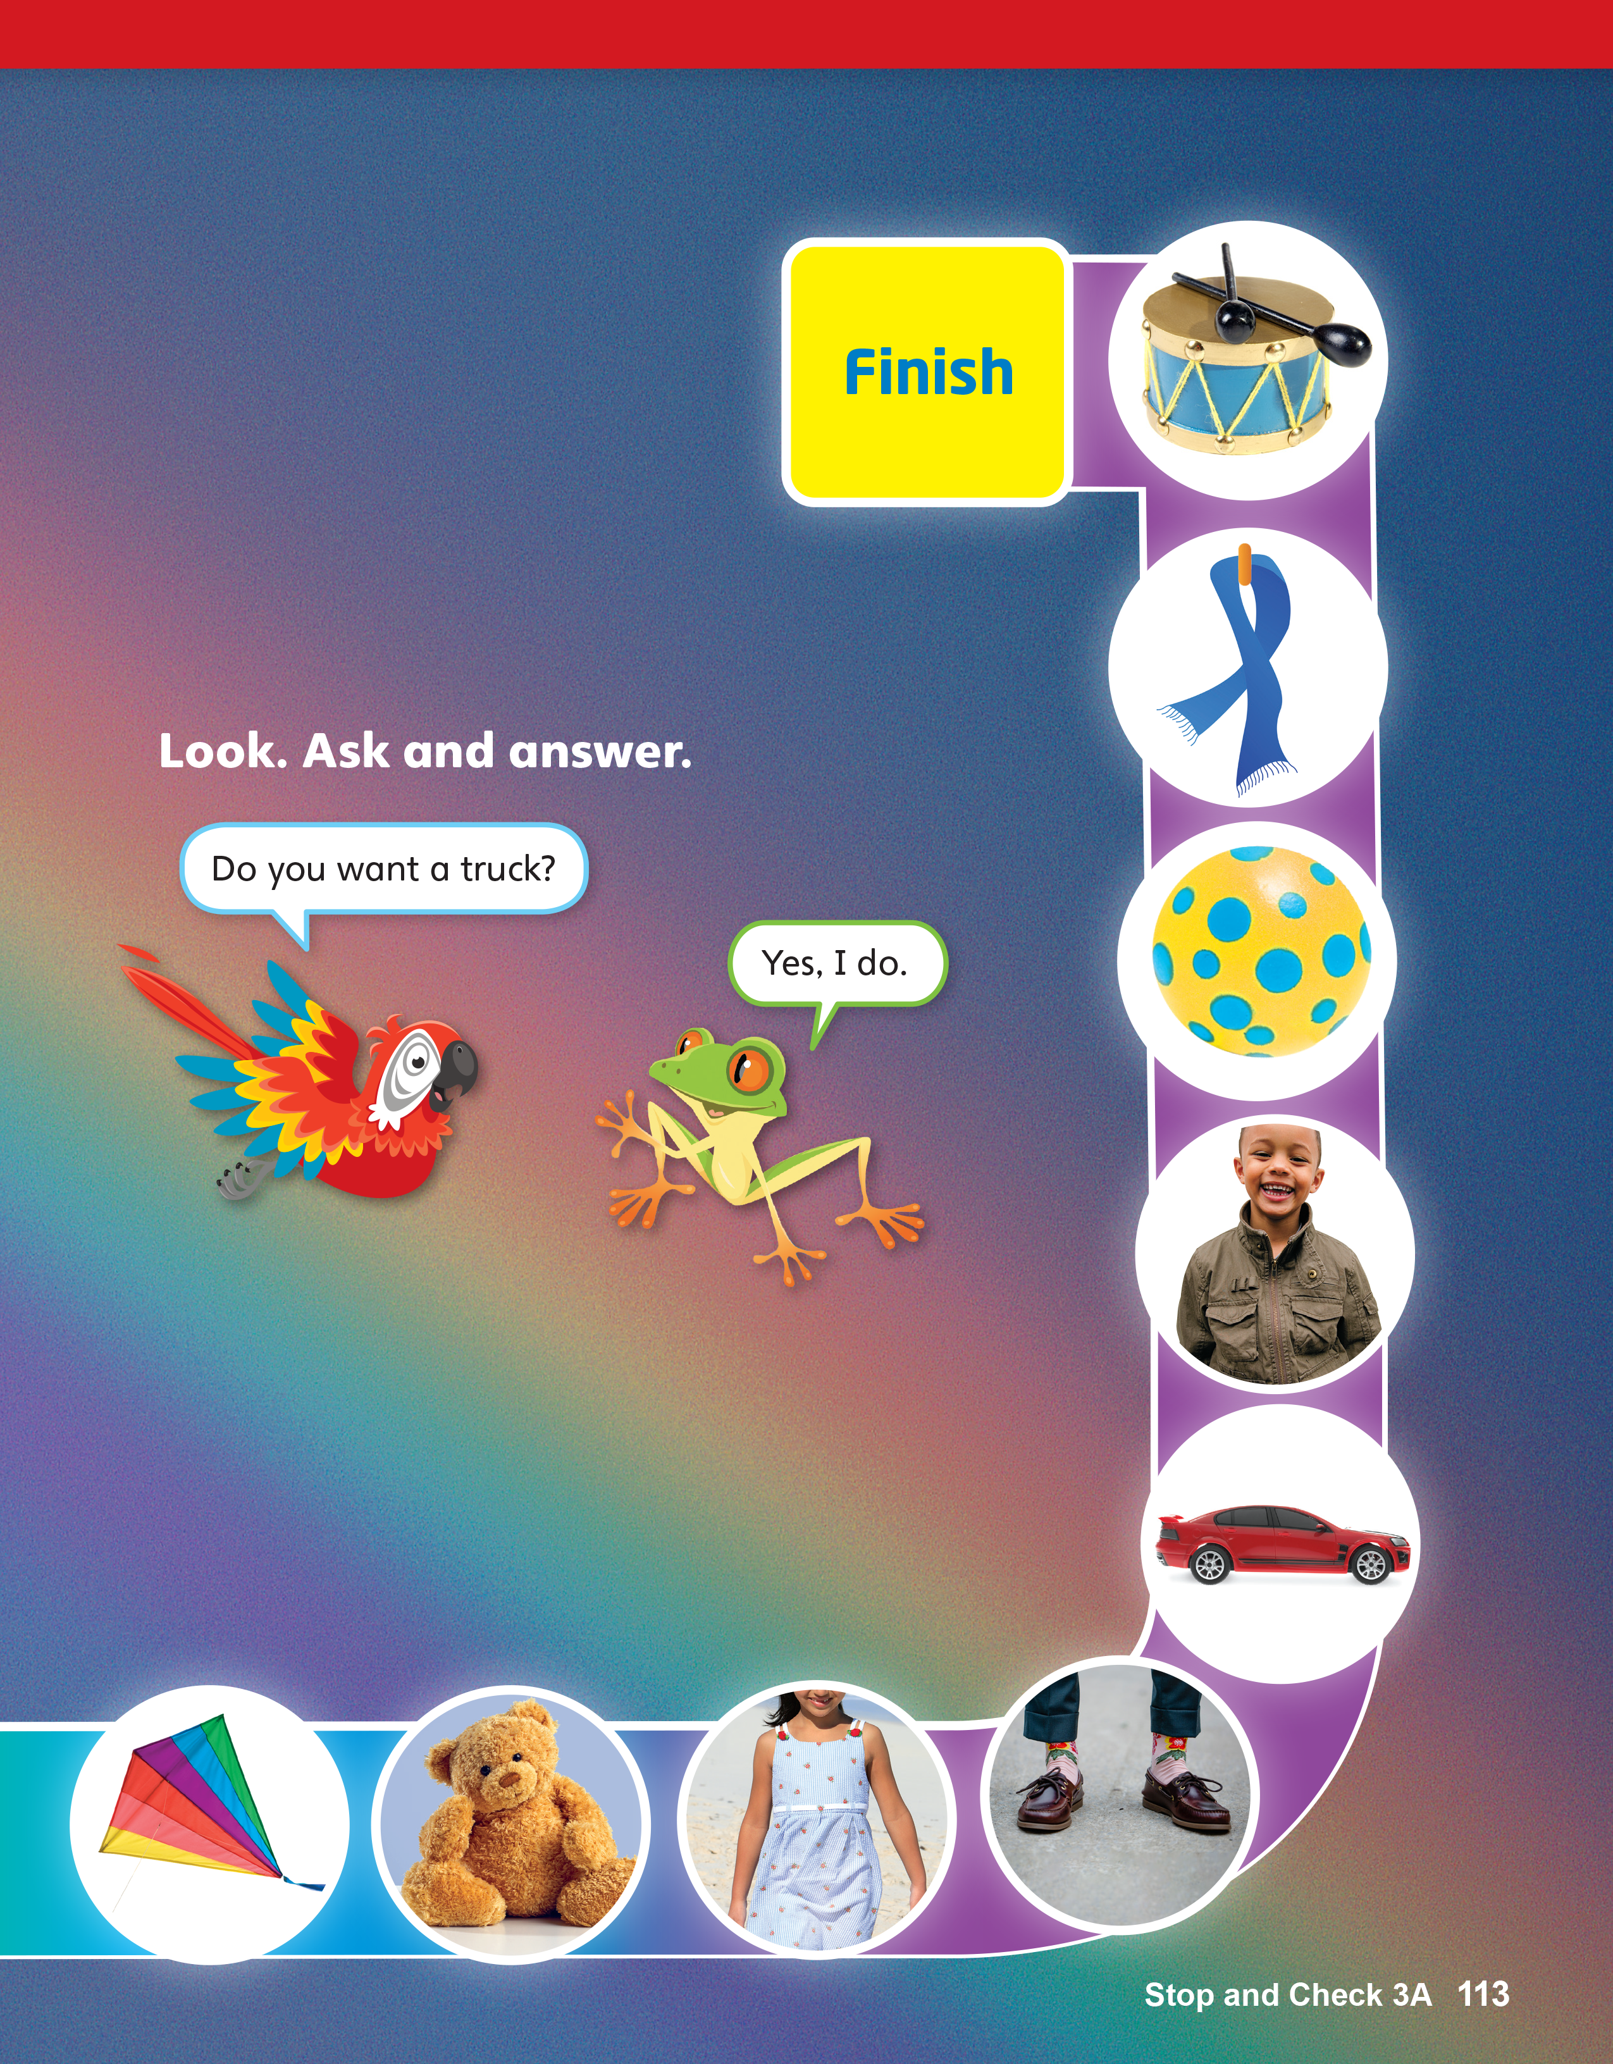
Notes:
Monitor students as they play the game.
Let them know that they can use responses such as
the following: A game. It’s a game. This is a game.
That’s a game.
Make sure students understand that they should
keep moving along the game route until they reach
Finish.

Slide 15
Goodbye Chant
Good work, class.
Hip hip, hooray!
Goodbye for now.
Have a nice day!
Notes:
Say Nice work today, class. Now let’s chant.
Lead the class in the Goodbye chant.

Slide 16

Let’s Check
Make a sentence with
a new word you learned.
Notes:
Can students remember and use the new words
they’ve learned?
As students leave the class, ask them to make a
sentence with one word they remember from
Units 5–6.

Slide 17
Stop and Check
3B

Slide 18
English Time Chant
English, (clap) English, (clap)
English (clap) today! (clap, clap)
English, (clap) English, (clap)
Hip, hip, (clap) hooray! (clap, clap)
Notes:
Say Good morning/afternoon, class. How are you
today?
Get students ready to use the English Time chant.
Lead the class in the chant.

Slide 19

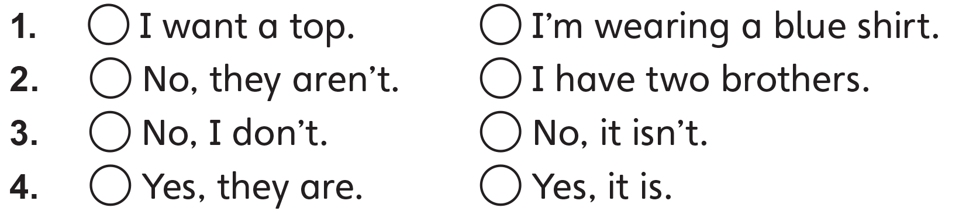
✓
✓
✓
✓
Notes:
Have students look at the sentences on p. 114.
Have students read aloud the sentences in each
question. Check pronunciation.
Say Listen and check. Play TR: B68. Have students
do the task.
Play the audio again and have students check their
answers. Elicit students’ responses.

Slide 20

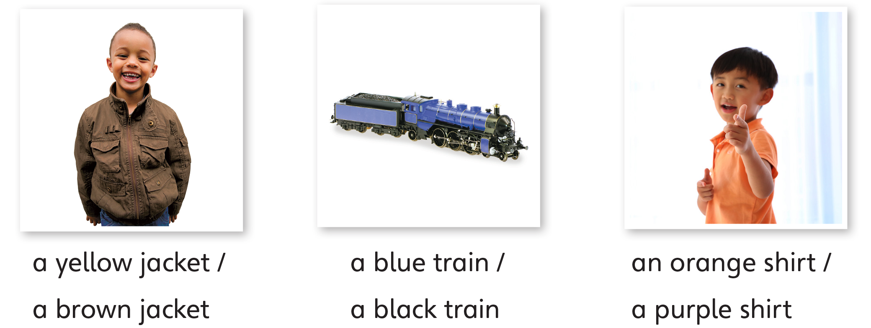
Notes:
Have students look at the pictures in Activity 2
and the phrases below them.
Say Read and look. Have them read the phrases
aloud. Check pronunciation.
Have students look at each picture and circle the
best descriptions of what they can see.
Walk around the room and check students’ work.

Slide 21

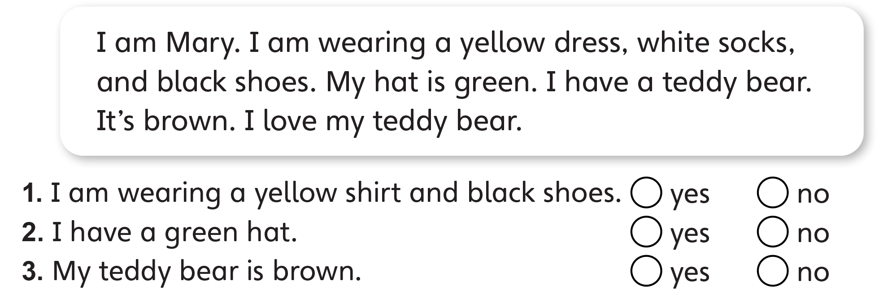
✓
✓
✓
Notes:
Ask students to read the text carefully. Invite a
student to read the text aloud.
Have students read the sentence in the first question
with you. Have them look at the text to find the
answers on their own and then check yes or no. Have
students continue with the remaining questions.
Go around to provide assistance. Elicit answers and
explain if necessary.

Slide 22

Notes:
Have students think about their own clothes and
toys. Elicit some related vocabulary or structures that
might be needed for the writing task.
Say Write about your clothes and your toys. Write
10–20 words.
Have students write their answers in the blanks.
Model an answer orally if necessary.
Call on some students to read their sentences aloud.
Conduct peer-checking and give feedback.

Slide 23
Goodbye Chant
Good work, class.
Hip hip, hooray!
Goodbye for now.
Have a nice day!
Notes:
Say Nice work today, class. Now let’s chant.
Lead the class in the Goodbye chant.

Slide 24
Let’s Check
Make a sentence with
a new word you learned.
Notes:
Can students remember and use the new words
they’ve learned?
As students leave the class, ask them to make a
sentence with one word they remember from
Units 5–6.

